Slide 1
Welcome to English Class8
Unit 9: NATURAL DISASTERS
(A closer look 2)
Let’s learn English !

Slide 2
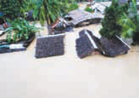
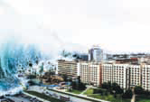
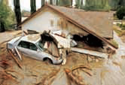
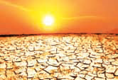
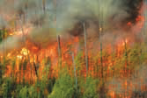
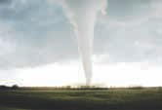
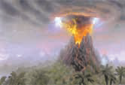
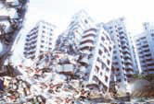
GAME
KIM’S GAME
Write the NATURAL DISASTERS
flood
tsunami
mudslide
drought
forest fire
tornado
volcano
earthquake

Slide 3
Unit 9:
NATURAL DISASTERS
A CLOSER LOOK 2

Slide 4
Unit 9: NATURAL DISASTERS (A CLOSER LOOK 2)
1. Read the conversation in GETTING STARTED and underline any sentences in the passive voice that you can find. Check your findings with a partner.
1. Was anyone injured?
2. ...Only a few minor injuries were reported
3. ...Many houses and public buildings were destroyed ...
4. Thousands of people were left homeless.
5. ... who were trapped in flooded homes
6. ... And equipment have also been sent
7. They’ve been taken to a safe place
8. ...Temporary accommodation will be provided for them.
GRAMMAR
➔ Form:
S + BE + Past participle (PP)...

Slide 5
2. Complete the sentences using the correct passive form of the verbs in brackets.
Unit 9: NATURAL DISASTERS (A CLOSER LOOK 2)
was scattered
Debris (scatter)…………....……across the countryside by the strong winds last night.
Ten new house (build)…………….in the town every year.
Residents of flooded villages (take)………………to a safe place last night.
In the future, natural disasters (predict) …………………. accurately with the help of technology.
Food and medicals supplies (deliver)………………...…..later this afternoon.
are built
were taken
will be predicted
will be delivered

Slide 6
Unit 9: NATURAL DISASTERS (A CLOSER LOOK 2)
GRAMMAR: The passive form:
S+ BE + Past participle (PP)...
Example:
People speak English all over the world.
... ......... ......
English
is spoken
all over the world
by people
.......................
Active:
S + V + O .....
Passive:
S+ (BE + PP) ...... By O

Slide 7
3. Rewrite the following sentences using the correct passive voice.
Unit 9: NATURAL DISASTERS (A CLOSER LOOK 2)
1. Volunteers have given out food and blankets to homeless people.
2. So far, rescue workers have freed ten people trapped in collapsed buildings.
3. Did the storm destroy the whole village?
4. If the storm hit the area, It will cause a lot of damage.
5. They are going to organise a garden party to raise money for the victims of the flood.
- Food and blanks have been given out to homeless people (by volunteers)
- Ten people trapped in collaped buildings have been freed (by the rescue workers) so far
- Was the whole village destroyed by the storm ?
- If the area is hit by the storm, a lot of damage will be caused
- A garden is going to organized to raise money for the victims of the flood.

Slide 8
Unit 9: NATURAL DISASTERS (A CLOSER LOOK 2)
4a. Read part of the conversation from getting started
Pay attention to the underlined part.
Nick : Was anyone injured?
Duong: Only a few minor injuries were reported. Most people had moved to safe areas when the storm broke.
Past perfect tense
Form:
S + had + past participle
+ Most people had moved to safe areas when the storm broke.
- Most people hadn’t moved to safe areas when the storm broke.
? Had Most people moved to safe areas when the storm broke?

Slide 9
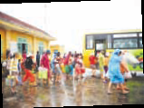
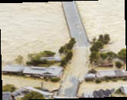
b. When do we use the past perfect? Can you think of any rules?
Unit 9: NATURAL DISASTERS (A CLOSER LOOK 2)
by 11 o’clock last night
Ex: People had managed to leave the flooded villages by 11 o’clock last night
=>We use the past perfect to describe an action before a started time in the past
when rescue workers arrived
Ex: People had already left the flooded villages when rescue workers arrived.
=>We use the past perfect to describe an action happened before another action in the past.

Slide 10
5.Complete the sentences by putting the verbs in brackets into the simple past or past perfect
Unit 9: NATURAL DISASTERS (A CLOSER LOOK 2)
had left
Most people (leave)………. before the vocano (erupt)………..
By the time we (arrive)…………. at the canyon, It (stop)……….............snowing.
They (spend)…………… the night in the floded are before help(arrive)……….
Simon (get)……….lost because he (not take) …………. a map with him.
I (find)…………..my pen after I (buy)…………... a new one.
erupted
arrived
had stopped
had spent
arrived
got
hadn’t taken
found
has bought

Slide 11
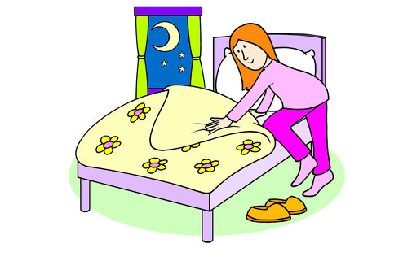
Unit 9: NATURAL DISASTERS (A CLOSER LOOK 2)
Ask and answer the questions
Do home work
Go to school
- What had he done before he went to school?
- Before he went to school, he had done his homework?
Watch TV
Go to bed
- What had she done by the time she went to bed?
- By the time she went to bed, she had watched TV

Slide 12
Unit 9: NATURAL DISASTERS (A CLOSER LOOK 2)
- What had you do before you went to school this morning?
=>Before I went to school this morning, I had got up, .
I had washed my face
I had had breakfast
I had got dressed
6.Work in pairs. Ask and answer the following questions about you
What had your mother done when you got up last Sunday?
What had you done before you went to bed last night?
What had already happened when you arrived at school today?
What had you done before you left school yesterday?
What had happened by the time you finished your homework yesterday?

Slide 13
Unit 9: NATURAL DISASTERS (A CLOSER LOOK 2)
* Homework:
- Learn vocabulary by heart and rewrite them in sentences.
Redo the exercise in your notebook.
Ask and answer part 6 again
- Prepare for communication of Unit 9

