Slide 1

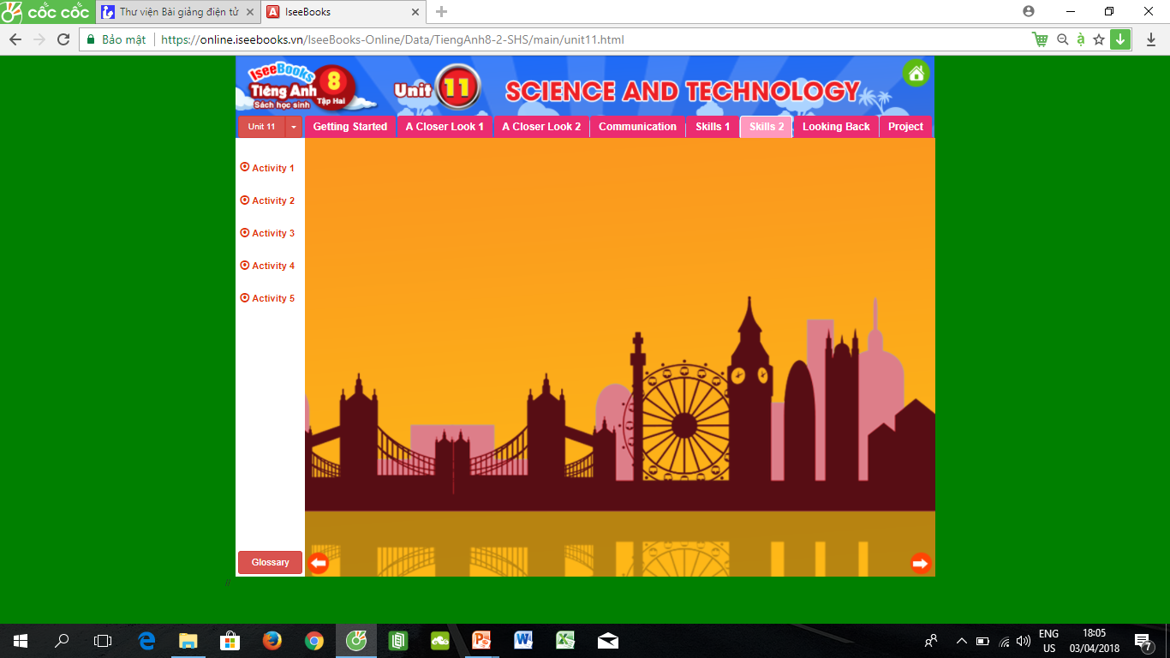
Lesson 5. SKILLS 2

Slide 2
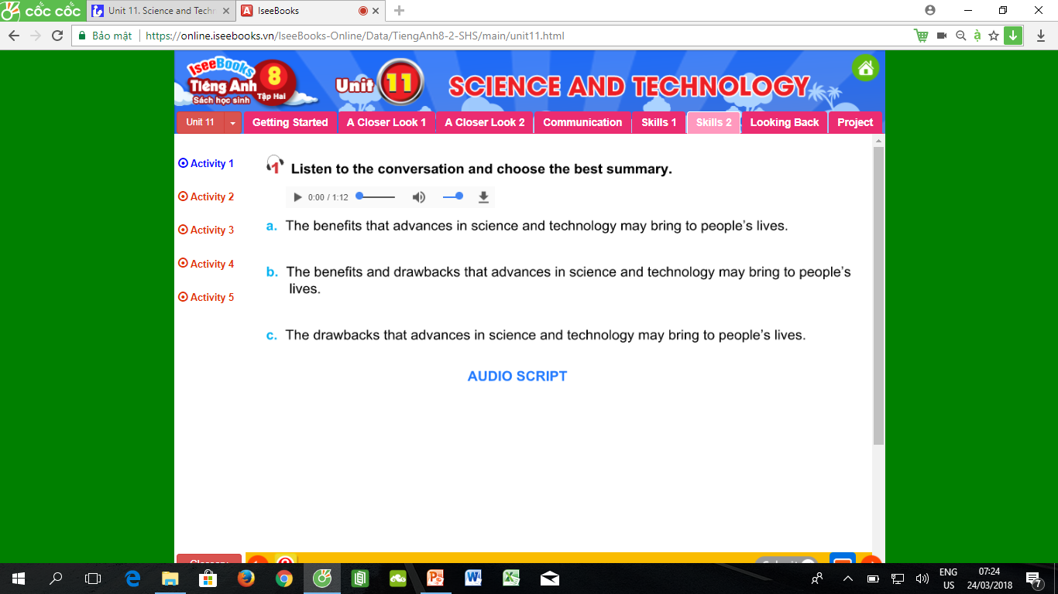
b

Slide 3
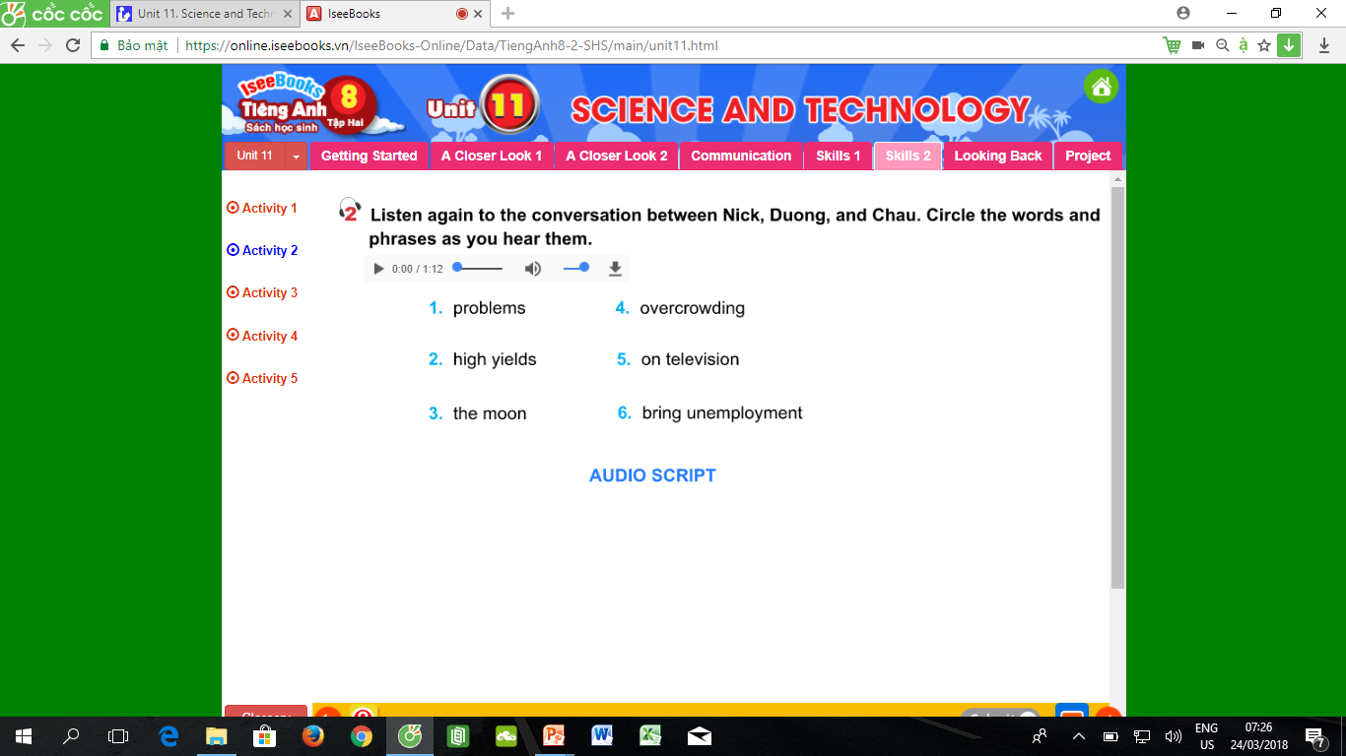

Slide 4
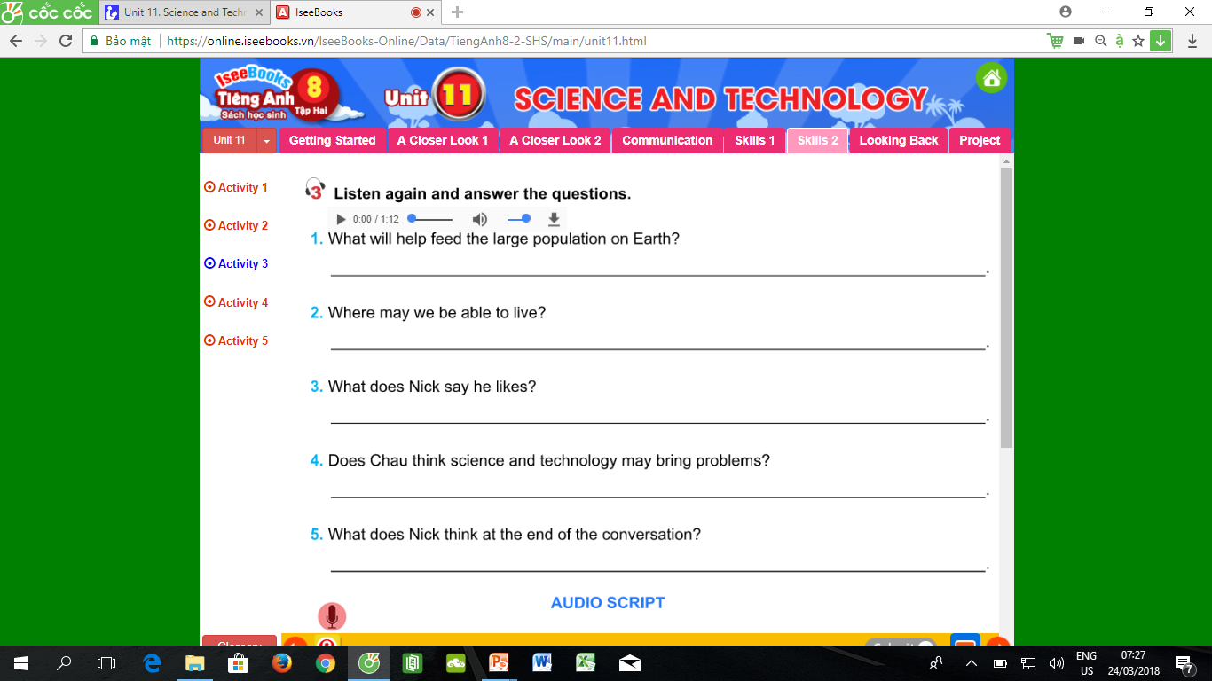
High yields in farming will (help feed the growing population on earth
(We may be able to live) on other planets
Nick says he likes the idea of having a lesson at home with a robot, and on the Internet
Yes, she does
He thinks there will be many new problems

Slide 5
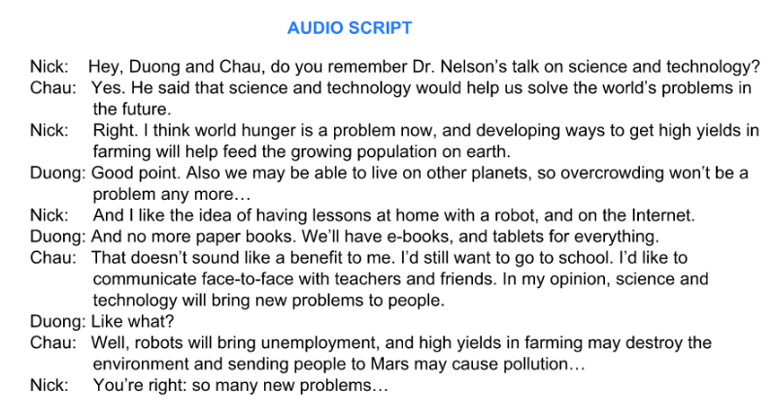

Slide 6
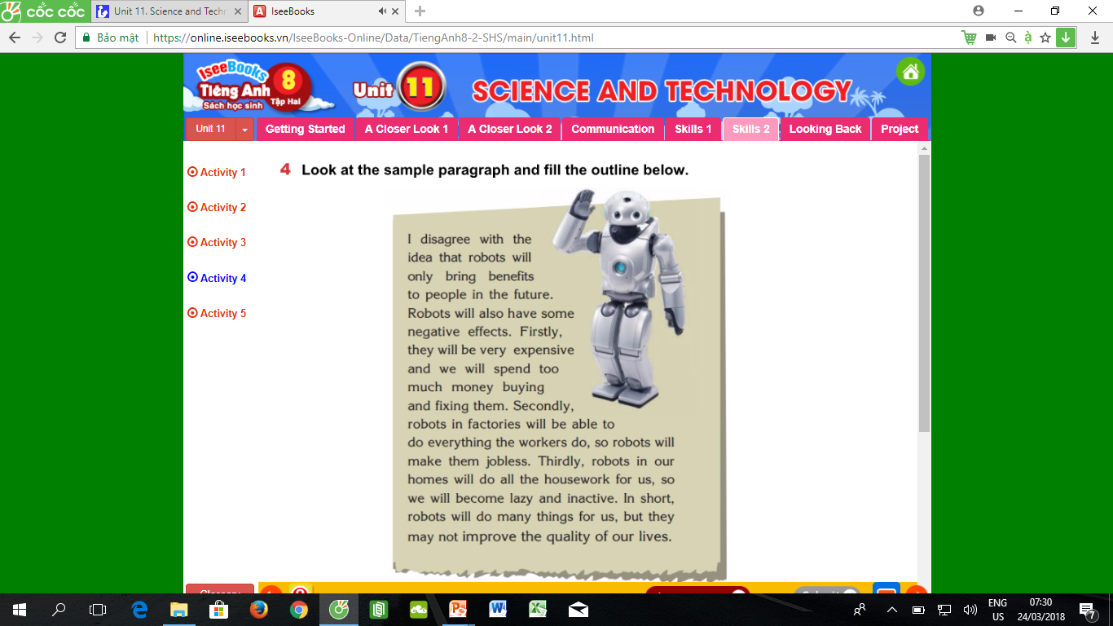
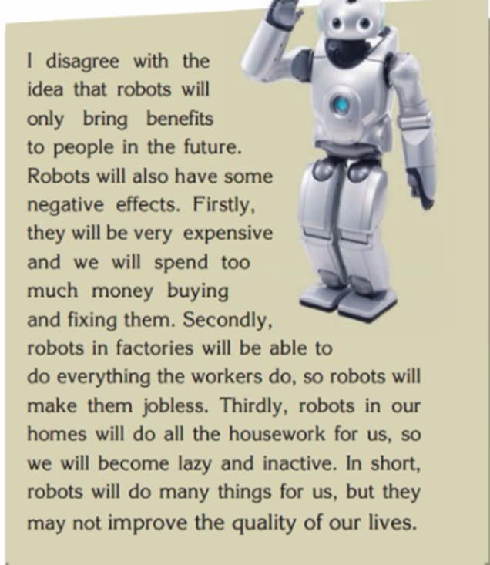
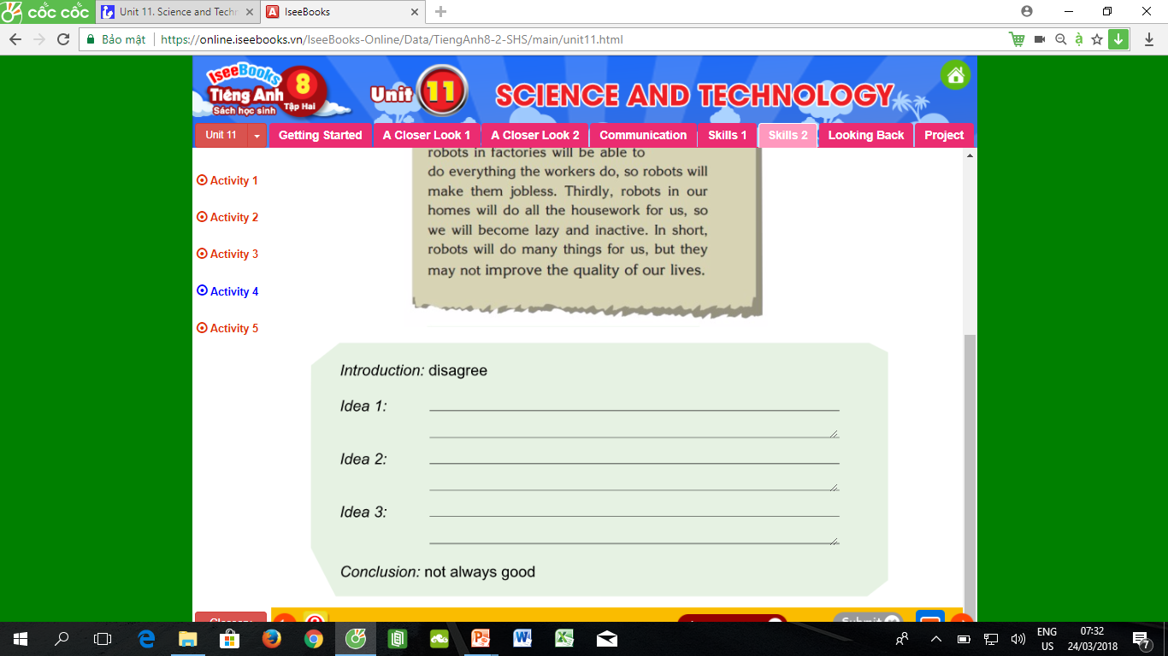
They will be very expensive and we will
spend too much money buying and fixing
them
Robots in factories will be able to do everything the workers do, so robots in our homes will do all the housework for us, …
Robots in our homes will do all the
housework for us ….inactive

Slide 7
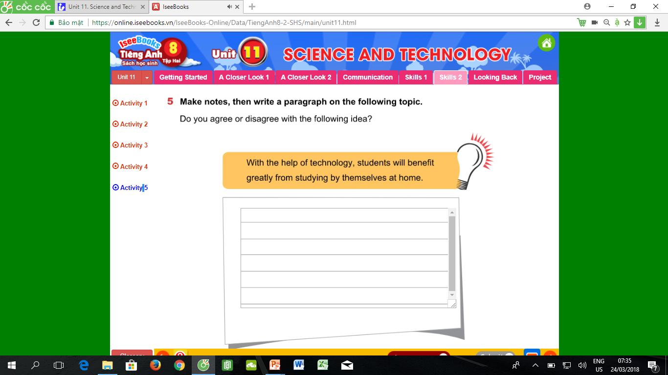

Slide 8
Homework:
Practice listening
Write again
Do exercise part E in workbook
Prepare the Looking back and project.

