Slide 1
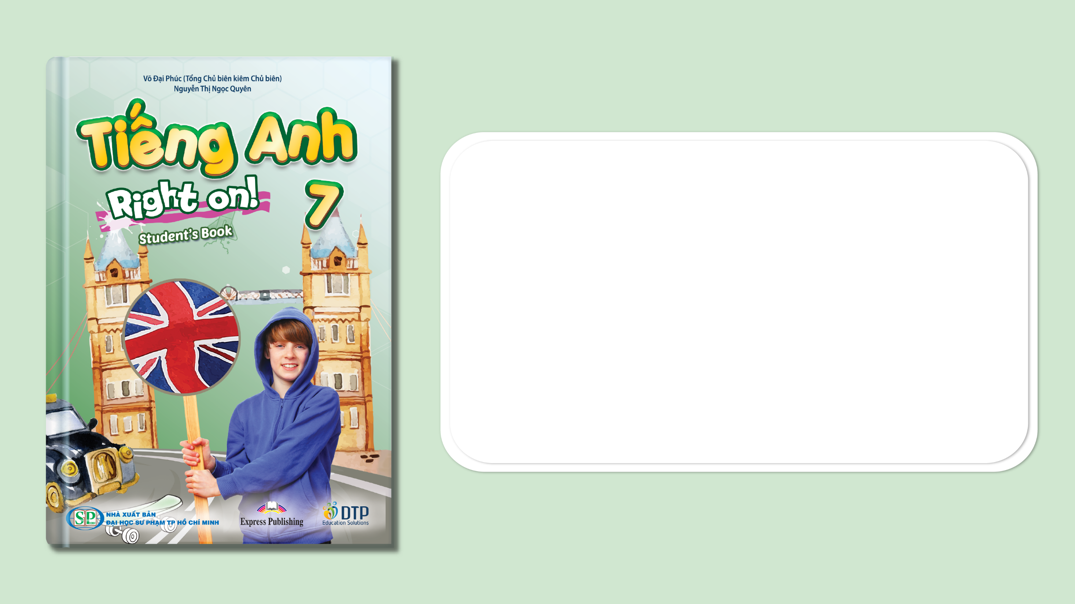
Unit 5: Travel & Transportation
Overview
Pages 78 & 79

Slide 2
Lesson Outline
Warm-up
Listening
Speaking
Consolidation
Wrap-up

Slide 3
Objectives
By the end of this lesson, students will be able to…
learn and use some vocabulary related to shops and services: baker’s, butcher’s, chemist’s, department store, ﬂorist’s, newsagent’s.
listen to people ask and give directions.
ask for / give directions.

Slide 4

WARM-UP

Slide 5

Work in pairs.
Choose the word whose underlined part is
pronounced differently from that of the other words.
1. A. meat B. dream C. bear D. sea
2. A. zoo B. school C. floor D. food
3. A. dinner B. service C. chicken D. driver
/miːt/
/driːm/
/beə(r)/
/siː/
/zuː/
/skuːl/
/flɔːr/
/fuːd/
/ˈdɪnər/
/ˈsɜːvɪs/
/ˈtʃɪkɪn/
/ˈdraɪvər/

Slide 6
Work in pairs.
How often do you go shopping?
Where do you/your family often go shopping?
Do you know how to get there?

Slide 7

It’s time to learn …

Slide 8
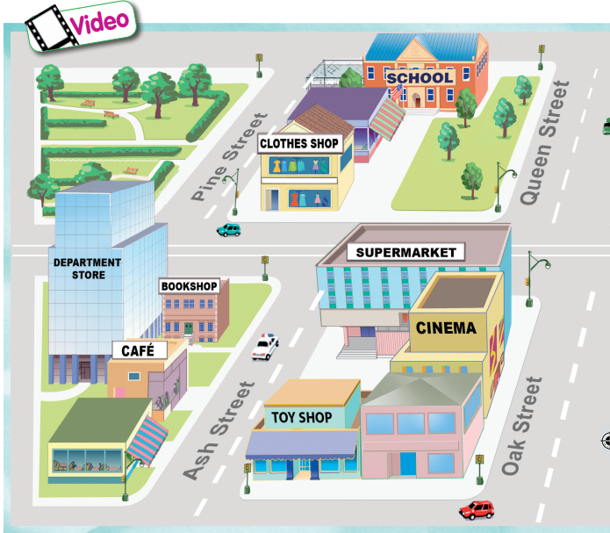


Vocabulary
Look at the map
Which are shops? Which are services?
shops: clothes shop, department store, bookshop, café, toy shop, supermarket, cinema, music shop, ﬂorist’s, pet shop, newsagent’s, butcher’s, baker’s, chemist’s
services: school, bank, restaurant, hospital, post office

Slide 9

Vocabulary
Listen and repeat.
baker’s /ˈbeɪkəz/ (n) cửa hàng bánh
butcher’s /ˈbʊtʃəz/ (n) cửa hàng thịt
chemist’s /ˈkemists/ (n) cửa hàng thuốc
department store /dɪˈpɑːrtmənt stɔːr/ (n) trung tâm thương mại
ﬂorist’s /ˈflɒrɪsts/ (n) cửa hàng bán hoa
newsagent’s /ˈnjuːzeɪdʒənts/ (n) cửa hàng bán báo, tạp chí

Slide 10
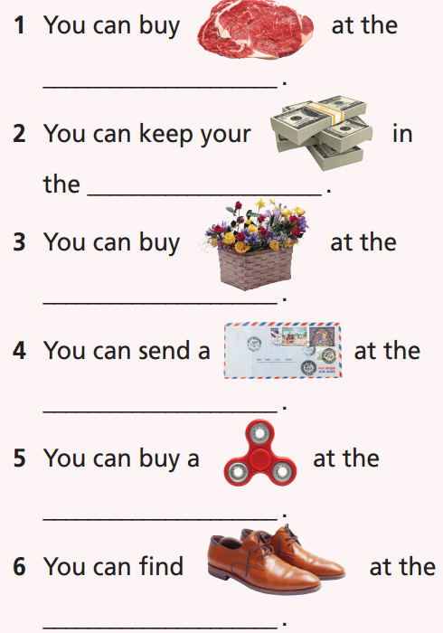
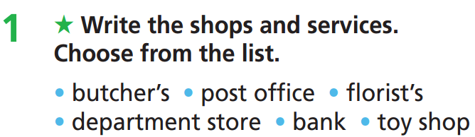
Extra Practice
WB page 42
butcher’s
bank
ﬂorist’s
post office
toy shop
department store

Slide 11
In my area, there is a bank, a hospital, a park and a school. There are a lot of shops in my area such as a butcher’s, a supermarket and two clothes shops. There isn’t a department store or a ﬂorist’s.

Slide 12

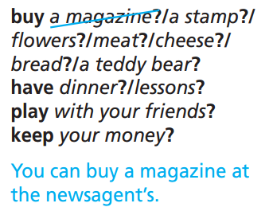
You can buy a stamp at the post office.
You can buy ﬂowers at the ﬂorist’s.
You can buy meat at the butcher’s/
supermarket.
You can buy cheese at the supermarket.
You can buy bread at the baker’s / supermarket.
You can buy a teddy bear at the toy shop.
You can have dinner at the restaurant.
You can have lessons at the school.
You can play with your friends at the park.
You can keep your money in the bank.
E.g.

Slide 13

Listening

Slide 14
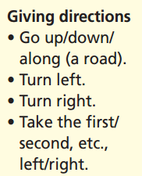
Pre-Listening

Slide 15
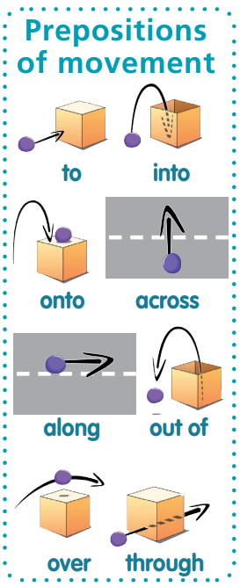
Please choose the correct preposition for each picture
Pre-Listening
across
into
out of
onto
along
over
through
to

Slide 16

Pre-Listening
Read the instruction quickly. Underline the key words. What are we going to do?
Where does John want to go?

Slide 17

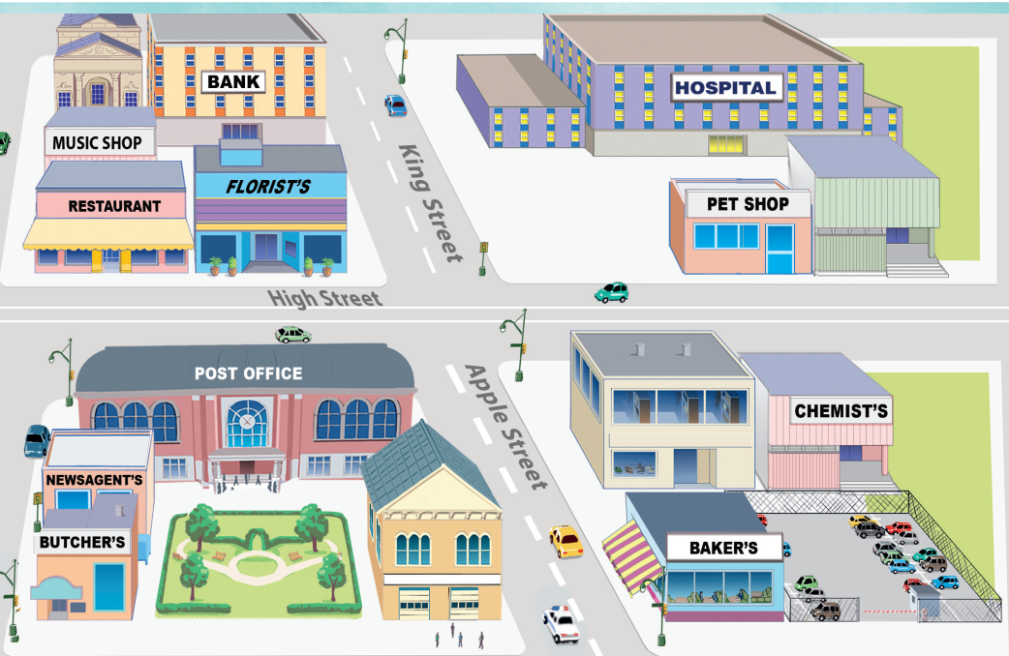
While-Listening
Now listen and write the correct answer.  FIRST TIME
☞ YOUR ANSWER?
He wants to go to the hospital.
☞ WHY?

Slide 18
While - listening
Now listen again and check.  SECOND TIME
While you are listening, focus on Ann’s directions and the map:
John: King Street – got it. So it’s on King Street?
Ann: That’s right. It’s opposite the bank. I’m standing right outside.
☞ THE ANSWER IS …
He wants to go to the hospital.

Slide 19
Extra practice
Listen again and decide whether the following statements are True, False, or Doesn’t say:
John and Ann are walking together on the street.
John is standing on Ash Street.
John can see a big supermarket on the corner.
John is Ann’ s brother.
Ann is staying at the bank.

Slide 20
Pre-Listening
Read the instruction quickly. Underline the key words. What are we going to do?
Listen again and decide whether the following statements are True, False, or Doesn’t say.
John and Ann are walking together on the street.
John is standing on Ash Street.
John can see a big supermarket on the corner.
John is Ann’ s brother.
Ann is staying at the bank.

Slide 21
While-Listening
Now listen and choose the correct answer.  FIRST TIME
☞ YOUR ANSWER?
False
John and Ann are walking together on the street.
John is standing on Ash Street.
John can see a big supermarket on the corner.
John is Ann’s brother.
Ann is staying at the bank.
True
True
Doesn’t say
False
☞ WHY?

Slide 22
Now listen again and check.  SECOND TIME
John: Hi, Ann! Sorry to call you, but I’m lost! I’m outside a café on Ash Street. Where do I go?
False
1. John and Ann are walking together on the street.
True
2. John is standing on Ash Street.

Slide 23
Now listen again and check.  SECOND TIME
Ann: OK. Go up Ash Street, past the bookshop, then turn right onto High Street. There’s a big supermarket on the corner.
John: Oh, yes. I can see it from here. So I turn right there?
True
3. John can see a big supermarket on the corner.

Slide 24
Now listen again and check.  SECOND TIME
John: Hi, Ann! Sorry to call you, but I’m lost! I’m outside a café on Ash Street. Where do I go?
Ann: OK. Go up Ash Street, past the bookshop, then turn right onto High Street. There’s a big supermarket on the corner.
John: Oh, yes. I can see it from here. So I turn right there?
Ann: Yes. Then walk along High Street and turn left into King Street.
John: King Street – got it. So it’s on King Street?
Ann: That’s right. It’s opposite the bank. I’m standing right outside.
John: Great! See you in a minute!
Doesn’t say
4. John is Ann’ s brother.

Slide 25
Now listen again and check.  SECOND TIME
Ann: That’s right. It’s opposite the bank. I’m standing right outside.
False
5. Ann is staying at the bank.

Slide 26
Audio Scripts
Practise the conversation in pairs.
John: Hi, Ann! Sorry to call you, but I’m lost! I’m outside a café on Ash Street. Where do I go?
Ann: OK. Go up Ash Street, past the bookshop, then turn right onto High Street. There’s a big supermarket on the corner.
John: Oh, yes. I can see it from here. So I turn right there?
Ann: Yes. Then walk along High Street and turn left into King Street.
John: King Street – got it. So it’s on King Street?
Ann: That’s right. It’s opposite the bank. I’m standing right outside.
John: Great! See you in a minute!

Slide 27

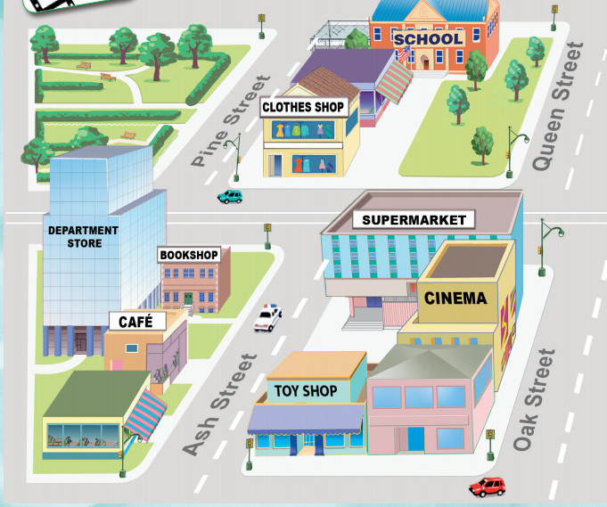
Post-Listening
Work in pairs
Look at the map on page 78. Ask and answer the way to the following places:
A: I'm outside the café / cinema / department store / etc. How can I get to clothes shop / toy shop / school / etc.?
B: Certainly. ...

Slide 28
Post-Listening
Work in pairs
Look at the map on page 78. Ask and answer the way to the following places:
A: I'm outside the café. How can I get to clothes shop?
B: Certainly. Go up Ash Street, past the bookshop, then turn left onto High Street. The clothes shop is on your right.

Slide 29

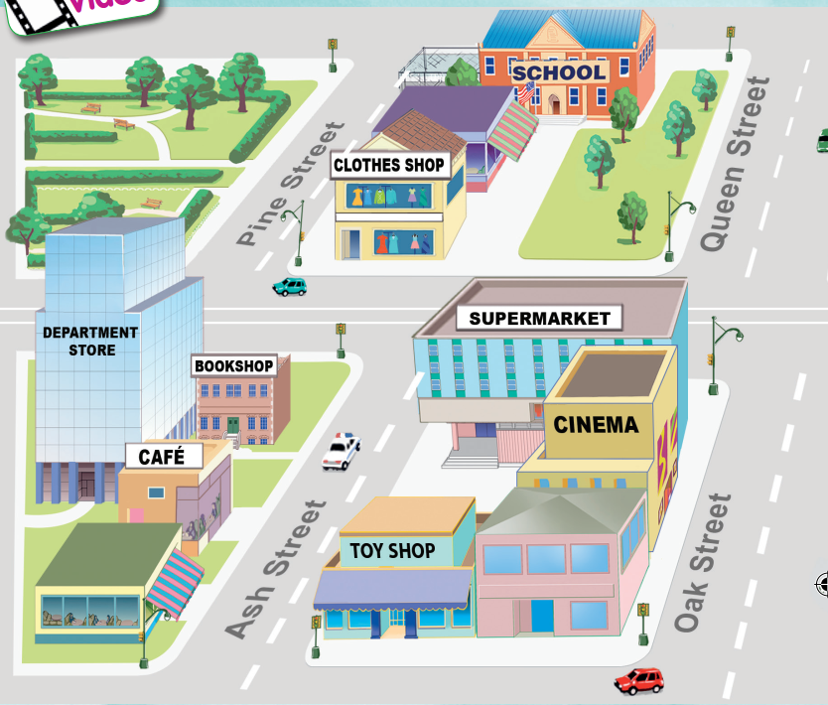

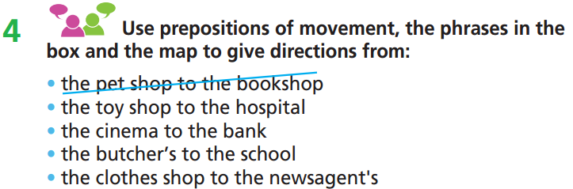
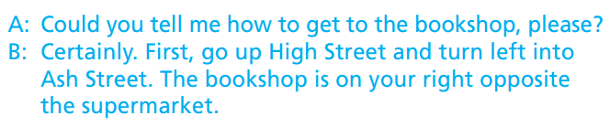
e.g.

Slide 30
A: How do I get to the hospital, please?
B: Go up Ash Street and turn right into High Street. Take the second road on the left; this is King Street. The hospital is on your right.

Slide 31
A: Where’s the bank, please?
B: Go up Oak Street and turn right on High Street. Walk along High Street and turn left on King Street. The bank is opposite the hospital.

Slide 32
A: How do I get to the school, please?
B: Go up Oak Street and turn left on High Street. Then turn right on Pine Street. Go up Pine Street. The school is opposite the park.

Slide 33
A: Could you tell me how to get to the newsagent’s, please?
B: Walk along High Street. Then turn right into Oak Street. The newsagent’s is between the butcher’s and the post office.

Slide 34

CONSOLIDATION

Slide 35
Write a paragraph (60-80 words) about the way to school or your favorite shop. You can include some of the following information:
What’s the name of your school / favorite shop?
How far is your school / your favorite shop from home?
How can you go there? (on foot/ by bus/ by motorbike/ by car, etc.)
Who do you often go there with?
What’s the simplest way to get there from home?

Slide 36
Write a paragraph (60-80 words) about the way to school or your favorite shop. You can include the following information:
I study at Tan An Secondary High school. My school is about three kilometres from home. I often go there by bicycle alone. I go along Bui Huu Nghia Street, then turn left to Nguyen Cuu Van Street. I turn right at the traffic light to Hung Vuong Street. Then I turn right to Nguyen Dinh Chieu Street. After that, I turn right at the roundabout and go straight for 100 metres. My school is on my right.

Slide 37

WRAP-UP

Slide 38
Today’s lesson
Vocabularies
baker’s
butcher’s
chemist’s
department store
ﬂorist’s
newsagent’s
Skills
- Listening: listen to people ask and give directions
- Speaking: ask for / give directions

Slide 39
Homework
Practise the vocabularies; and make sentences using them.
Do the exercises in TA 7 Right on WB (page 42)
Prepare the next lesson (page 80 SB)
Do the exercise in TA 7 Right on Notebook (pages 34 & 35)

Slide 40

Enjoy your day!

