Slide 1

Unit 9: Houses in the Future
Lesson 1.3: Pronunciation & Speaking
Page 72

Slide 2
Lesson Outline
Warm-up
Pronunciation
Practice
Speaking
Consolidation
Wrap-up

Slide 3
Objectives
By the end of this lesson, students will be able to…
Pronounce the /z/ sounds.
Talk about homes in the future and where they would like to live in the future.
Ask people to explain anything that they don’t understand.

Slide 4

WARM-UP

Slide 5

Work in pairs.
Choose the word whose main stress is placed
differently from the others.
1. A. support B. forest C. mountain D. highland
/səˈpɔːrt/ /ˈfɔːrɪst/ /ˈmaʊntən/ /ˈhaɪlənd/
2. A. travel B. control C. donate D. order
/ˈtrævəl/ /kənˈtrəʊl/ /ˈdoʊneɪt/ /ˈɔːdər/
3. A. dangerous B. exciting C. wonderful D. beautiful
/ˈdeɪndʒərəs/ /ɪkˈsaɪtɪŋ/ /ˈwʌndərfl/ /ˈbjuːtəfl/

Slide 6
Work in pairs.
Choose the word whose underlined part is
pronounced differently from that of the other words.
A. topic B. eco C. campsite D. city
2. A. locked B. laughed C. missed D. cleaned
3. A. home B. post C. show D. shop
/ˈtɑːpɪk/
/iːkoʊ/
/ˈkæmpsaɪt/
/ˈsɪti/
/ lɒkt/
/lɑːft/
/mɪst/
/kliːnd/
/ hoʊm/
/ poʊst/
/ ʃoʊ/
/ ʃɑːp/

Slide 7
Work in pairs.
Share ideas about schools in the future.
What do you think schools will be like in the future?
I think schools will ………
I think teachers will ………
I think students will ………

Slide 8


Presentation

Slide 9








Slide 10




Slide 11
Listen and repeat the words.
Pay attention to the sounds: /s/, /z/, /~/
/s/ | /z/ | /~/


opera house

always
trash

jeans

smart device

selfish
palace
noodles
ocean




Slide 12

Practice

Slide 13
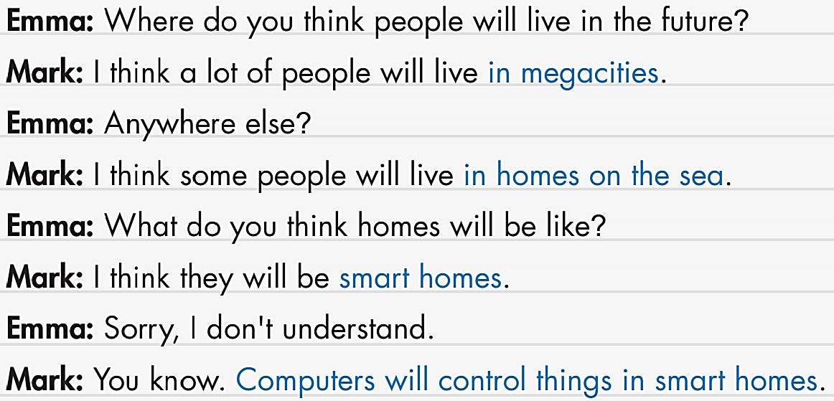

Slide 14
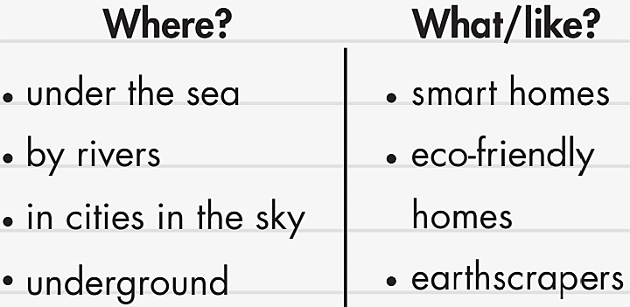

Slide 15


Slide 16

Speaking

Slide 17
Pre-Speaking
Work in pairs.
Test your partner:
Student A: says a phrase from the box.
Student B: shows the correct picture.

Slide 18
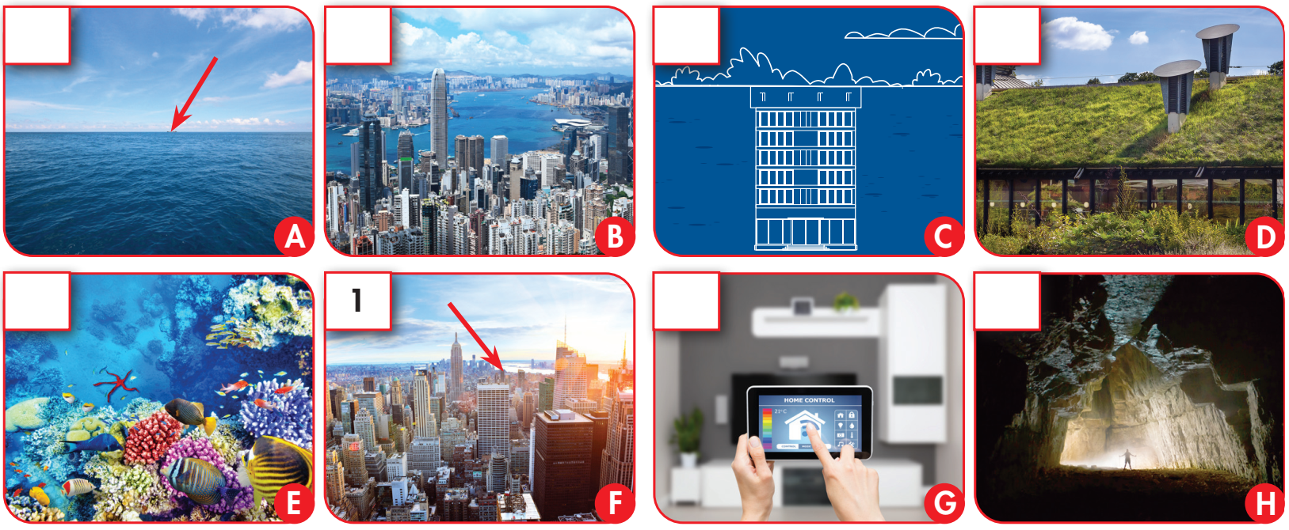

in a city underground under the sea on the sea
megacity smart home eco-friendly home earthscraper
1
2
3
4
5
7
8

Slide 19
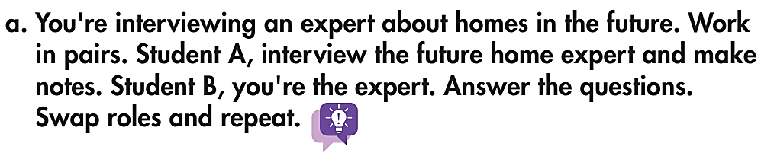

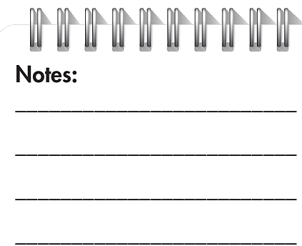

While-Speaking

Slide 20
Post-Speaking
b. Join another pair. Discuss where you'd like to live in the future. Ask them to explain anything you don't understand.
Where would you like to live in the future?
In the future, I’d like to…

Slide 21

CONSOLIDATION

Slide 22

Write your answers:
Where would you like to live in the future?
________________________________________________
What will your homes be like?
________________________________________________

Slide 23

WRAP-UP

Slide 24
Today’s lesson
Pronunciation
Final sounds /z/
Speaking
Homes in the future

Slide 25
Homework
Learn by heart vocabularies and grammar structures in Lesson 1, SB pages 70 + 71.
Prepare the next lesson (page 73 - SB)
Play the consolidation games in Tiếng Anh 6 i-Learn Smart World DHA App on www.eduhome.com.vn

Slide 26

Enjoy your day!

