Slide 1

Unit 4: Community Services
Lesson 2.1: Vocabulary & Listening
Page 31

Slide 2



LESSON OUTLINE
Consolidation

Slide 3

By the end of this lesson, students will be able to…
talk about what they can do to help the community.
practice listening for main ideas and specific information.

Slide 4
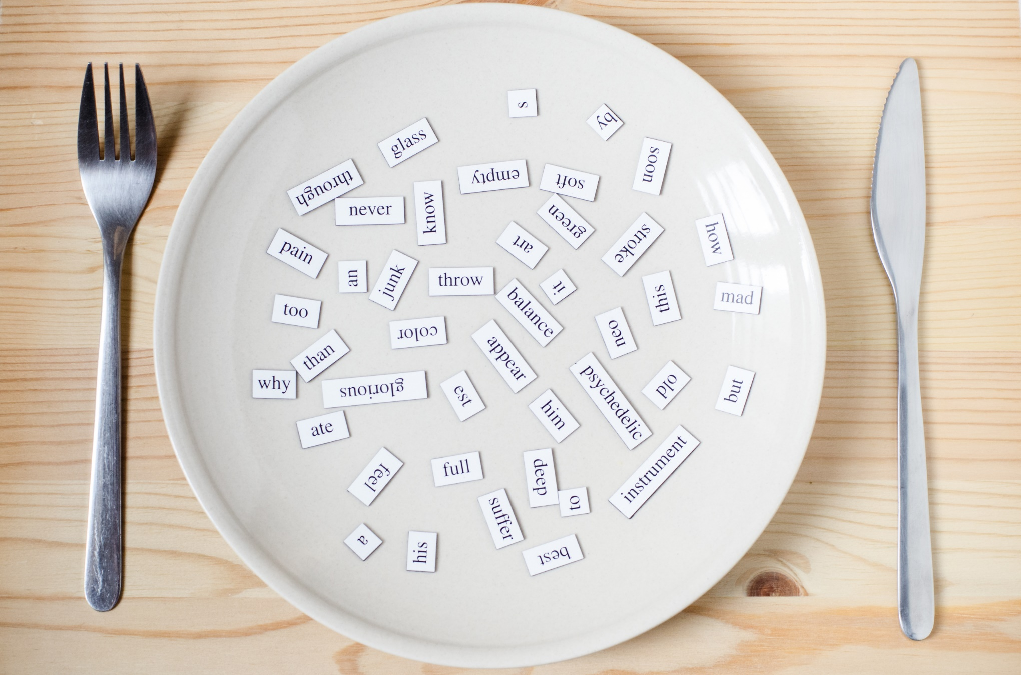
New words
Clean up parks
Clean up streets
Donate books
Donate old clothes
Plant flowers
Plant trees
Raise money
Recycle bottles

Slide 5

WARM-UP

Slide 6

Work in pairs
What do you usually do to help poor people?
How do you keep the environment around you clean?

Slide 7
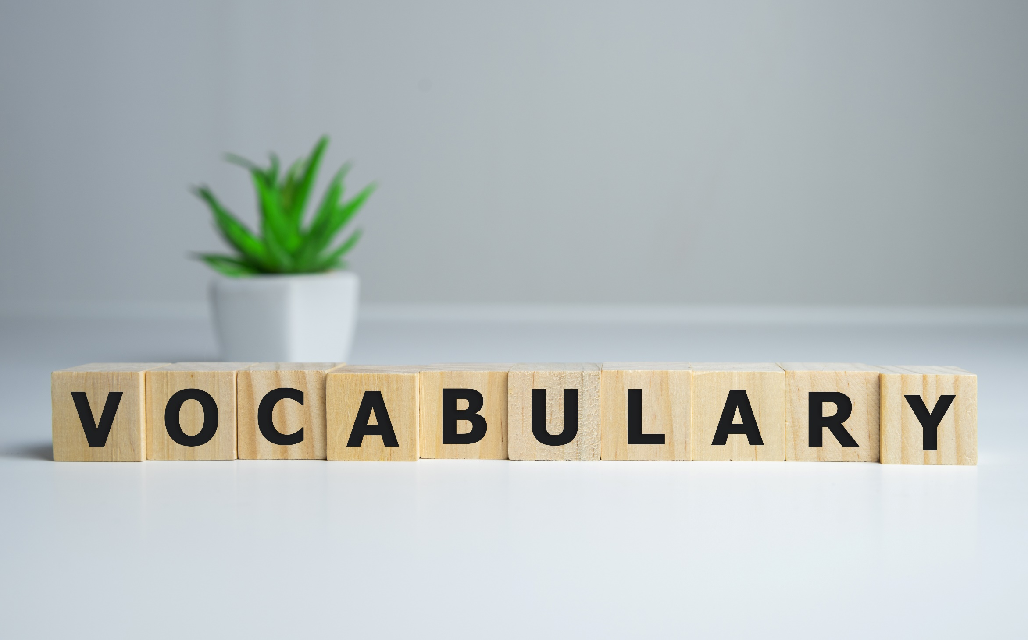


Slide 8

Work in pairs. Fill in the table.
recycle raise plant donate clean up
plant
raise
clean up
recycle
donate
trees flowers | money | parks streets | cans bottles | books old clothes

Slide 9
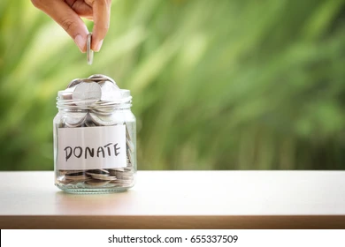

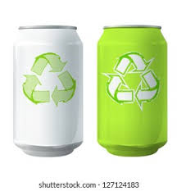
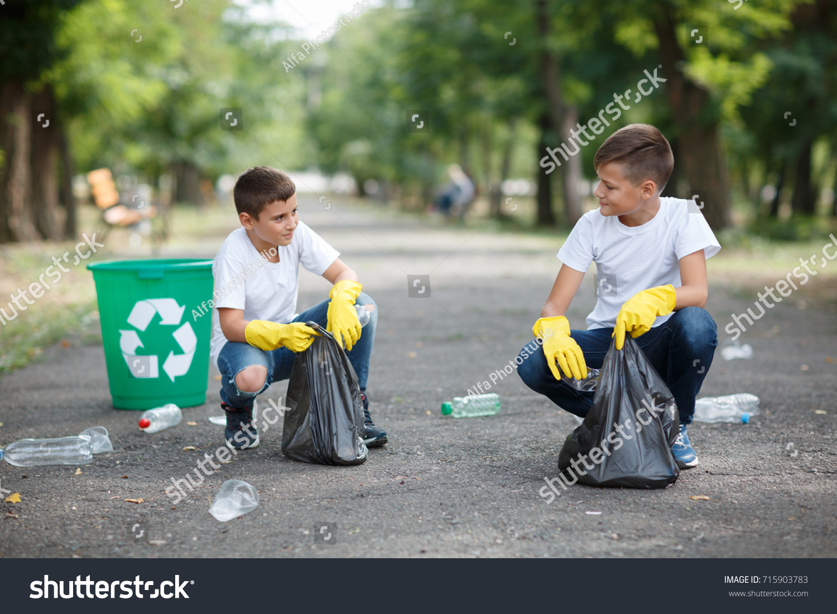
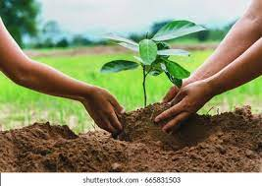
Work in pairs, matching the pictures with the phrase in the previous slide.
Raise money
Donate books
Recycle cans
Clean up streets
Plant trees
715903783

Slide 10

Listen and repeat. Click each phrase to hear the sound.
clean up parks (v. phr) /kliːn ʌp pɑːrks/ làm sạch công viên
clean up streets (v. phr) /kliːn ʌp striːts/ làm sạch đường phố
donate books (v. phr) /ˈdoʊneɪt bʊks/ quyên góp/ tặng sách
donate old clothes (v. phr) /ˈdoʊneɪt oʊld kloʊðz/ quyên góp/ tặng quần áo cũ
plant flowers (v. phr) /plænt ˈflaʊərz/ trồng hoa
plant trees (v. phr) /plænt triːz/ trồng cây
raise money (v. phr) /reɪz ˈmʌni/ quyên góp tiền
recycle bottles (v. phr) /ˌriːˈsaɪkl ˈbɑːtl/ tái chế chai

Slide 11
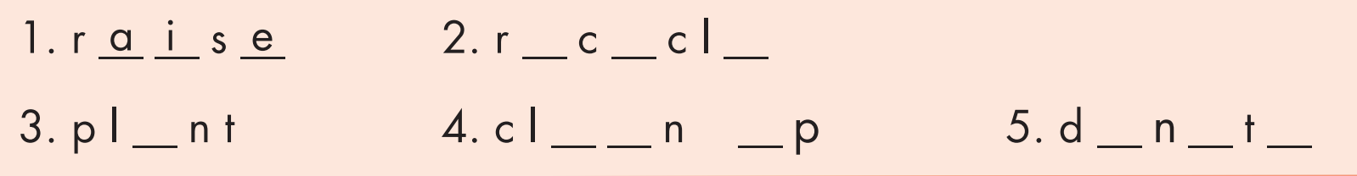
Extra Practice
WB, page 22
e
y
e
a
e
a
u
o
a
e

Slide 12
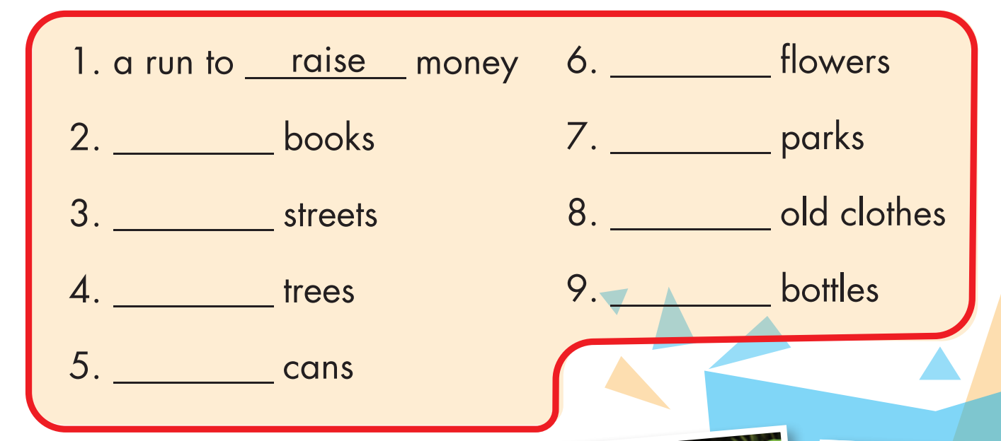
plant
donate
clean up
clean up
donate
plant
recycle
recycle

Slide 13
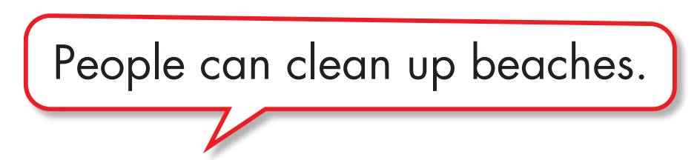

Work in pairs.
b. Add more words to the table and share your ideas with the class.

Slide 14


It’s listening time….

Slide 15
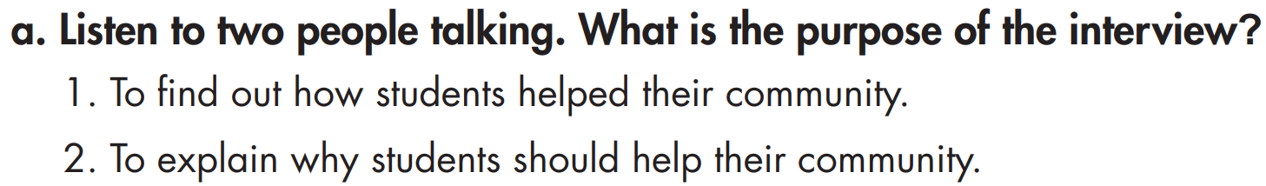
Pre - listening
Read the instruction quickly. Underline the key words. What are we going to do?
Listen and choose the correct purpose of the interview.

Slide 16
While - listening
Now listen and choose the correct answer.  FIRST TIME
☞ YOUR ANSWER?
1. To find out how students helped their community.
☞ WHY?

Slide 17
While - listening
Now listen again and check.  SECOND TIME
While you are listening, focus on what Annie, her sister, and her friends did to help the community.
Annie: I donated warm clothes and my old toys.
My sister donated some comics.
Annie: I cleaned up the park near my house.
We also planted flowers and trees there.
Annie: My friends and I volunteered at Fair View's soup kitchen.
☞ YOUR ANSWER?
1. To find out how students helped their community.
2. To explain why students should help their community.
☞ THE ANSWER IS …

Slide 18
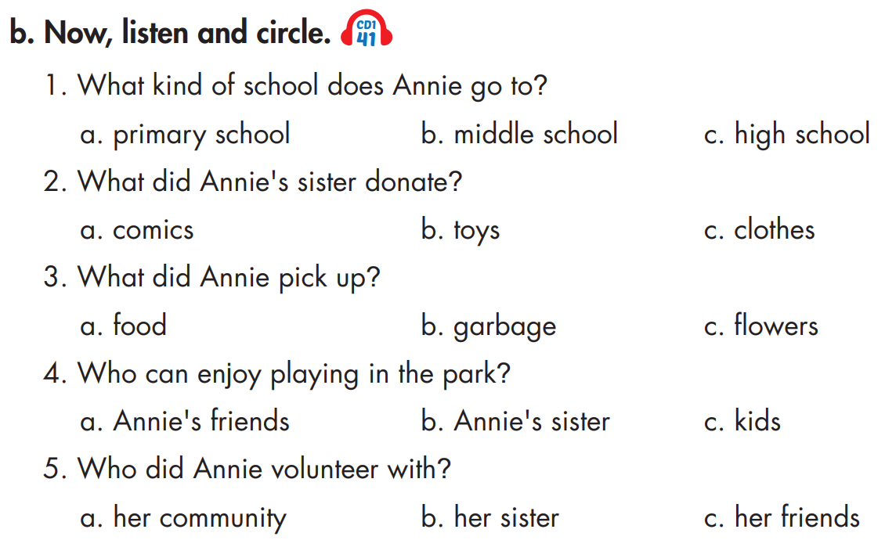
Pre - listening
Read the instruction and questions quickly. Underline the key words. What are we going to do?
Listen and circle a, b, or c.

Slide 19
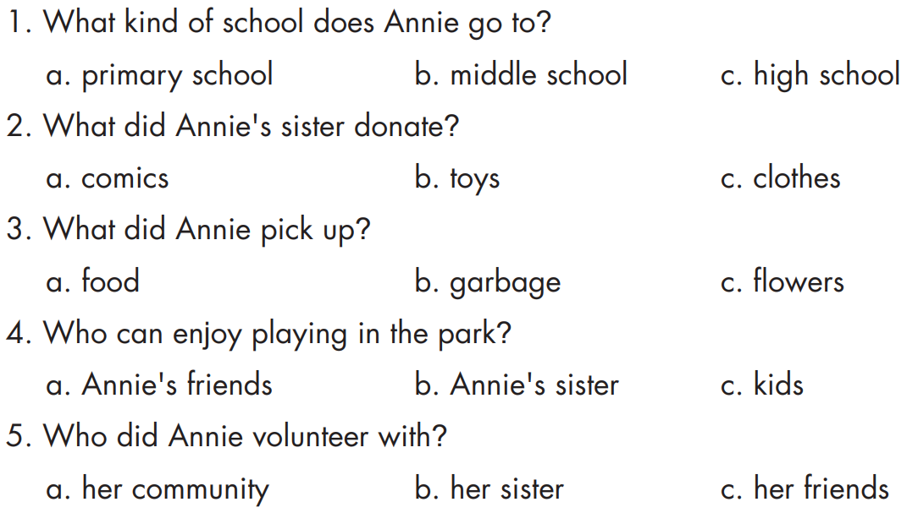
While - listening
Now listen and circle a, b, or c.  FIRST TIME
☞ WHAT ARE YOUR ANSWERS?

Slide 20
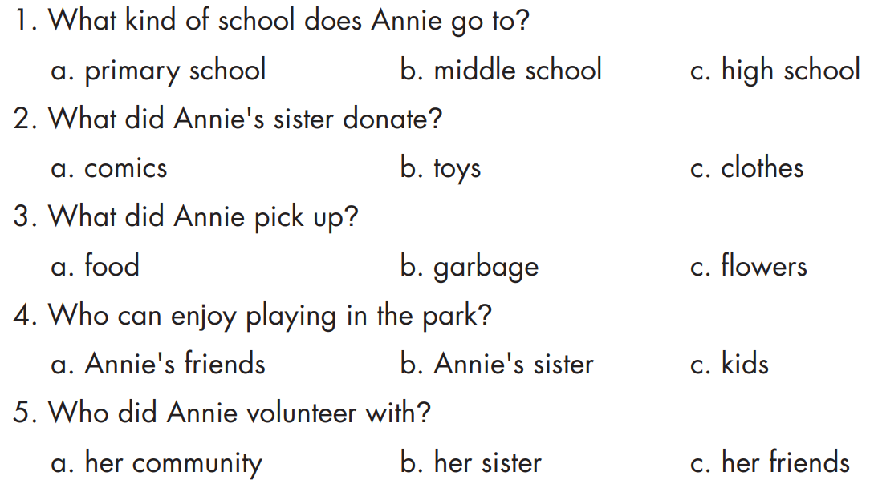
While - listening
Now listen again and check.  SECOND TIME
☞ WHY ARE THESE ANSWERS?

Slide 21
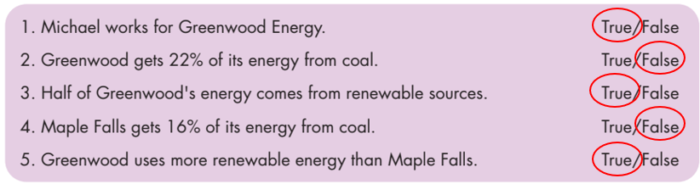
While - listening
Now listen again and check.  THIRD TIME
Ms. White: I'm talking to Annie Williams. She's a middle school student…
1. What kind of school does Annie go to? b. middle school
Annie: Last month, I donated warm clothes and my old toys. My sister donated some comics.
2. What did Annie's sister donate? a. comics
Annie: Last week, I cleaned up the park near my house. It was dirty so we picked up the garbage.
3. What did Annie pick up?
b. garbage

Slide 22
Annie: We also planted flowers and trees there. Now, kids can enjoy playing in the park.
4. Who can enjoy playing in the park? c. kids
Annie: Well, yesterday, my friends and I volunteered at Fair View's soup kitchen.
5. Who did Annie volunteer with? c. her friends

Slide 23
Audio - Scripts
Practice the conversation with a partner.
Ms. White: So, Annie, let's talk about what you did to help our community.
Annie: Last month, I donated warm clothes and my old toys. My sister donated some comics. They went to the poor children.
Ms. White: Great. What else did you do?
Annie: Last week, I cleaned up the park near my house. It was dirty so we picked up the garbage. We also planted flowers and trees there. Now, kids can enjoy playing in the park.
Ms. White: Fantastic. Can you tell us about your volunteer work?
Annie: Well, yesterday, my friends and I volunteered at Fair View's soup kitchen.
Ms. White: Wow! You guys did a great job to help our community.
Annie: Thank you, Ms. White.

Slide 24

Work in pairs
Post - listening
What kinds of things could you do to help your local community?
I could clean up the streets near my house or donate my old books to the poor children in my neighborhood.

Slide 25
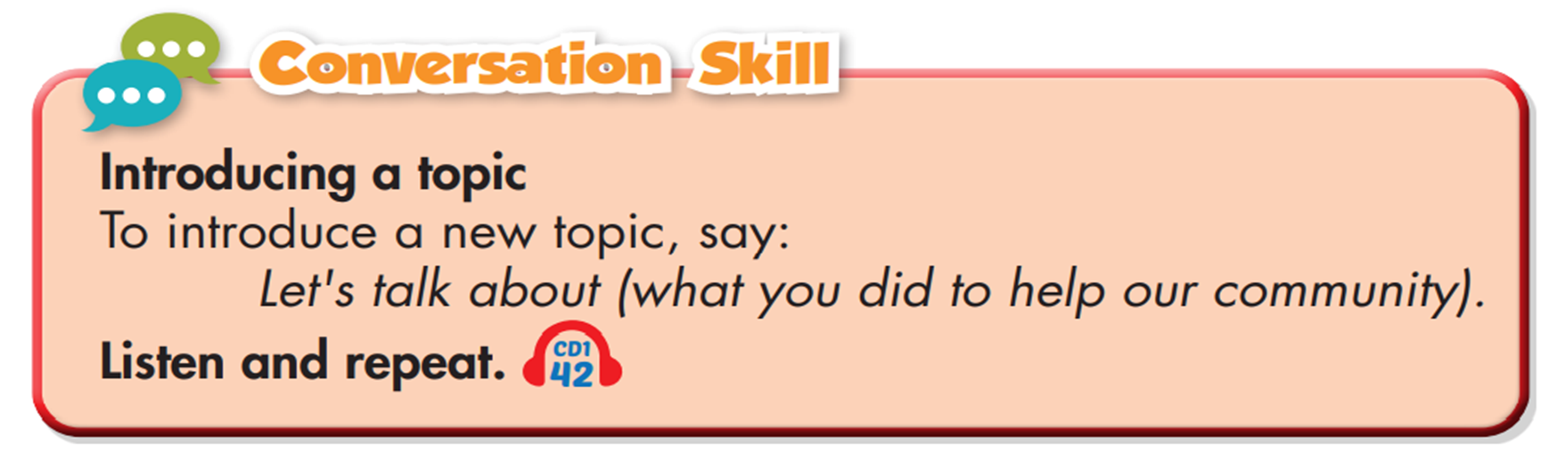

Slide 26
Work in pairs
Let’s talk about what you did to help our community.
I cleaned up the park near my school and planted some new trees.

Slide 27

CONSOLIDATION

Slide 28
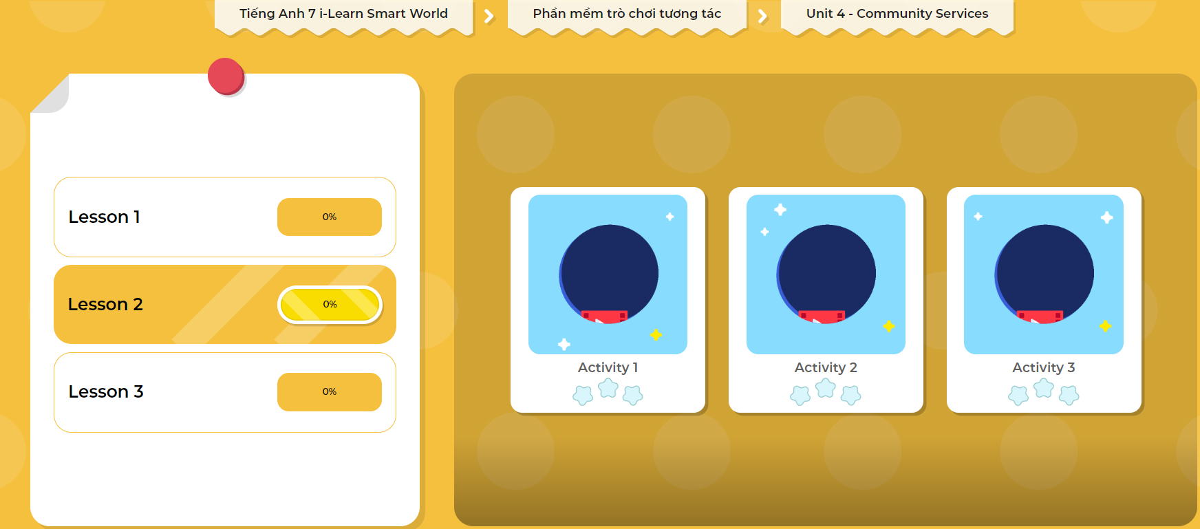
LET’S PLAY!
Click here to play the games

Slide 29
Write 5 sentences about what you did to help our community. Use the information from the Listening Section.
Use the Past Simple tense:
I cleaned up the streets.
My friends donated their old books and old clothes.

Slide 30

WRAP-UP

Slide 31
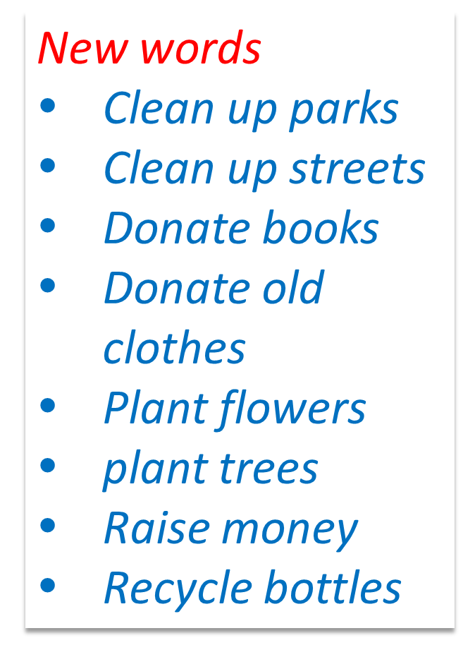
Today’s lesson

Slide 32
Today’s lesson
Listening:
Listening for main ideas and specific information.
Speaking:
Talking about what you did to help our community.
Introducing a topic.

Slide 33
Homework
Practice the vocabularies and make sentences using them.
Do the Listening exercise on page 22 WB.
Do the exercises in Tiếng Anh 7 i-Learn Smart World Notebook on page 24.
Prepare the next lesson (page 32 SB).
Play the consolidation games in Tiếng Anh 7 i-Learn Smart World DHA App on www.eduhome.com.vn

Slide 34

Lesson 3
Stay positive and have a nice day!

