Slide 1

Unit 3: All about food
Lesson 3f: Skills
Page 63

Slide 2
Lesson Outline
Warm-up
Vocabulary
Speaking
Listening
Writing
Consolidation
Wrap-up

Slide 3
Objectives
By the end of this lesson, students will be able to…
learn some more vocabulary about food.
ask and answer “why” questions.
listen and choose the best answer.
write a blog entry about street food in your country.

Slide 4

WARM-UP

Slide 5
PAIRWORK
Ask ans answer about street food.
What street food have you eaten?
What is your favourite street food?
What street food would you like to try? Why?

Slide 6

It’s time to learn …

Slide 7

Vocabulary

Slide 8
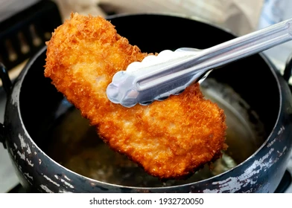
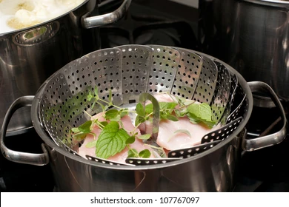
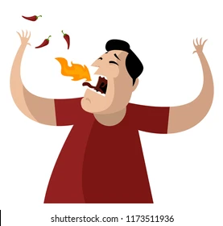
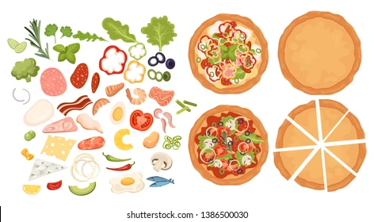
Label these pictures with the following words:
toppings, steam, spicy and fry.
fry
steam
spicy
toppings

Slide 9
VOCABULARY
FOOD
5. Complete the sentences with toppings, steam, spicy and fry.
1 People ________________ potatoes in oil to make chips.
2 My dad puts ______________ like mustard and onions on his burger.
3 I add pepper to my soup to make it _______________ .
4 Boil the water and ______________ the carrots for 15 minutes
before you serve them.
fry
toppings
spicy
steam
Which words describe cooking methods?
fry, steam

Slide 10
Make your own sentences, using the four words: toppings, steam, spicy and fry.
I enjoy spicy food such as Kimchi or Thai hot pot.

Slide 11

Speaking

Slide 12
SPEAKING
6. Which of the street foods in Exercise 1 (hot dogs or fish and chips) would you like to try? Why?
Tell your partner.
I would like to try ______________ because ______________ .
I would like to try fish and chips because I like
chips and I think fish is tasty.
I would like to try hot dogs because I like
sausages and I can put many toppings on it.

Slide 13
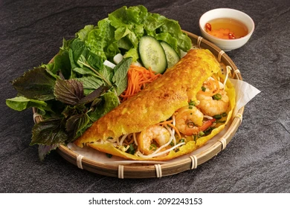
EXTRA PRACTISE
Which street foods in Vietnam would you like to try? Why? Tell your partner.
I would like to try bánh xèo because I like
eating something crispy and I really enjoy the toppings on them.

Slide 14

Listening

Slide 15
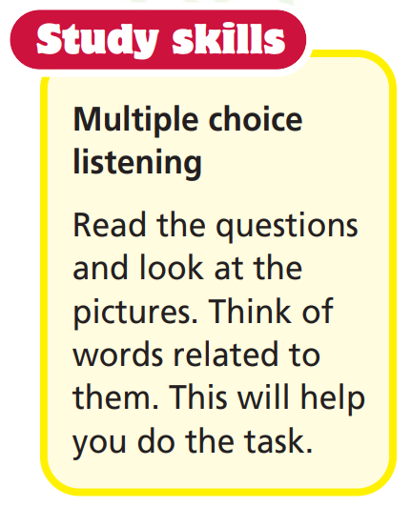

Slide 16
Pre-listening
Look at the questions and underline key words.
1 What’s Paul’s favourite food?
2 What does Ann want to drink?
3 What does Lyn need to buy?

Slide 17
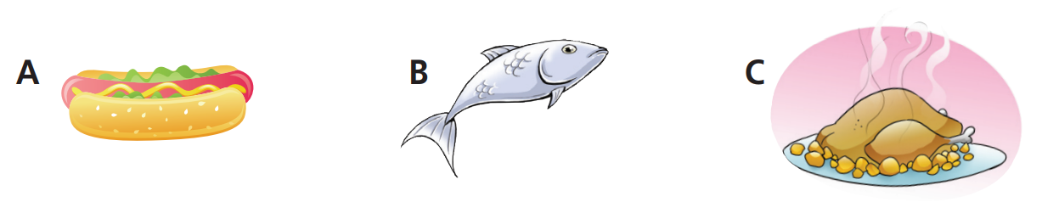
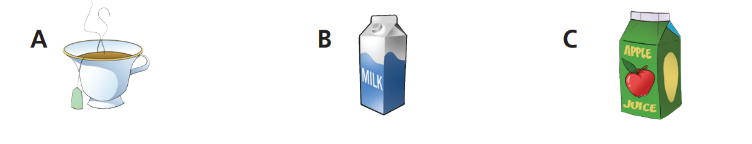
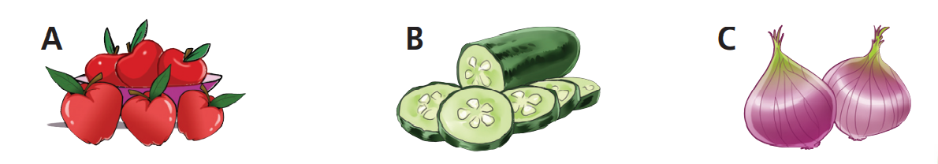
Look at the pictures and label them.
hot dog
fish
chicken
tea
milk
apple juice
apples
cucumbers
onions

Slide 18
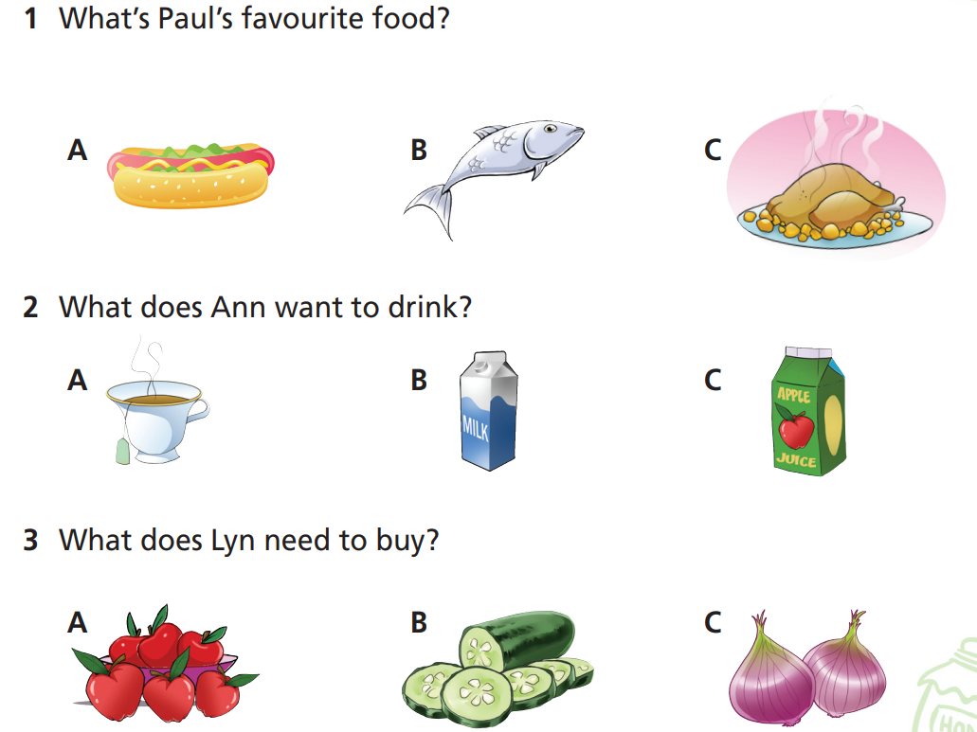

While-listening
7 Listen and choose the correct answer (A, B or C).

Slide 19
Post-listening
Tell your friend your favourite dinner, drink and fruit.
I like to eat fried chicken for dinner. My favourite drink is orange juice. About vegetables, I enjoy carrots the most.

Slide 20

Writing

Slide 21
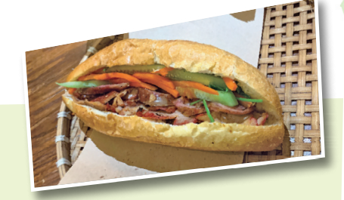
Read the text and note these things:
Name of street food:
How they make it:
What they serve with it:
Bánh mì
filled with pickled vegetables, coriander, fresh chilli, slices of pork meat and a coat of pâté.
egg, chicken or meatballs
Bánh mì is the Vietnamese word for bread. It is also the name of a very popular street food. This Vietnamese sandwich is a baguette filled with pickled vegetables, coriander, fresh chilli, slices of pork meat and a coat of pâté. Other toppings can include egg, chicken or meatballs.

Slide 22
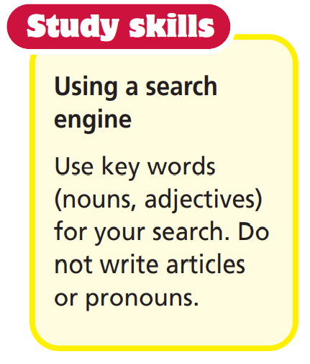
Writing (a blog entry about street food in your country)
8. Think of a popular street food in your country. Collect information under the headings:
name of street food
how they make it
what they serve with it

Slide 23
Planning
name of street food:
how they make it:
what they serve with it:
Rice noodle soup
steam some kinds of meat to make hot broth.
slices of beef, pork or chicken and vegetables.

Slide 24
Sample
Complete the email with suitable words or phrases.
Rice noodle soup is a …………………. street food in Vietnam. People ………………… some kinds of meat to make hot broth. Vendors serve rice noodles in ……………………….. with slices of beef, pork or chicken and some kind of ………………….. vegetables. You can ……………….. chilli, lemon juice or fish sauce if you like. It’s the best way to start your day in Vietnam.
popular
steam
hot broth
fresh
add

Slide 25

CONSOLIDATION

Slide 26
Tell your friend about the street food you have written about, including how to make it and what you can serve it with.

Slide 27

WRAP-UP

Slide 28
Today’s lesson
Vocabularies
fry, steam, spicy, toppings
Speaking
Ask and answer “why” questions.
Listening
Listen and choose the best answers.
Writing
Write a blog entry about street food in your country.

Slide 29
Homework
Learn the vocabularies and make sentences using them.
Do the exercises in TA 6 Right on Notebook (p. 33)
Prepare the next lesson (p. 64 SB)
Do Unit 3 Test 1 in Bài Tập Bổ Trợ TA 6 Right on (pp. 26-27)

Slide 30

Enjoy your day!

