Slide 1

Unit 9: English in the World
Lesson 1.3: Pronunciation & Speaking
Page 70

Slide 2



LESSON OUTLINE
Consolidation

Slide 3

By the end of this lesson, students will be able to…
- talk about holiday plans.
- practice the /ð/ sound.

Slide 4

WARM-UP

Slide 5

Work in pairs.
Choose the word whose main stress is placed
differently from the others.
1. A. participant B. environment C. experience D. competition
2. A. historic B. delighted C. annual D. annoying
3. A. conclusion B. tradition C. attraction D. evidence
/pɑːrˈtɪsəpənt/
/ɪnˈvaɪrənmənt/
/ɪkˈspɪriəns/
/ˌkɑ:mpəˈtɪʃn/
/hɪˈstɔ:rɪk/
/dɪˈlaɪtɪd/
/ˈænjuəl/
/əˈnɔɪɪŋ/
/kənˈklu:ʒn/
/trəˈdɪʃn/
/əˈtrækʃn/
/ˈevɪdəns/

Slide 6
Work in pairs.
Choose the word whose underlined part is
pronounced differently from that of the other words.
1. A. homestays B. mothers C. photos D. workshops
2. A. pudding B. sculpture C. customs D. luggage
3. A. suggestion B. tradition C. emotion D. location
/ˈhoʊmsteɪz/
/ˈmʌðəz/
/ˈfoʊtoʊz/
/ˈwɜ:rkʃɑ:ps/
/ˈpʊdɪŋ/
/ˈskʌlptʃər/
/ˈkʌstəmz/
/ˈlʌɡɪdʒ/
/səˈdʒestʃən/
/trəˈdɪʃn/
/ɪˈmoʊʃn/
/loʊˈkeɪʃn/

Slide 7

Work in pairs. Ask and answer the following questions.
1. Do you have any plans for your next holiday?
2. Where are you going?
3. Where are you going to stay?
4. Where are you going to do?
5. Where are you going to eat?

Slide 8



Slide 9
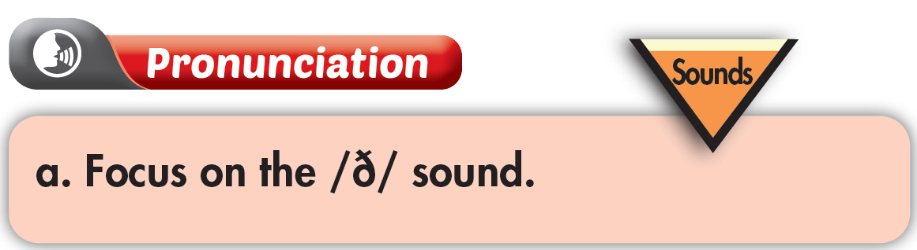
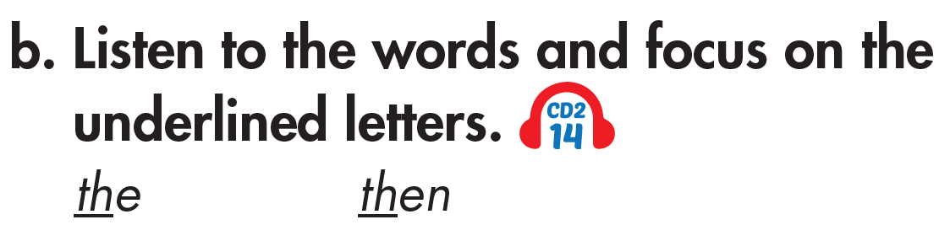

Click on the icon to hear the sound

Slide 10
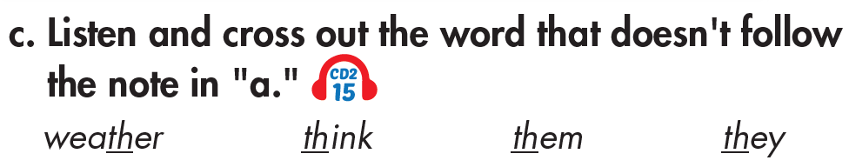

Click on each icon to hear the sound

Slide 11

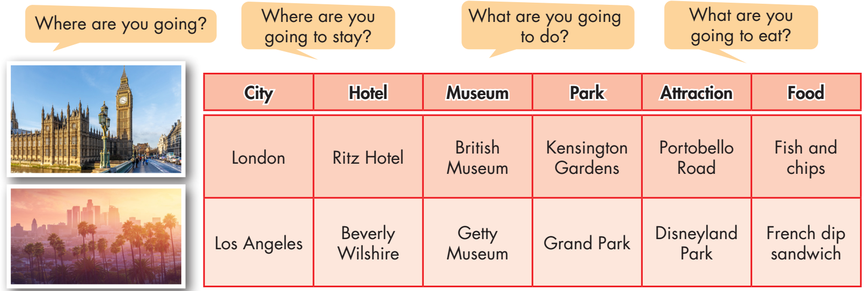

Slide 12
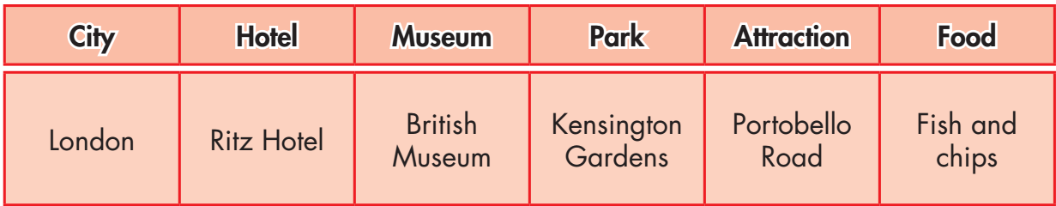
Do the same
Where are you going?
I’m going to London.

Slide 13
Do the same
Where are you going to stay?
I’m going to stay in Ritz Hotel.

Slide 14
Do the same
What are you going to do?
I’m going to visit British Museum, Kensington Gardens, and Portobello Road.

Slide 15
Do the same
What are you going to eat?
I’m going to eat fish and chips.

Slide 16


You're talking to your friend about your holiday plans. In pairs: Student B . Student A, answer Student B's questions about Australia. Swap roles. Ask about Canada and complete the table.

Slide 17
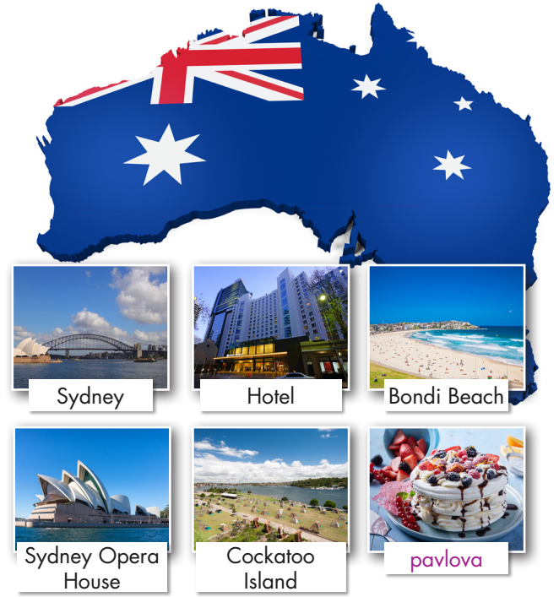
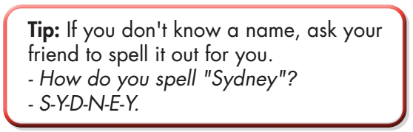
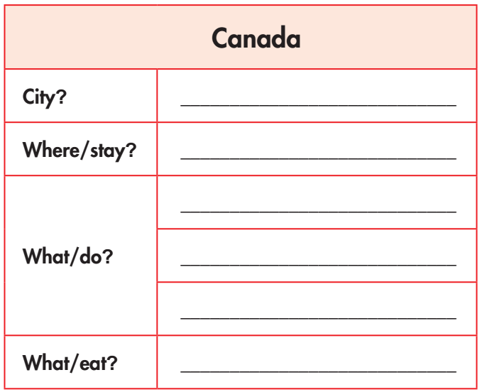

Slide 18
Discuss with your partner:
b. Which city would be more interesting to visit? Why?

Slide 19

CONSOLIDATION

Slide 20
Write a paragraph about your holiday plans. Write about 70 words.

Slide 21

WRAP-UP

Slide 22
Today’s lesson
Pronunciation:
- Practice pronouncing the /ð/ sound.
Speaking:
- Talk about holiday plans.

Slide 23
Homework
Practice pronouncing the /ð/ sound.
Review the vocabulary and grammar notes in Tiếng Anh 7 i-Learn Smart World Notebook (pages 54 & 55).
Prepare the next lesson (page 71 SB).
Play the consolidation games in Tiếng Anh 7 i-Learn Smart World DHA App on www.eduhome.com.vn

Slide 24

Lesson 3
Stay positive and have a nice day!

