Slide 2



Unit
9
Cities of the world
LESSON 1: GETTING STARTED
What nice photos!
1

Slide 3
LESSON 1: GETTING STARTED
LESSON 1: GETTING STARTED
WARM-UP
The body part song
Task 1: Listen and read.
Task 2: Write the names of the cities in the correct place.
Task 3: Read the conversation again and match the cities with the adjectives describing them.
Task 4: Match the cities with their landmarks.
PRESENTATION
PRACTICE
Task 5: Game: What city is it?
PRODUCTION
Wrap-up
Homework
CONSOLIDATION

Slide 4

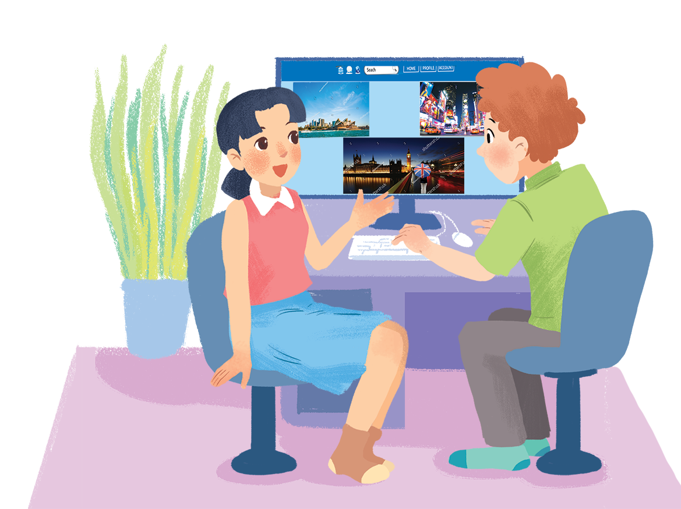
PRACTICE
1
What nice photos!
Listen and read.

Slide 5
PRACTICE
1
Listen and read.
Mai: Tom, are these photos from your vacations?
Tom: Yes, they are. This is Sydney, a city in Australia.
Mai: What’s it like?
Tom: It’s exciting with a lot of beaches.
Mai: What a beautiful place!
Tom: Yes, its beaches are very clean.
Mai: Wonderful. Oh, this is London. Isn’t it raining? What bad weather!
Tom: Yes, it rains all the time. Can you see Big Ben?
Mai: Yeah ... on the River Thames. It’s a landmark of London.
Tom: It is. And this is Times Square in New York, crowded but interesting.
Mai: You’re lucky to visit many places.
Tom: I am. What about your vacations?
Mai: Here are some photos of mine. This is ...

Slide 6

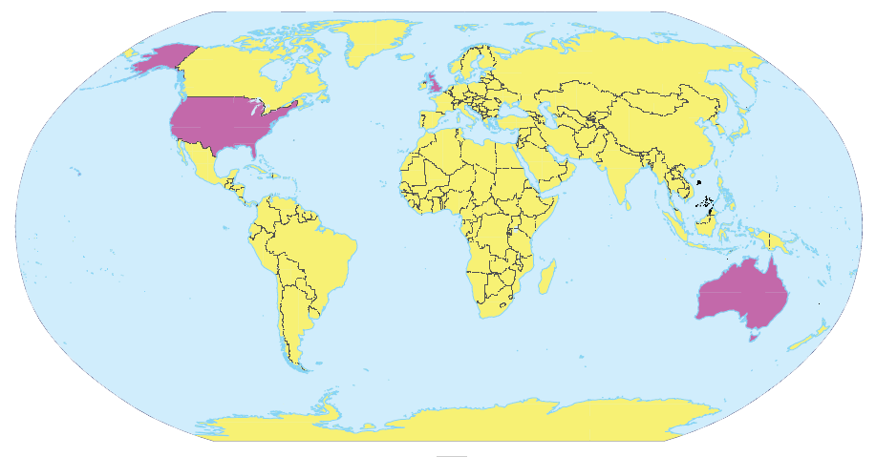
PRACTICE
2
Fill the blanks with the words from the conversation.
1.
London
New York
2.
Sydney
London
New York
3.
Sydney

Slide 7
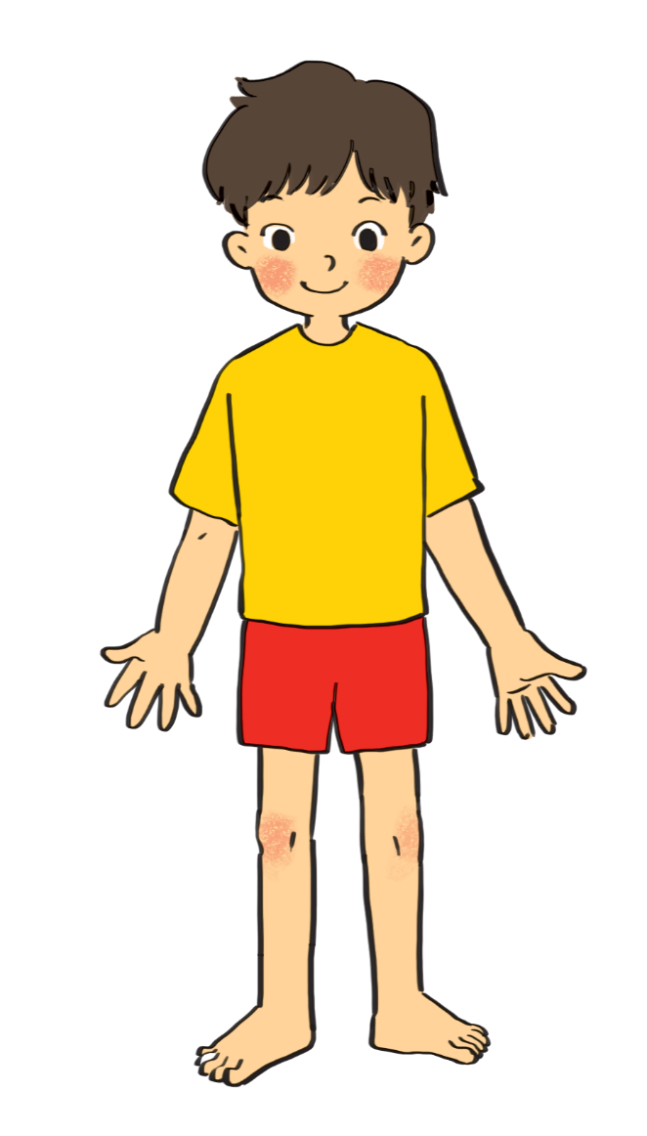
PRACTICE
3
Label the body parts with the words in the box.
1.
10.
9.
2.
8.
3.
7.
4.
5.
6.

Slide 8

PRACTICE
3
cheek
eye
hand
arm
mouth
cheek
eye
hand
arm
mouth
leg
nose
hair
shoulder
foot
leg
nose
hair
shoulder
foot
eye
hair
Do you know any other words for body parts?
1.
10.
nose
cheek
2.
9.
mouth
shoulder
8.
3.
arm
hand
7.
4.
leg
foot
5.
6.

Slide 9
PRACTICE
4
Work in groups. Complete the word webs.
arms
hair
nose
eyes
Example:
long / short
big / small
leg
hair
blonde
curly
hair

Slide 10
PRACTICE
4
Work in groups. Complete the word webs.
Example:
nose
eyes
big / small
head
feet
hand
ears

Slide 11
PRACTICE
4
Work in groups. Complete the word webs.
Example:
blonde
curly
long/short
black
hair
wavy
straight
fair

Slide 12

PRODUCTION
5
GAME: Guessing
Work in groups. Take turns to describe a classmate. Other group members guess who he / she is.
Example:
A: She has long hair and big eyes.
B: Is that Lan?
A: That’s right.

Slide 13

CONSOLIDATION
1
Wrap-up
What have we learnt in this lesson?
identify the topic of the unit
use lexical items related to friends
identify the language features that are covered in the unit

Slide 14

CONSOLIDATION
2
Homework
Write some sentences to describe at least 3 classmates.

Slide 15






Website: hoclieu.vn
Fanpage: facebook.com/www.tienganhglobalsuccess.vn/

Slide 16
Website: hoclieu.vn
Fanpage: facebook.com/www.tienganhglobalsuccess.vn/

