Slide 1

Unit 5: Food and Drinks
Lesson 1.2: Grammar
Page 37

Slide 2


LESSSON OUTLINE
Consolidation

Slide 3

By the end of this lesson, students will be able to…
ask and answer about quantities and amounts, using much, many, how much, how many.

Slide 4

WARM-UP

Slide 5








Which ingredients do we need for ….?
some cakes
some noodles
fried beef
some lemonade
Cakes
Noodles
Fried beef
Lemonade

Slide 6

PRESENTATION
much
many
How much / How many…?

Slide 7
Look at these sentences and guess the words.
How much sugar do we need?
How many eggs do we need?
We don’t have much milk left.
We don’t have many eggs left.
We use much +
We use many +
Uncountable nouns
Countable nouns
Saying about quantities and amounts

Slide 8
Countable nouns: things you can count.
Uncountable nouns: things you can’t count
Point and count some classroom objects:
1 chair, 4 chairs
3 pens, 10 pencils
a board, 20 backpacks…
Can you count ………..?
water
rice
time

Slide 9
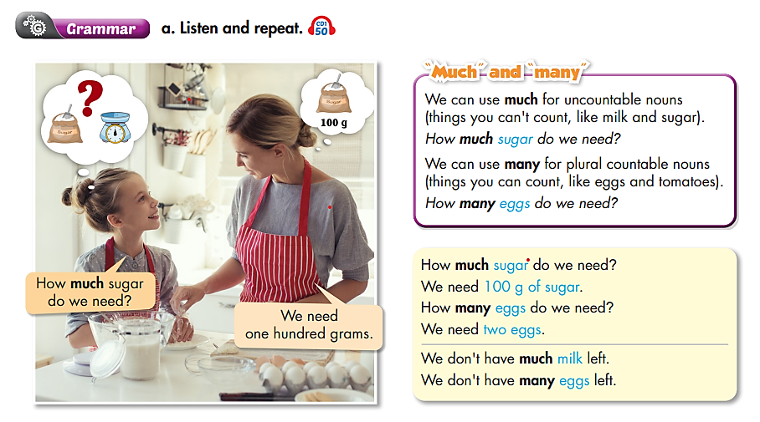


Slide 10

PRACTICE

Slide 11
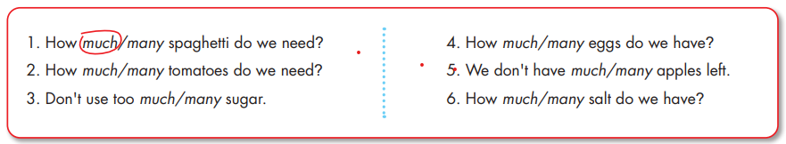
Game time.
Students are divided into 2 teams and try to slap the correct words and explain why.

Slide 12
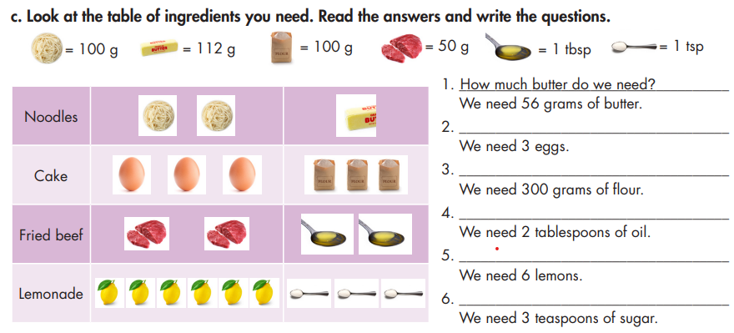
Suppose that you (Student A) and your mom (Student B) are at the supermarket for food. Ask and answer about the ingredients you need.

Slide 13
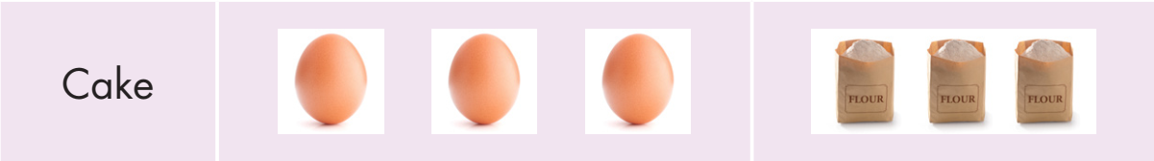
2. _____________________________________
We need 3 eggs.
3. _____________________________________
We need 300 grams of flour.
How many eggs do we need?
How much flour do we need?

Slide 14
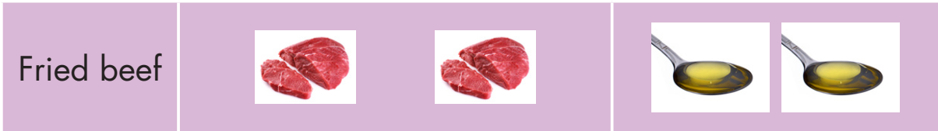
4. __________________________________
We need 2 tablespoons of oil.
How much oil do we need?

Slide 15
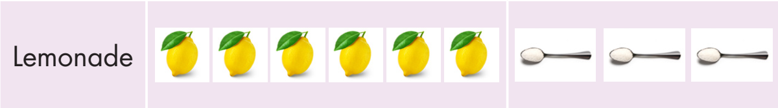
5. ____________________________________
We need 6 lemons.
6. ____________________________________
We need 3 teaspoons of sugar.
How many lemons do we need?
How much sugar do we need?

Slide 16
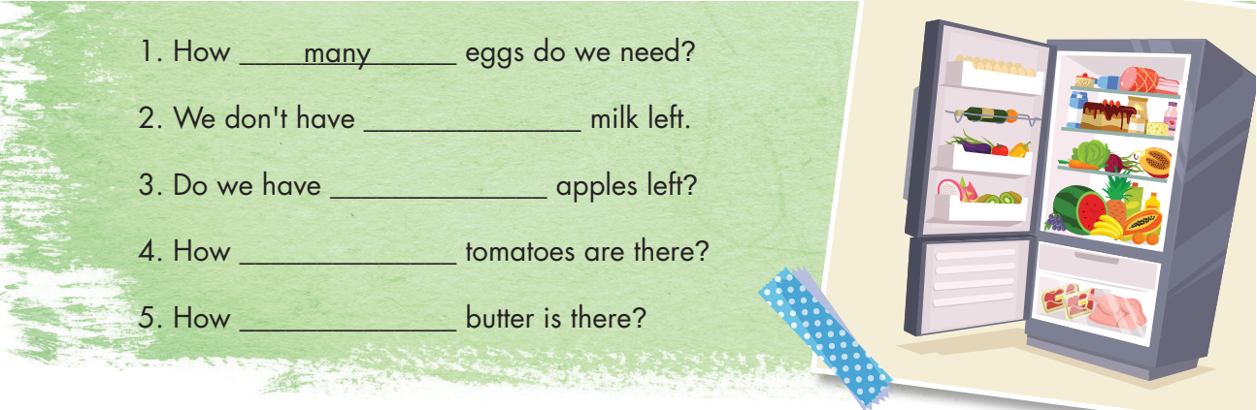
Extra Practice
WB p. 27
Work in pairs to fill in the blanks using much or many. Cross-check the answers with your friends.
much
many
many
much

Slide 17
Extra Practice
WB p. 27
Come to the board to unscramble the sentences.
do/ How/ need?/ we/ many/ onion
How many onions do we need?

Slide 18
is/ there?/ much/ How/ flour
How much flour is there?

Slide 19
don’t/ much/ coffee/ We/ have/ left.
We don’t have much coffee left.

Slide 20
many/ apples?/ Do/ need/ we
Do we need many apples?

Slide 21
PRODUCTION

Slide 22
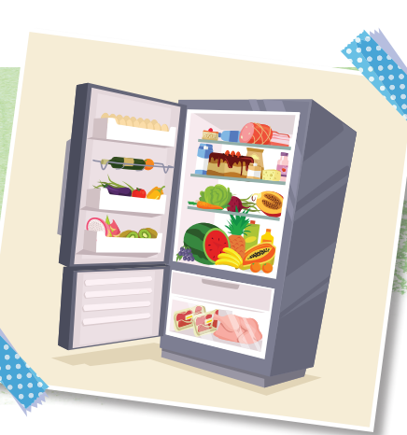

Work in pairs. Ask and answer about ingredients you have in your fridge.

Slide 23

CONSOLIDATION

Slide 24
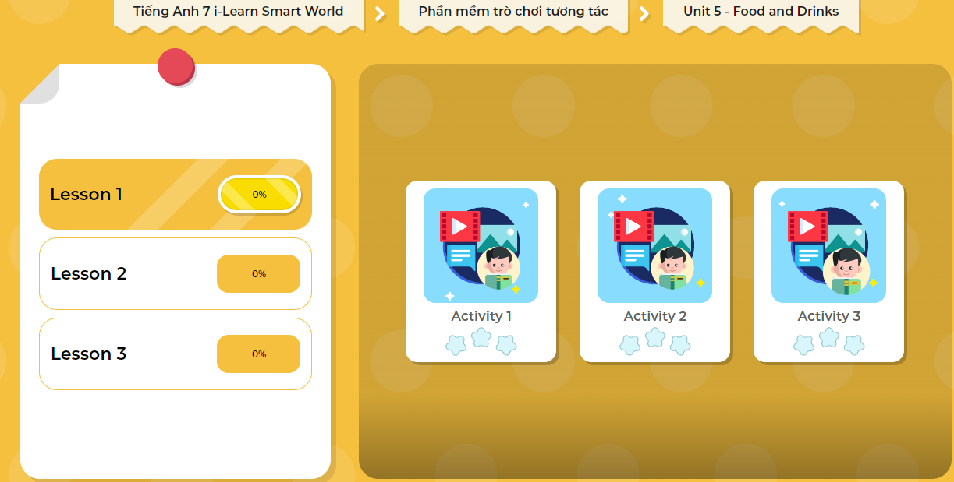
LET’S PLAY!
Click here to play the games

Slide 25
Role play. You (Student A) and your mom (Student B) are going to buy some ingredients to make food. Ask and answer about the ingredients you need.
A: We are going to make a chocolate cake.
B: Wow, that’s great mom. What ingredients do we need?
A: We need 300 grams of flour. Anything else, you know?
B: Umm, I think we need some milk. How much milk do we need?
A: We need 200 milliliters of milk. And we need some eggs.
B: How many eggs do we need?
A: We need 3 eggs.
………………………………………….

Slide 26

WRAP-UP

Slide 27
Today’s lesson
Grammar
much + uncountable nouns
many + countable nouns
How much + uncountable nouns?
How many + countable nouns?
We don’t have much + uncountable nouns.
We don’t have many + countable nouns.

Slide 28
Homework
Review the grammar point and make sentences using it.
Do the exercises on page 27 WB.
Complete the grammar notes in Tiếng Anh 7 i-Learn Smart World Notebook (page 29).
Prepare the next lesson (page 38 SB).
Play the consolidation games in Tiếng Anh 7 i-Learn Smart World DHA App on www.eduhome.com.vn

Slide 29

Lesson 3
Stay positive and have a nice day!

