Slide 2
Unit
2
The generation gap
Unit
FAMILY LIFE
LESSON 4
SPEAKING
Talking about different generations

Slide 3
LESSON 4
SPEAKING
WARM-UP
Guessing game
CONTROLLED PRACTICE
Brainstorming
Task 1. Put the sentences (A–D) in order to complete the conversation.
LESS- CONTROLLED PRACTICE
Task 2. Talk about the different generations of your family.
Task 3. Discuss the question.
FREE PRACTICE
Further practice
Wrap-up
Homework
CONSOLIDATION

Slide 4
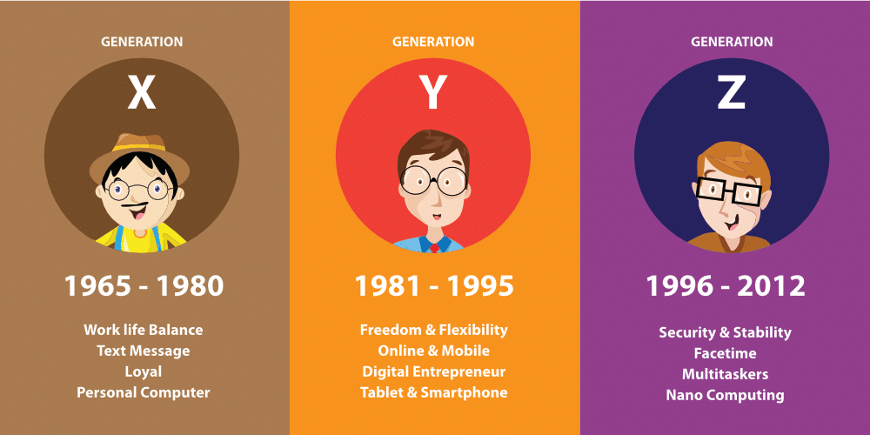
GUESSING GAME

Slide 5
BRAINSTORMING
Do these ideas relate to members of your family?
Suggested ideas:
• be open to new ways of thinking
• have fixed ideas about the world
• want to make their own decisions
• hold traditional views about many issues
• not want big changes in life
• be good at using electronic devices

Slide 6
GUESSING GAME
Tips to start a conversation or discussion, you can:
+ present the topic.
Example: Let's talk about ...
+ ask your partner for personal information related to the topic.
Example: Ly, do you live with your extended family?/ Ly, what kind of family do you have?
+ ask for an opinion.
Example: Ly, do you think there are any differences between the generations of your family?/ Ly, what do you think about your generation?

Slide 7
CONTROLLED PRACTICE
1
Put the sentences (A–D) in order to complete the conversation. Then practise it in pairs.
Kevin: Ly, do you live with your extended family?
Ly: (1) _____
Kevin: (2) _____
Ly: (3) _____
Kevin: (4) _____
Ly: Well, they're only in their 40s. I think they're quite open to new ways of thinking.
I can share lots of things with my parents.
A. Yes. My grandparents are over 60 now. They hold very traditional views about everything.
B. I see. What about your parents?
C. Yes, I do. I live with my grandparents, my parents, and my younger sister.
D. That's interesting. Have you noticed any differences between the generations?
C
D
A
B

Slide 8
LESS CONTROLLED PRACTICE
2
Work in pairs. Talk about the different generations of your family. Use the model and tips in 1, and the ideas below to help you.
Suggested ideas:
• be open to new ways of thinking
• have fixed ideas about the world
• want to make their own decisions
• hold traditional views about many issues
• not want big changes in life
• be good at using electronic devices

Slide 9
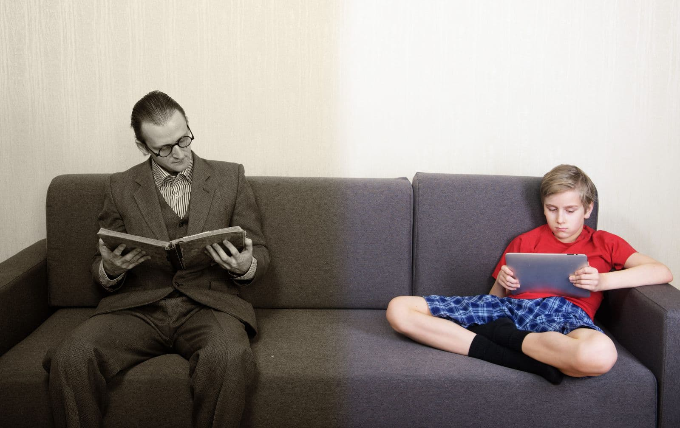
LESS CONTROLLED PRACTICE
3
Discussion
What are the most common generation gaps
in your families?

Slide 10
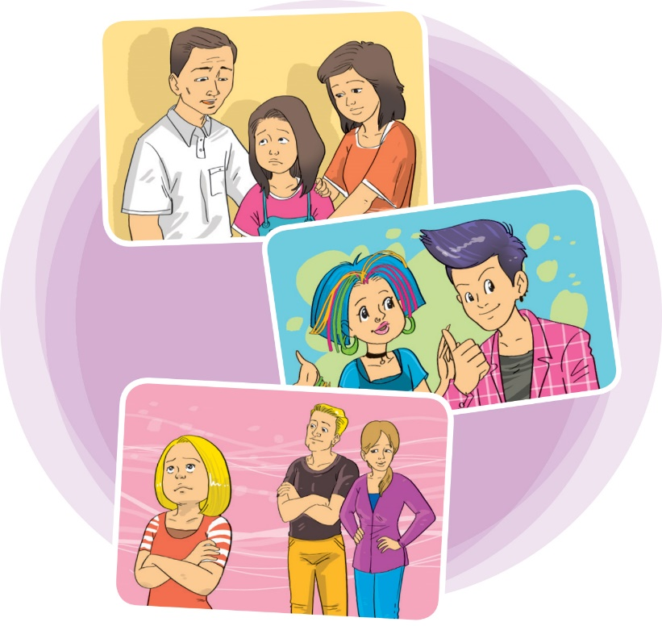
FREE PRACTICE
FURTHER PRACTICE
Work in pairs and come up with more ideas about generation differences.
Demonstrate your discussion in front of the class.

Slide 11
CONSOLIDATION
1
Wrap-up
What have you learnt today?
How to start a conversation or discussion
Vocabulary to talk about different generations

Slide 12
CONSOLIDATION
2
Homework
Do exercises in the workbook.
Prepare for Lesson 5 - Unit 2.

Slide 13
Website: hoclieu.vn
Fanpage: facebook.com/www.tienganhglobalsuccess.vn

