Slide 1

Unit 9: English in the World
Lesson 2.1: Vocabulary & Listening
Page 71

Slide 2



LESSON OUTLINE
Consolidation

Slide 3
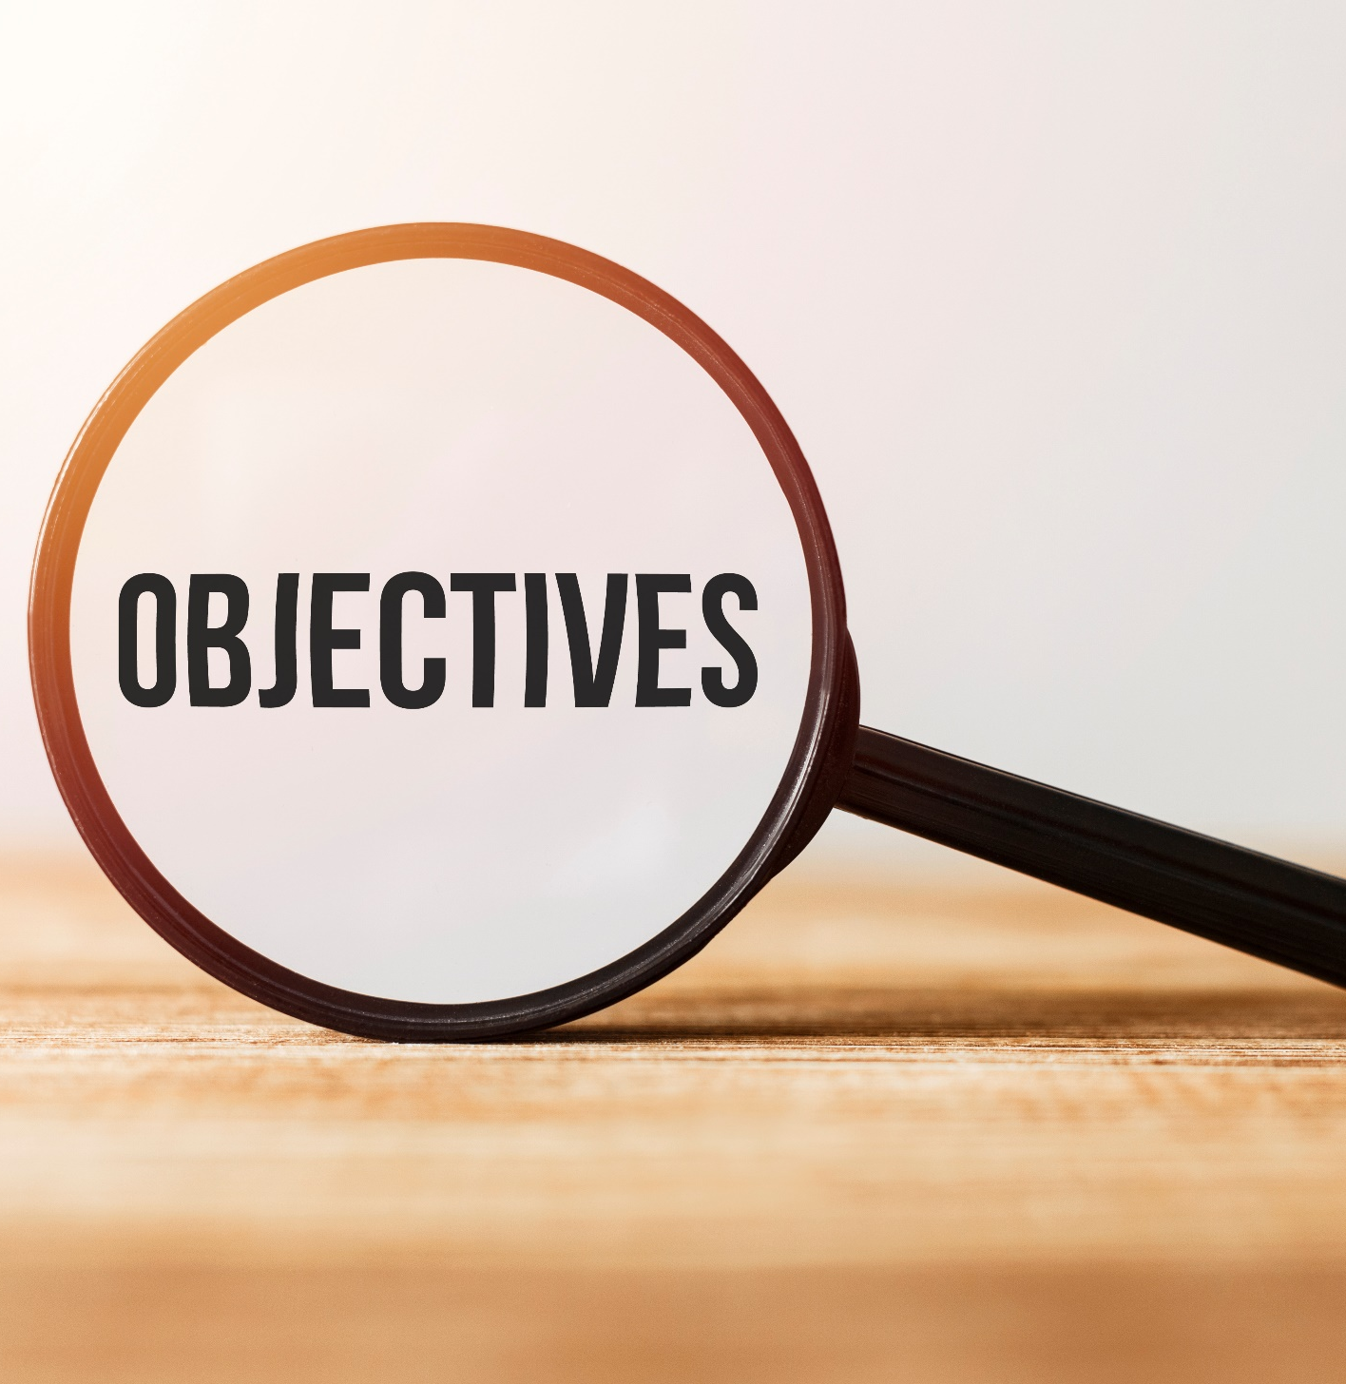
By the end of this lesson, students will be able to…
talk about holidays.
practice listening for main ideas and specific information.

Slide 4

New words
souvenir
sightseeing
swimsuit
postcard
photo
beach
wallet

Slide 5
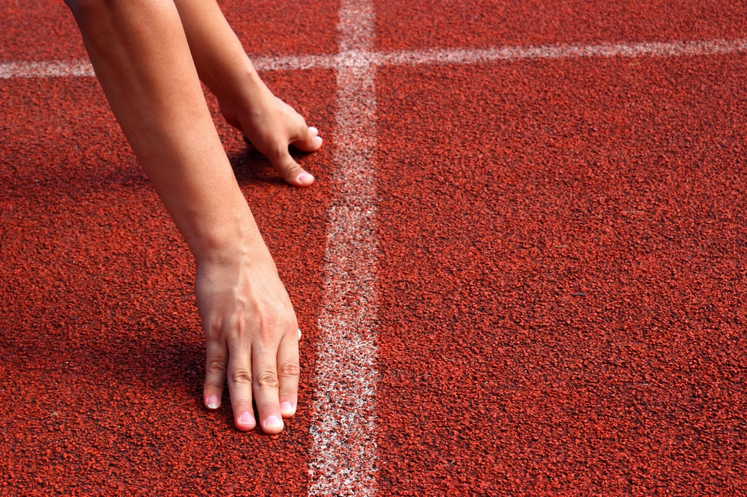
WARM-UP

Slide 6

Work in pairs.
What do you usually do when you go on holiday?

Slide 7
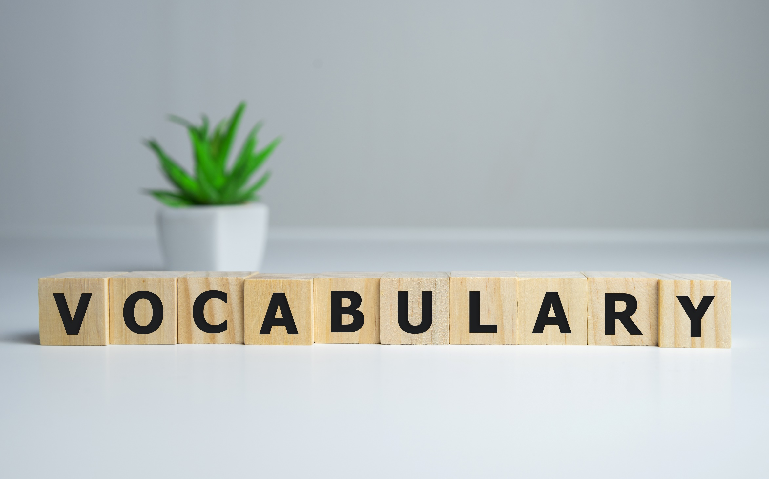


Slide 8


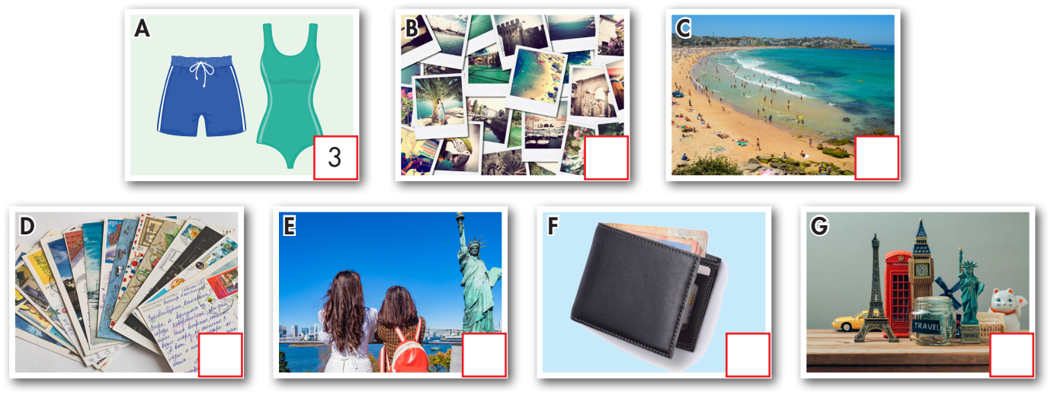
5
6
4
2
7
1

Slide 9

Listen and repeat. Click each phrase to hear the sound
souvenir (n) /ˌsuːvəˈnɪr/ quà lưu niệm
sightseeing (n) /ˈsaɪtˌsiːɪŋ/ việc tham quan, ngắm cảnh
swimsuit (n) /ˈswɪmsuːt/ đồ bơi
postcard (n) /ˈpoʊstkɑːrd/ bưu thiếp
photo (n) /ˈfoʊtoʊ/ hình ảnh
beach (n) /biːtʃ/ bãi biển
wallet (n) /ˈwɑːlɪt/ ví
Notes:
GV click vào từng cụm nghe âm thanh

Slide 10
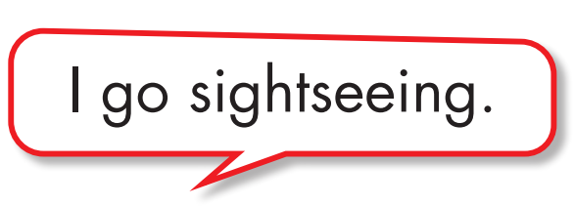
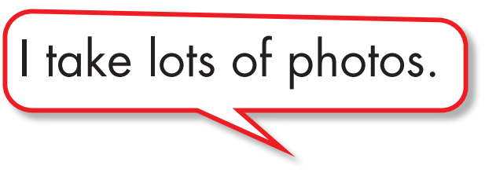

Work in pairs.
b. Talk about the things you do on vocation.

Slide 11
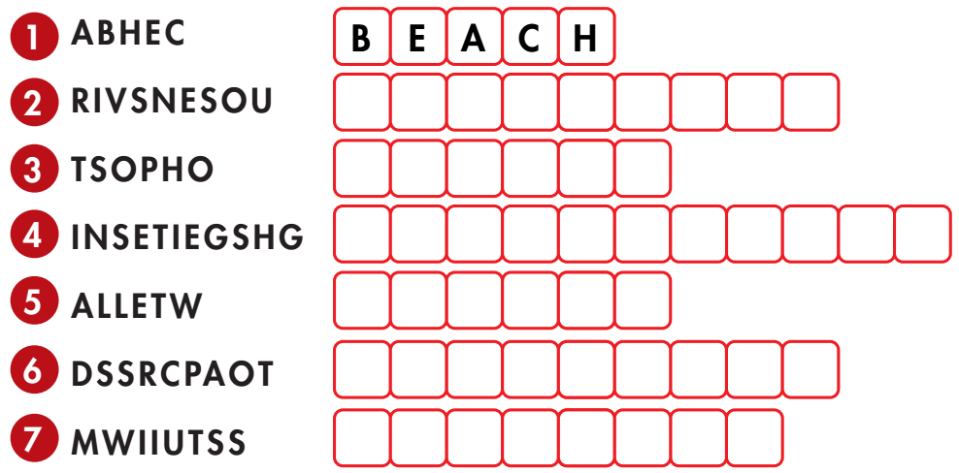
Extra Practice
WB, page 52
Unscramble the words.
S O U V E N I R S
P H O T O S
S I G H T S E E I N G
W A L L E T
P O S T C A R D S
S W I M S U I T

Slide 12
Extra Practice
WB, page 52
c. Fill in the blanks with the words from the previous task.
1. The weather was nice, so we spent a day swimming in the sea and relaxing on the ___________.
2. On the last day, we went to the market and bought ___________. I bought some "I ❤ NYC" T-shirts and a small statue of the Statue of Liberty.
3. I forgot my ___________ and had to ask my brother to lend me some money.
4. I took lots of ___________ during the trip with my new camera.
5. I like to buy ___________ when visiting different cities, but I never write on any of them.
6. My mom bought me a new ___________ because I started having swimming lessons.
7. I want to spend the first day going ___________. I want to see Big Ben, the Tower of London, and Buckingham Palace.
beach
souvenirs
wallet
photos
postcards
swimsuit
sightseeing

Slide 13
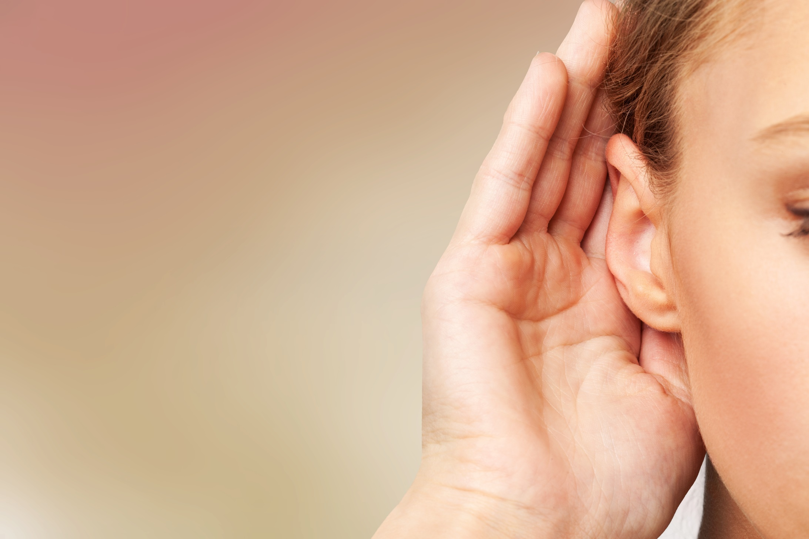

It’s listening time….

Slide 14
Pre - listening
Read the instruction quickly. Underline the key words. What are we going to do?
Listen and answer the question.
a. Listen to Peter and Janet talking about their holidays.
Who enjoyed their holiday more?

Slide 15
While - listening
Click on the icon to hear the sound
Now listen and answer the question.  FIRST TIME
a. Listen to Peter and Janet talking about their holidays.
Who enjoyed their holiday more?
☞ YOUR ANSWER?
☞ WHY?

Slide 16
While - listening
Click on the icon to hear the sound
Now listen again and check.  SECOND TIME
While you are listening, focus on what Peter and Janet talk.
Peter: Hey Janet, how was your holiday in London?
Janet: I had a good time, but on the first day, I lost my wallet.
………..
Janet: I did and they were great! How was your trip to New York?
Peter: It was fantastic. We visited the Statue of Liberty and the Empire State building. Then we went to Central Park. It was really beautiful. The food in New York was great.
☞ THE ANSWER IS …
Peter

Slide 17
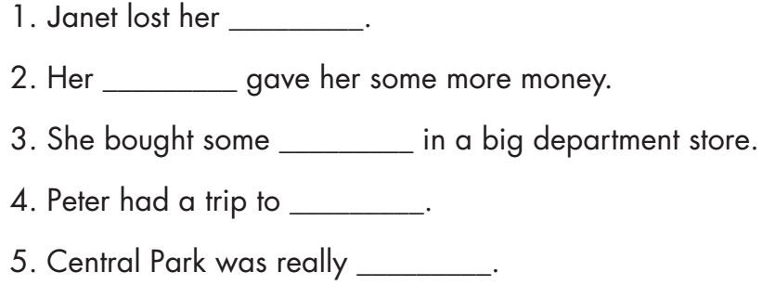
Pre - listening
Read the instruction and questions quickly. Underline the key words. What are we going to do?
Listen and fill in the blanks.

Slide 18
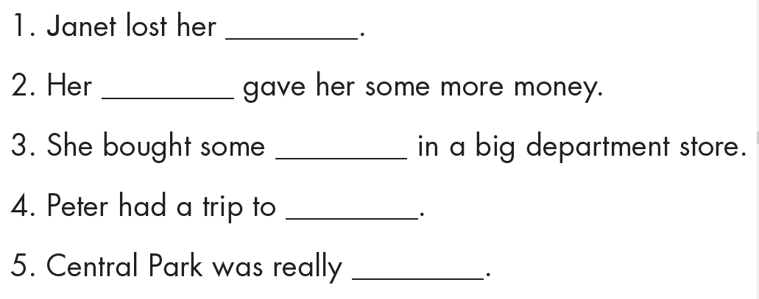
While - listening
Click on the icon to hear the sound
Now listen and fill in the blanks.  FIRST TIME
☞ WHAT ARE YOUR ANSWERS?

Slide 19
While - listening
Click on the icon to hear the sound
Now listen again and check.  SECOND TIME
wallet
mom
souvenirs
New York
beautiful
☞ WHY ARE THESE ANSWERS?

Slide 20


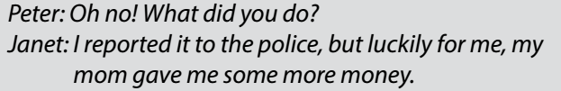

Now listen again and check.  THIRD TIME
While - listening
Click on the icon to hear the sound
wallet
mom
souvenirs

Slide 21
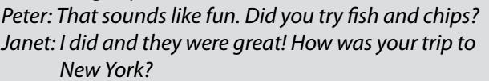

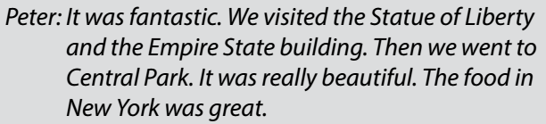
Now listen again and check.  THIRD TIME
Click on the icon to hear the sound
New York
beautiful

Slide 22
Audio - Scripts
Practice the conversation with a partner.
Peter: Hey Janet, how was your holiday in London?
Janet: I had a good time, but on the first day, I lost my wallet.
Peter: Oh no! What did you do?
Janet: I reported it to the police, but luckily for me, my mom gave me some more money.
Peter: How about the rest of your holiday?
Janet: We went sightseeing and I took photos of Big Ben. Then, I bought some souvenirs in a big department store.
Peter: That sounds like fun. Did you try fish and chips?
Janet: I did and they were great! How was your trip to New York?
Peter: It was fantastic. We visited the Statue of Liberty and the Empire State Building. Then we went to Central Park. It was really beautiful. The food in New York was great.
Janet: So, you liked it a lot then?
Peter: Oh yes.
Janet: Well, it was great talking to you.
Peter: You, too! Bye!

Slide 23

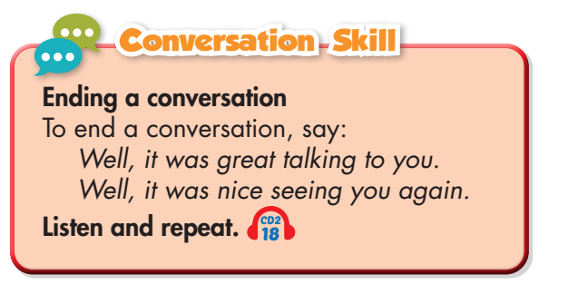
Work in pairs
Post - listening
What did you like most about your last holiday?

Slide 24

FURTHER PRACTICE

Slide 25

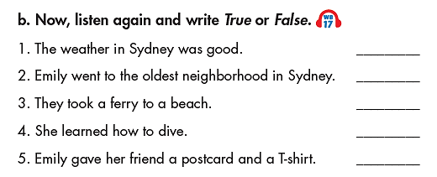
Click on the icon to hear the sound
Extra Practice
WB, page 53
✓
✓
True
True
True
False
False

Slide 26

CONSOLIDATION

Slide 27
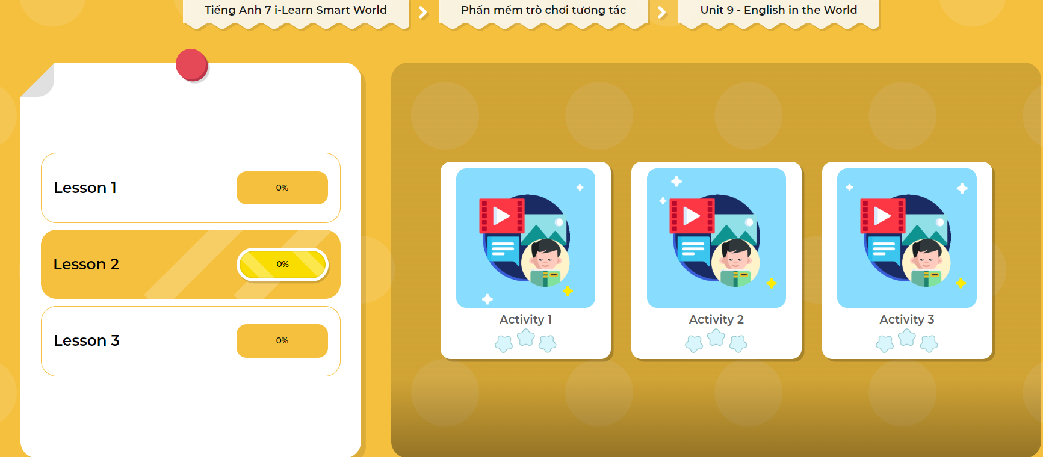
LET’S PLAY!
Click here to play the games!

Slide 28
Write a paragraph about your last holiday. (70 words)

Slide 29

WRAP-UP

Slide 30
Today’s lesson
Vocabularies
souvenir
sightseeing
swimsuit
postcard
photo
beach
wallet

Slide 31
Today’s lesson
Listening:
Listening for main ideas and specific information.
Speaking:
Talking about your last holiday.

Slide 32
Homework
Learn by heart vocabularies and make sentences using them.
Do the Listening exercise in Tiếng Anh 7 i-Learn Smart World Workbook on page 53.
Do the exercises in Tiếng Anh 7 i-Learn Smart World Notebook on page 56.
Prepare the next lesson (page 72 SB).
- Play consolidation games in Tiếng Anh 7 i-Learn Smart World DHA App on www.eduhome.com.vn

Slide 33

Lesson 3
Stay positive and have a nice day!

