Slide 1

Unit 1: Free Time
Lesson 2.3: Pronunciation & Speaking
Page 9

Slide 2




LESSON OUTLINE
Consolidation

Slide 3

By the end of this lesson, students will be able to…
- use intonation for Yes / No questions.
- ask and answer about future plans, using the Present Continuous tense and prepositions of places.
- discuss a plan to join in a free time activity.
- start a friendly conversation.

Slide 4

WARM-UP

Slide 5

Work in pairs.
Choose the word whose main stress is placed
differently from the others.
A. alley B. hobby C. today D. physics
2. A. shopping B. center C. city D. balloon
3. A. present B. extreme C. busy D. early
/ˈæli/
/ˈhɑːbi/
/təˈdeɪ/
/ˈfɪzɪks/
/ˈʃɑːpɪŋ/
/ˈsentər/
/ˈsɪti/
/bəˈluːn/
/ ˈpreznt/
/ɪkˈstri:m/
/ˈbɪzi/
/ˈɜːrli/

Slide 6
Work in pairs.
Choose the word whose underlined part is
pronounced differently from that of the other words.
1. A. town B. south C. north D. cow
2. A. play B. skate C. make D. watch
3. A. kitchen B. helper C. dinner D. center
/taʊn/
/saʊθ/
/nɔːrθ/
/kaʊ/
/plei/
/skeit/
/meik/
/wɑːtʃ/
/ˈkɪtʃən/
/ˈhelpər/
/ˈdɪnər/
/ˈsentər/

Slide 7
Yes/No questions or Wh-questions?
1. Can you talk now?
2. Are you going to the fair tonight?
3. Where should we meet?
4. Is she coming with us?
5. What are you doing tonight?
6. Do you like bowling?

Slide 8



Slide 9
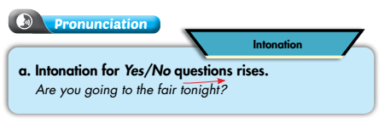


Listen again and repeat.

Slide 10
c. Listen and cross out the sentence that doesn't follow the note in "a.“
Can we meet in front of the park?
Do you like bowling?
d. Read the questions with the rising intonation to a partner.

Slide 11
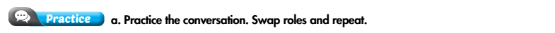
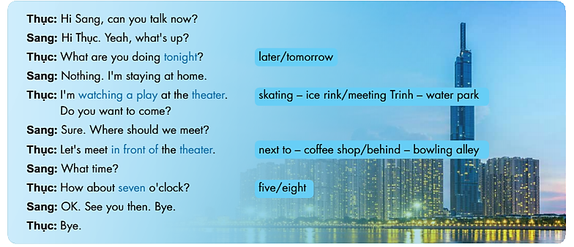

Slide 12

What are you doing at the weekend?
Nothing. I'm staying at home.
I'm going shopping at the shopping mall. Do you want to go with me?
Sure. Where and when should we meet?
Let's meet in front of the shopping mall at 9 a.m.
OK. See you then. Bye.

Slide 13
What are you doing tomorrow?
Nothing. I'm staying at home.
I'm going on a picnic at the park. Do you want to come?
Sure. Where and when should we meet?
Let's meet in front of the park at 8 a.m.
OK. See you then. Bye.

Slide 14
What are you doing on Sunday morning?
Nothing. I'm staying at home.
I'm playing badminton with Jack. Do you want to come?
Sure. Where and when should we meet?
Let's meet at the sports center at 8.30 a.m.
OK. See you then. Bye.

Slide 15

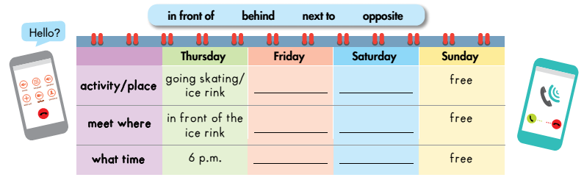
a. You’re inviting your friend to join you in a free time activity. Student B goes to page 118, file 1. Student A writes activities and places in the table, then invites Student B. If he/she can come, discuss where and when to meet and complete the table.
LET’S GO OUT!
Example
?
?
?
?
?
?

Slide 16
Are you free on Thursday?
Yes, I am.
I'm going skating at the ice rink. Do you want to come?
Sure. Where and when should we meet?
Let's meet in front of the ice rink at 6 p.m.
OK. See you then. Bye.

Slide 17
b. Make a new pair. Ask your partner what they arranged to do with their friend, when and where they will meet them.
LET’S GO OUT!

Slide 18

CONSOLIDATION

Slide 19
Write about what you are doing with your friend at the weekend.
When and where you are meeting.
Write about 60-80 words.

Slide 20
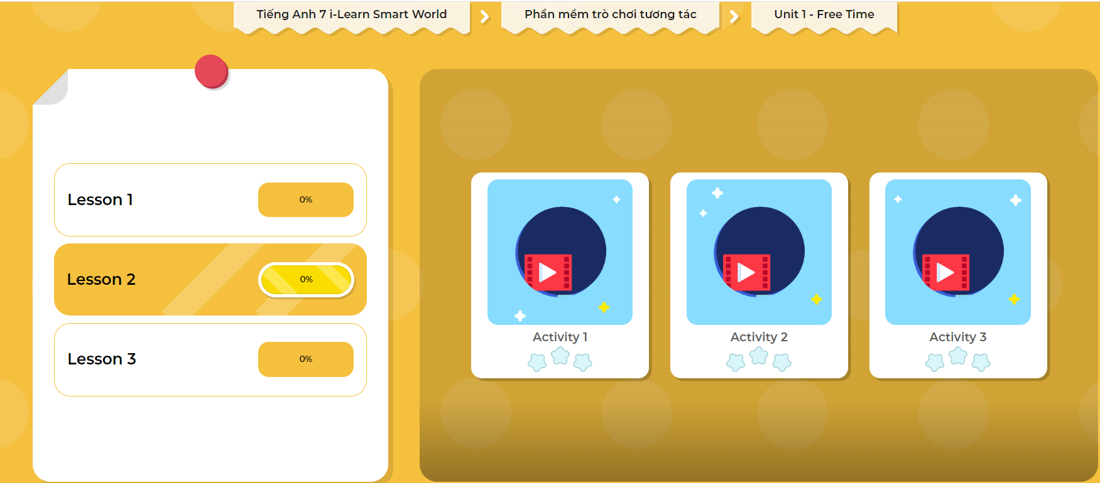
Extra Practice
DHA App
Let’s play!
Click here to play the game

Slide 21

WRAP-UP

Slide 22
Today’s lesson
- Intonation for Yes / No questions: rising.

Slide 23
Homework
Make 2 Yes / No questions, then practice reading them.
Complete the table for those who haven’t finished it in class.
Prepare: Lesson 3 – Listening and Reading (page 10 - SB).
Play the consolidation games in Tiếng Anh 7 i-Learn Smart World DHA App on www.eduhome.com.vn

Slide 24

Lesson 3
Stay positive and have a nice day!

