Slide 1

Welcome to our class

Slide 2







Game: Matching
d
a
1. New Zealand
2. Singapore
3. Canada
e
b
4. The USA
5. The United Kingdom
f
c
6. Australia

Slide 3
Unit 8 (cont): ENGLISH SPEAKING COUNTRIES
period 64: A CLOSER LOOK 1
Vocabulary
1. Write the name for the people who belong to these places. Then listen and repeat the words.
Country | People
1. The USA
2. England
3. Scotland
4. Wales
5. Ireland
6. Canada
7. Australia
8. New Zealand
the Americans
the English
the Scottish / the scots
the Welsh
the Irish
the Canadians
the Australians
the New Zealanders

Slide 4
Unit 8 (cont): ENGLISH SPEAKING COUNTRIES
period 64: A CLOSER LOOK 1
Vocabulary
2. Change the words into a noun (N), an adjective (A) or a verb (V).
N = history
1. historic
2. symbol | V =
3. legend | A=
4. iconic | N=
5. spectacle | A=
6. festive | N=
7. scenery | A=
8. attraction | V=
symbolize
legendary
icon
spectacular
festival
scenic
attract

Slide 5
Unit 8 (cont): ENGLISH SPEAKING COUNTRIES
period 64: A CLOSER LOOK 1
Vocabulary
3. Use the words in the box to complete the sentences.
icon symbolises scenic unique attracts
icon
1. The Golden Gate Bridge in San Francisco is an ...............................of this
famous city.
2. Big Ben is a major monument in London which.................................
the United Kingdom.
3. New Zealand is famous for the.........................................beauty of its
mountains and forests.
4. Australia is home to...........................................animals like the kangaroo
and koala, which are native to Australia.
5. The Glastonbury Festival in England is a celebration of music and it
...........................................thousands of people.
symbolises
scenic
unique
attracts

Slide 6
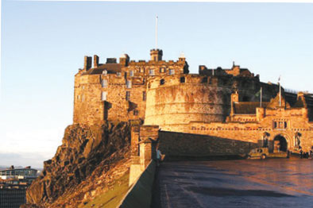
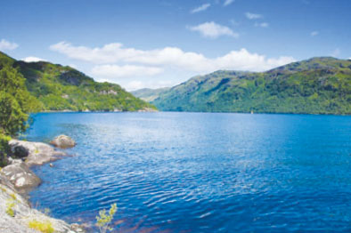
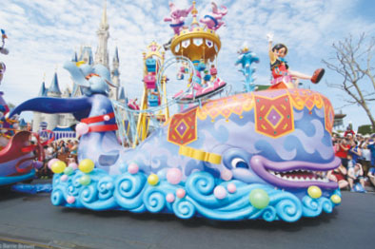
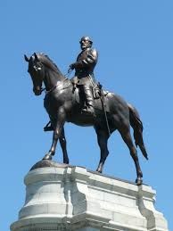
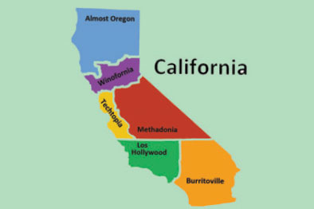
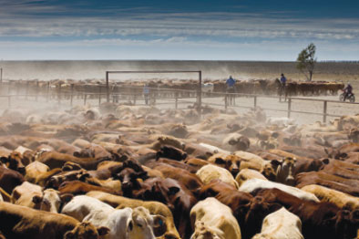
Unit 8 (cont): ENGLISH SPEAKING COUNTRIES
period 64: A CLOSER LOOK 1
Vocabulary
4. Match the words / phrases with the pictures
parade state loch cattle station monument castle
castle
loch
parade
monument
state
cattle station

Slide 7

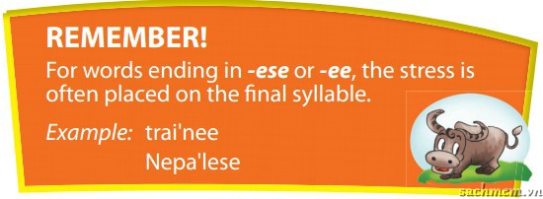
Unit 8 (cont): ENGLISH SPEAKING COUNTRIES
period 64: A CLOSER LOOK 1
Pronunciation
Stress in words ending in –ese and –ee
5. Listen and repeat the words
-ese | -ee
1. Cantonese | 5. employee
2. Taiwanese | 6. adoptee
3. Japanese | 7. addressee
4. Portuguese | 8. interviewee

Slide 8
Unit 8 (cont): ENGLISH SPEAKING COUNTRIES
period 64: A CLOSER LOOK 1
Pronunciation
Stress in words ending in –ese and –ee
6. Mark the stress in the underlined words. Then listen and repeat the sentences.
1. One- fifth of the people in the world are Chinese.
2. A refugee is a person who is forced to leave a country.
3. My daughter is a trainee.
4. Japanese is the language of Japan.
5. This printer has a two year guarantee.

Slide 9
Unit 8 (cont): ENGLISH SPEAKING COUNTRIES
period 64: A CLOSER LOOK 1
Vocabulary
Pronunciation
HOMEWORK
Learn by heart the names of the countries and their people in this lesson.
Prepare for the “A closer look 2”
Do exercises in your workbooks.

