Slide 1

Unit 8: The World around Us
Lesson 2.1: Vocabulary & Reading
Page 65

Slide 2
Lesson Outline
Warm-up
Vocabulary
Reading
Consolidation
Wrap-up

Slide 3
Objectives
By the end of this lesson, students will be able to learn…
Vocabulary: sleeping bag, flashlight, bottled water, tent, battery, pillow, towel
Structure: - What do you use … for?
- To…………………………….
Reading: Reading for specific information

Slide 4

WARM-UP

Slide 5
Word scramble: What is the word? It is an outdoor activity.
Nyakakig
kayaking

Slide 6
Word scramble: What is the word? It is a place.
teiscapm
campsite

Slide 7
Word scramble: What is the word? It is a place.
yocann
canyon

Slide 8
Word scramble: What is the word? It is an outdoor activity.
aitgnfr
rafting

Slide 9
Word scramble: What is the word? It is an outdoor activity.
iikhgn
hiking

Slide 10
Word scramble: What is the word? It is a place.
eavc
cave

Slide 11

New words
sleeping bag, flashlight, bottled water, tent, battery, pillow, towel

Slide 12

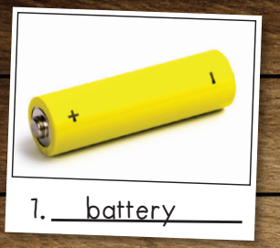
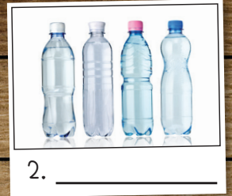
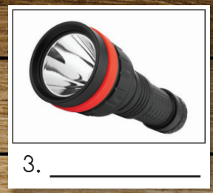
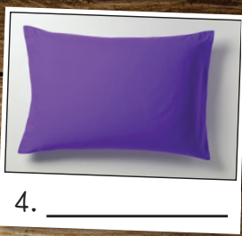
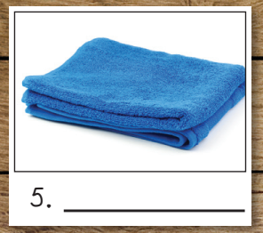
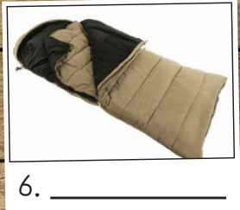
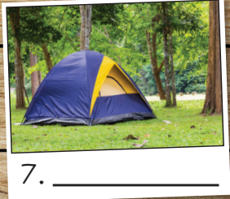
Click each picture to hear the sound.
sleeping bag flashlight bottled water tent battery pillow towel
bottled water /ˈbɒtld ˈwɔːtər/
flashlight/ˈflæʃlaɪt/
pillow /ˈpɪləʊ/
sleeping bag /ˈsliːpɪŋ bæɡ/
towel /ˈtaʊəl/
tent /tent/
Notes:
Click vào từng hình để nghe

Slide 13
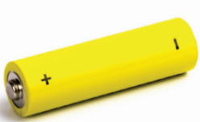
battery
SHOW

Slide 14
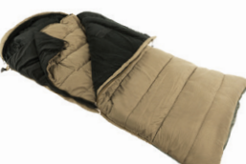
sleeping bag
SHOW

Slide 15
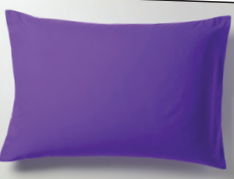
pillow
SHOW

Slide 16
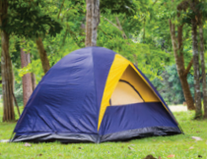
tent
SHOW

Slide 17
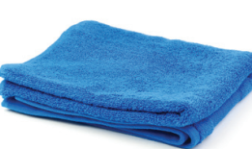
towel
SHOW

Slide 18
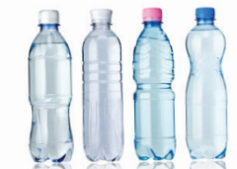
bottled water
SHOW

Slide 19
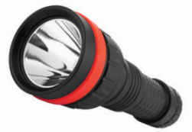
flashlight
SHOW

Slide 20
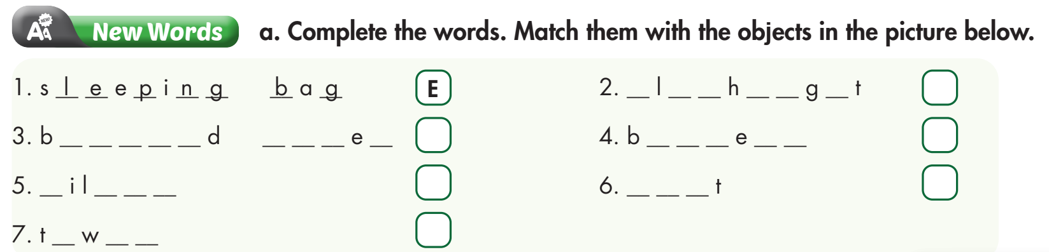
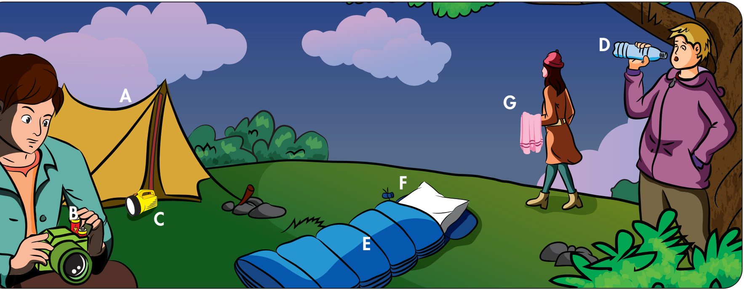
C
D
B
F
A
G
3. bottled water
Workbook, page 46
6. tent
7. towel
4. battery
5. pillow
2. flashlight
1. sleeping bag

Slide 21

towel
1. You should bring a ___________________. You'll be wet after going rafting.
2. We need to bring a ___________________ so we have somewhere to stay.
3. I will sleep in a ___________________ so I don't get cold at night.
4. I have a really soft ___________________ and blanket on my bed.
5. We should bring ___________________ so we have something to drink.
6. My camera doesn't have a big ___________________. I will bring an extra so we can take lots of photos.
7. We need a ___________________ so we can see when it's dark.
tent
sleeping bag
pillow
bottled water
battery
flashlight

Slide 22
Structures
What do you use … for?
To ………………

Slide 23

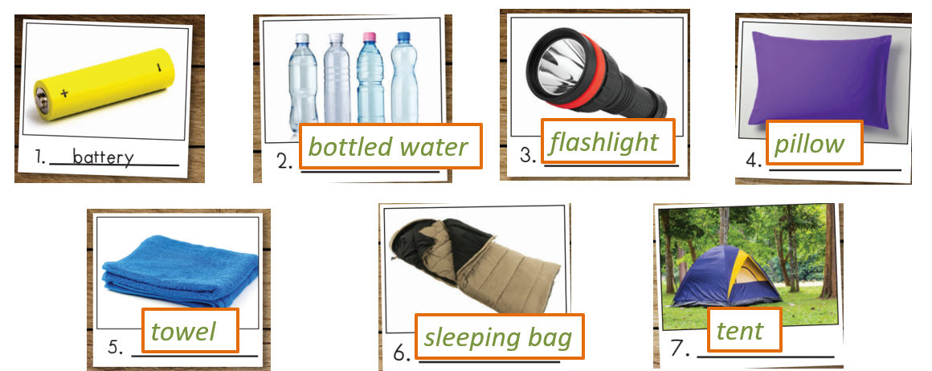
What do you use a flashlight for?
To see when it's dark.

Slide 24
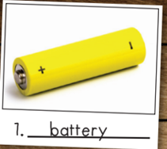
battery
What do you use a ___________ for?
take lots of photos
To _________________.

Slide 25
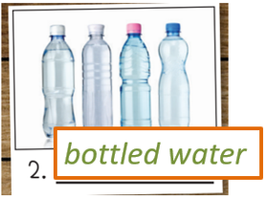
bottled water
What do you use a _______________ for?
have something to drink
To _________________.

Slide 26
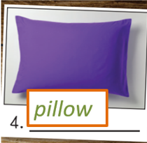
pillow
What do you use a ___________ for?
have something to sleep
To ________________________.

Slide 27
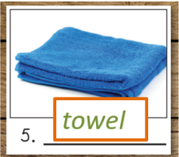
towel
What do you use a ___________ for?
use after going rafting
To ________________________.

Slide 28
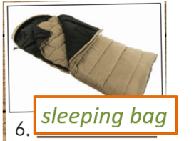
sleeping bag
What do you use a _____________ for?
sleep when it’s cold at night
To ________________________.

Slide 29
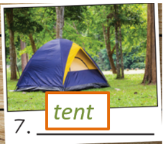
tent
What do you use a ___________ for?
have somewhere to stay
To ________________________.

Slide 30

Reading

Slide 31
Pre-Reading
Work in pairs and discuss.
What do people often bring on a camping trip?

Slide 32

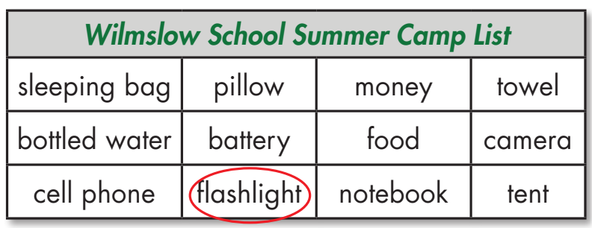
While-Reading
a. Two friends are messaging about their camping trip. Circle the things on the list Jill and Dave need to bring.

Slide 33
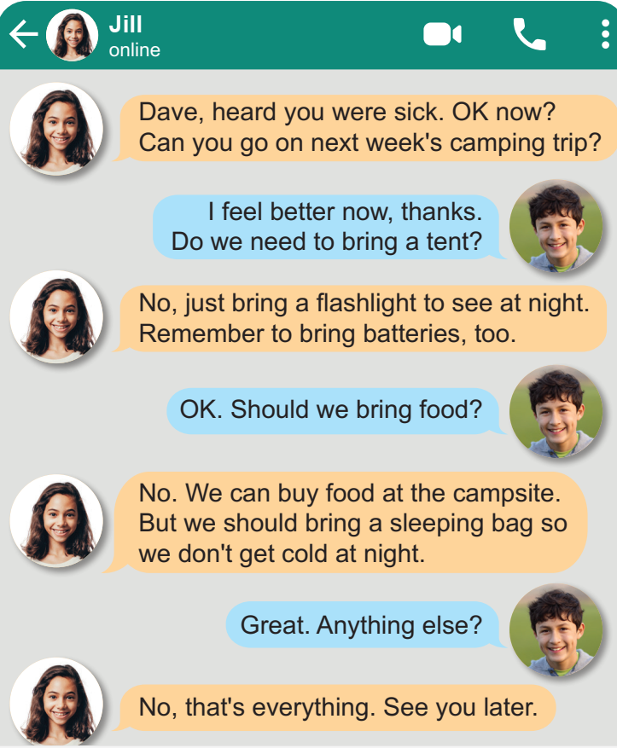
a. Two friends are messaging about their camping trip. Circle the things on the list Jill and Dave need to bring.

Slide 34
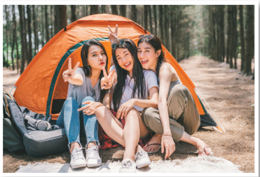
While-Reading
b. Read the messages again and answer the questions.
1. When is their camping trip?
__________________________________
2. What was wrong with Dave?
__________________________________
3. What do they need for their flashlight?
__________________________________
4. What don't they need to bring?
__________________________________
Next week
He was sick.
They need batteries.
They don’t need to bring any food.

Slide 35
Post-Reading
Work in pairs and discuss.
What do you and your friends need to bring on a camping trip? Why?

Slide 36

CONSOLIDATION

Slide 37
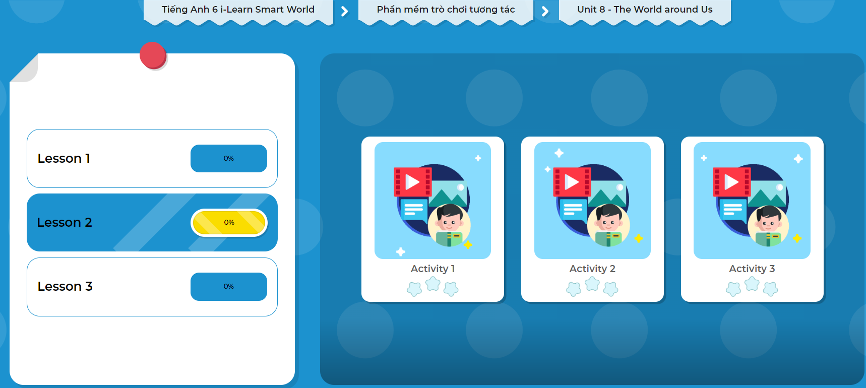
Extra Practice
DHA App
LET’S PLAY!
Click the picture below to play the games!

Slide 38

WRAP-UP

Slide 39
Today’s lesson
Vocabularies
sleeping bag
flashlight
bottled water
tent
battery
pillow
towel
Structures/ Sentence patterns:
What do you use … for?
To ………………
Reading:
Reading for specific information

Slide 40
Homework
Learn by heart vocabularies and make sentences using them.
Do the exercises on page 46 WB.
Do the exercises in Tiếng Anh 6 i-Learn Smart World Notebook on page 48.
Prepare the next lesson (page 66 - SB).
Play the consolidation games in Tiếng Anh 6 i-Learn Smart World DHA App on www.eduhome.com.vn

Slide 41
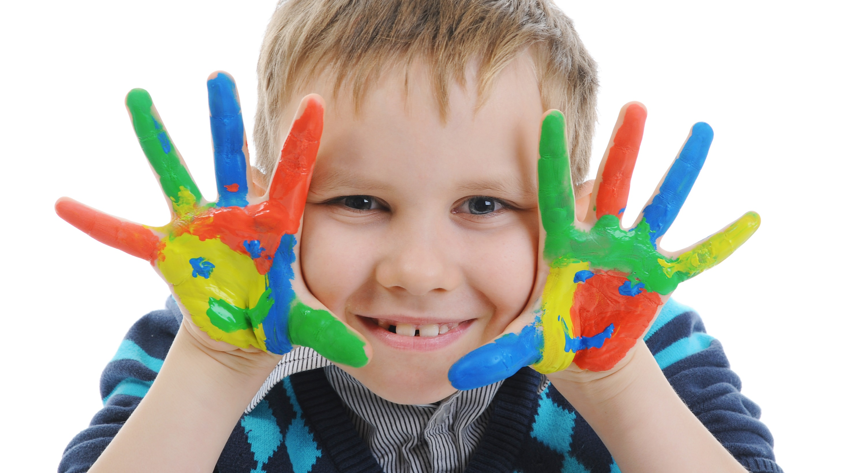
Enjoy your day!

