Slide 2
Unit
10
The ecosystem
Unit
FAMILY LIFE
LESSON 2
LANGUAGE

Slide 3
LESSON 2
LANGUAGE
WARM-UP
Categorizing game
Task 1: Listen and practise in pairs.
Task 2: Listen and mark the intonation in the question tags.
PRONUNCIATION
Task 1: Match the words with their meanings
Task 2: Complete the sentences using the words in Task 1
VOCABULARY
Task 1: Use the words in the box to make five compound nouns
Task 2. Use the words in the box to make compound nouns. Then make sentences with them.
GRAMMAR
Wrap-up
Homework
CONSOLIDATION

Slide 4
WARM-UP
CATEGORIZING GAME
- Work in groups.
- Put plants and animals into correct categories.
- The first team to complete the task correctly is the winner.
- The winners go to the board and show the correct answers.

Slide 5
WARM-UP
Put plants and animals into correct categories.
salmon parrot ant wasp dolphin
human butterfly mushroom cactus palm
squirrel daisy bamboo oak deer
lobster peacock eagle hedgehog marigold
orchird owl daffodil squid oyster
bat seagull crow snail beetle
worm poopy lily seaweed trout octopus
Mammals | Birds | Insects and invertebrates | Flowers | Trees and other plants | Sea and river creatures

Slide 6
WARM-UP
Put plants and animals into correct categories.
Mammals | Birds | Insects and invertebrates | Flowers | Trees and other plants | Sea and river creatures
human squirrel hedgehog deer bat dolphin | seagull crow owl eagle peacock parrot | wasp butterfly snail beetle worm ant | marigold orchird daffodil poppy lily daisy | cactus palm bamboo oak seaweed mushroom | lobster squid trout octopus oyster salmon

Slide 7
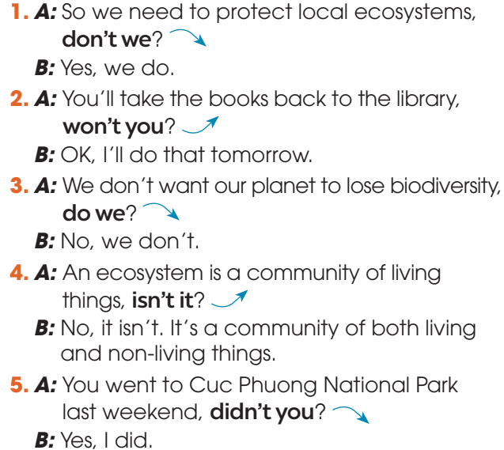
PRONUNCIATION
1
Listen to these conversations. Pay attention to the intonation of the question tags. Then practise saying them in pairs

Slide 8
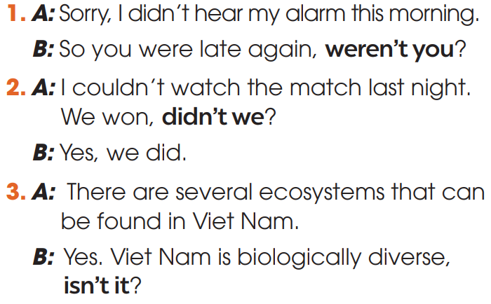
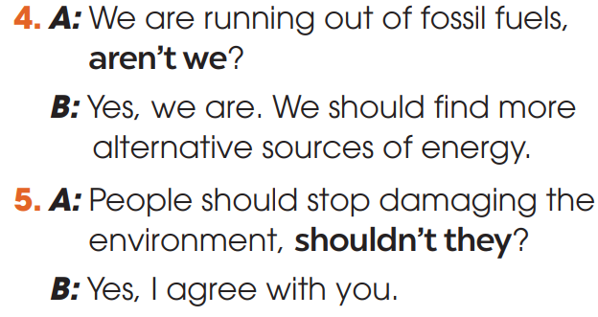
PRONUNCIATION
2
Mark the intonation in the question tags, using falling intonation or rising intonation. Then practise saying the conversations in pairs

Slide 9
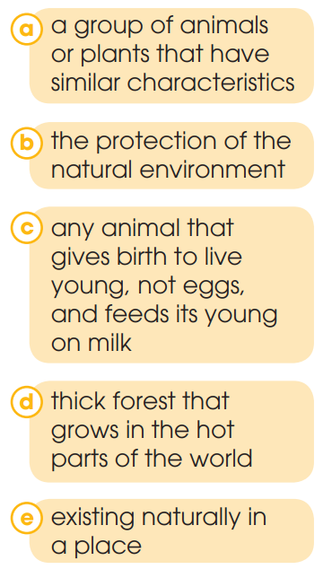
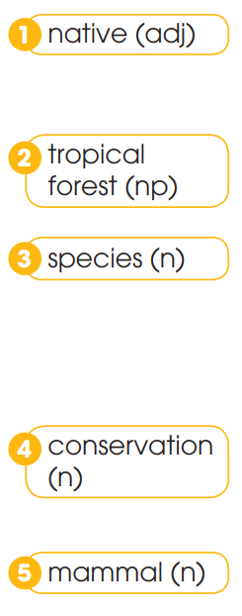
VOCABULARY
1
Match the words with their meanings

Slide 10
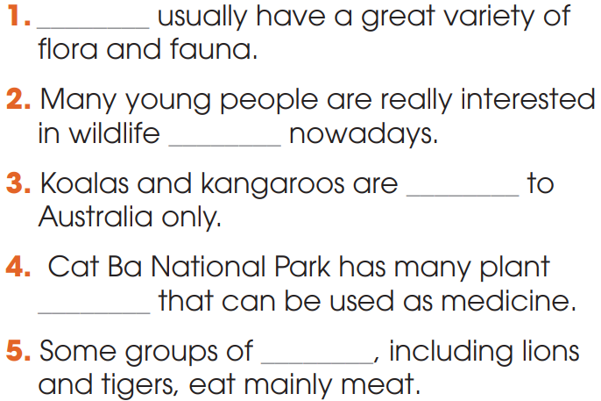
VOCABULARY
2
Complete the sentences using the words in Task 1
1. Tropical forests
2. conservation
3. native
4. species
5. mammals

Slide 11
GRAMMAR
A compound noun is a noun that is made with two or more words. It is usually formed by:
1. noun + noun | E.g: bus stop
2. adj + noun | E.g: wildlife
3. V-ing + noun | E.g: washing machine
4. noun + V-ing | E.g: film-making
5. verb + preposition | E.g: break-out

Slide 12
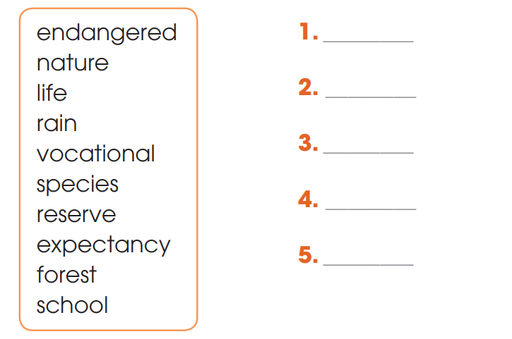
GRAMMAR
1
Use the words in the box to make five compound nouns.
endangered species
life expectancy
rainforest
nature reserve
vocational school

Slide 13
GRAMMAR
2
Work in pairs. Use the words in the box to make compound nouns. Then make sentences with them.
wildlife sea level
swimming pools mobile phone

Slide 14
CONSOLIDATION
1
Wrap-up
What have you learnt today?
Some lexical items about the ecosystem;
Intonation in question tags;
Compound nouns.

Slide 15
CONSOLIDATION
2
Homework
Do exercises in the workbook.
Prepare for Lesson 3 - Unit 10.

Slide 16
Website: hoclieu.vn
Fanpage: facebook.com/sachmem.vn/

