Slide 1

Unit 4: All things high-tech
Lesson: Right on!
Page 75

Slide 2
Lesson Outline
Warm-up
Project
Consolidation
Wrap-up

Slide 3
Objectives
By the end of this lesson, students will be able to…
- prepare a leaflet about the Dos and Don’ts of using smartphones.
- give a presentation on smartphone etiquette.
- talk about the value of online etiquette.

Slide 4

WARM-UP

Slide 5

Work in pairs.
Choose the word whose main stress is placed
differently the others.
1. A. entrance B. birthday C. browser D. today
2. A. open B. behave C. decide D. affect
3. A. select B. connect C. compete D. listen
/ˈentrəns/
/ˈbɜːθdeɪ/
/ˈbraʊzər/
/təˈdeɪ/
/ˈəʊpən/
/bɪˈheɪv/
/dɪˈsaɪd/
/əˈfekt/
/sɪˈlekt/
/kəˈnekt/
/kəmˈpiːt/
/ˈlɪsən/

Slide 6
Choose the word whose underlined part is pronounced differently
from that of the other words.
1. A. go B. work C. post D. show
2. A. bank B. game C. day D. age
3. A. alien B. strategy C. newsagent D. bravery
/ɡəʊ/
/wɜːk/
/pəʊst/
/ʃəʊ/
/bæŋk/
/ɡeɪm/
/deɪ/
/eɪdʒ/
/ˈeɪliən/
/ˈstrætədʒi/
/ˈnjuːzeɪdʒənt/
/ˈbreɪvəri/

Slide 7

It’s time to learn …

Slide 8

Presentation

Slide 9
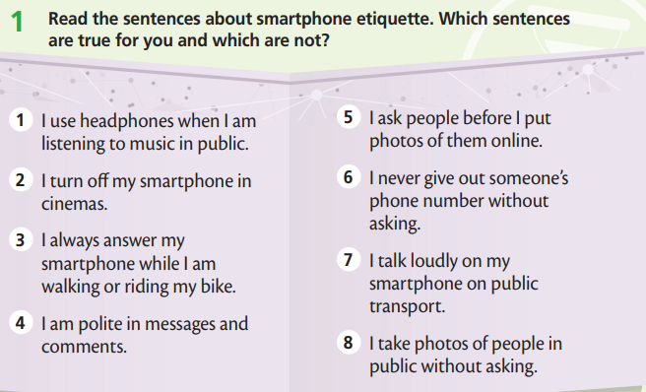
What are the sentences about?
- Smartphone etiquette.
What are you going to do?
- Read and choose which sentences are true and not true for us.

Slide 10
1 Which sentences are true for you and which are not?
1. I use headphones when I am listening to music in public.
2. I turn oﬀ my smartphone in cinemas.
3. I always answer my smartphone while I am walking or riding my bike.
4. I am polite in messages and comments.
5. I ask people before I put photos of them online.
6. I never give out someone’s phone number without asking.
7. I talk loudly on my smartphone on public transport.
8. I take photos of people in public without asking.

Slide 11
Suggested Answer Key
Sentences 1, 2 and 7 are true for me. This shows that I have good smartphone etiquette and I think for the people around me when I’m using my smartphone.

Slide 12

Practice

Slide 13

2 Work in groups. Use the ideas in Exercise 1 to create a leaﬂet about the Dos and Don’ts of using smartphones. Use photos or drawings.
What are you going to create?
A leaﬂet about the Dos and Don’ts of using smartphones.
What are you going to use?
Photos or drawings.

Slide 14

Smartphone etiquette
DOs
• use headphones when you are listening to music in public.
• turn off your smartphone in cinemas.
• be polite in messages and comments.
• ask people before you put photos of them online.

Slide 15
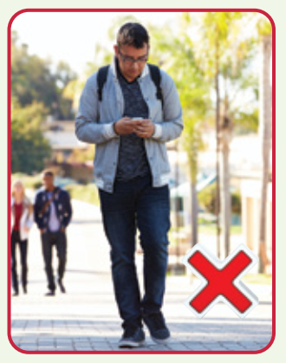
Smartphone etiquette
DON’Ts
• look at your smartphone while you are walking.
• give someone’s phone number without asking.
• talk loudly on your smartphone on public
transport.
• take photos of people in public without asking.

Slide 16
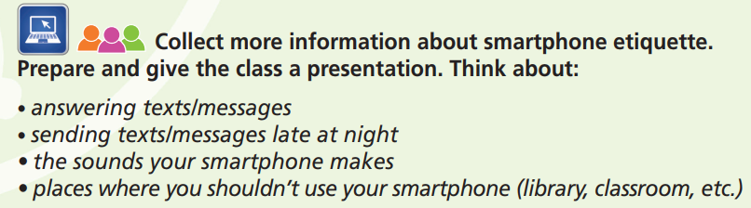
What are you going to collect?
More information about smartphone etiquette.
What are you going to do?
Prepare and give a presentation.

Slide 17
Suggested Answer Key
Today, I’m going to talk about smartphone etiquette.
Firstly, you shouldn’t respond to texts or calls at some times. For example, when you are driving or riding your bicycle, it’s too dangerous.
Secondly, don’t use your mobile phone in some places. For example, never use your smartphone in the library or a classroom.
Thirdly, don’t send texts or messages late at night. Remember that some people go to sleep early! Finally, try not to pick an annoying ringtone.
Also, think about turning the volume of your ringtone down, or even switching to vibrate when you are in public. So remember – be smart when you use your smartphone. Think about others. Thanks for listening.

Slide 18

Production

Slide 19
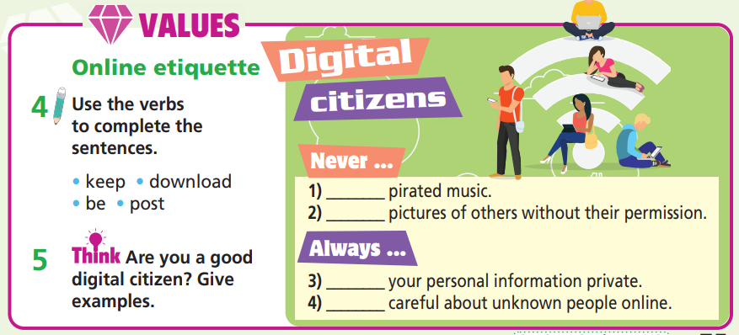
How many statements are there?
→ There are four.
What are you going to do?
→ Use the verbs
to complete the sentences.

Slide 20

Online etiquette
Digital citizens
Never ...
1) ________ pirated music.
2) ________ pictures of others without their permission.
Always ...
3) ________ your personal information private.
4) ________ careful about unknown people
download
post
keep
be

Slide 21

Are you a good digital citizen? Give examples.
Suggested Answer Key
I think I am a good digital citizen because I never download pirated music. It’s against the law. I never post pictures of others without their permission because they might not want their faces to appear on the Internet. Also, I always keep my personal information private and I never give strangers information about my personal life. I am always careful about unknown people online because they might not be good.

Slide 22

CONSOLIDATION

Slide 23

Work in pairs.
Ask and answer about smartphone etiquette.

Slide 24
STUDENT A
STUDENT B
What do you do when using smartphone?
I turn off my smartphone in
cinemas.
What else?
I am polite in messages and comments.
I don’t look at my smartphone
while I’m walking.
What don’t you do?
And?
I don’t talk loudly on my smartphone on public transport.

Slide 25

WRAP-UP

Slide 26
Today’s lesson
- Develop research skills.
- Develop public speaking skills.

Slide 27
Homework
Prepare the next lesson (page 76 SB).

Slide 28
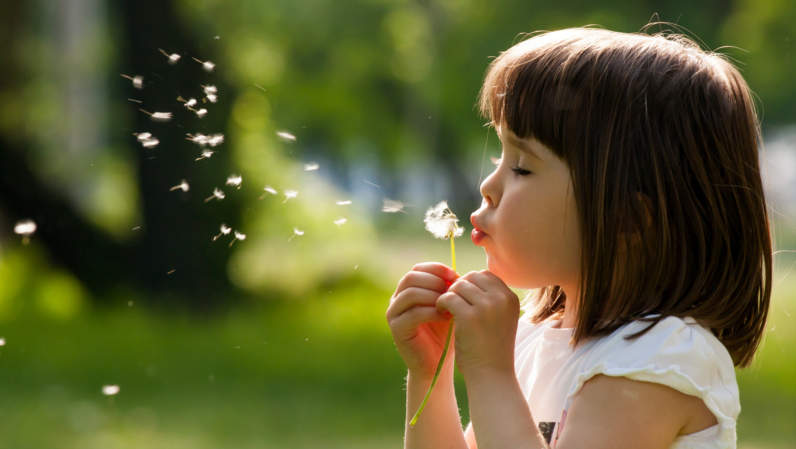
Enjoy your day!

