Slide 1


Welcome to our class

Slide 2
Unit 3: Peoples of Viet Nam
Lesson 7: Looking back + Project

Slide 3
Vocabulary
1. Complete the sentences with the words/ phrases from the box.
costumes activities ethnic diverse
unique communal cultural groups
cultural groups
At the Museum of Ethnology, you can see many ways of life of different _______________ in our country.
In each village of the Bahnar there is a _______________ house, where public _______________ are held.
Young women of each ethnic group in Viet Nam have their own characteristics and _______________, making the beauty of the 54 ethnic groups more _______________ and attractive.
Many special schools have been built to improve the education standards of _______________ people.
Although ethnic groups have their own _______________ culture, they have established good relations and cooperation with each other.
communal
activities
costumes
diverse
ethnic
unique

Slide 4
2. Use the correct form of the words in brackets to finish the sentences.
Everywhere in our country we can find elements of the (culture) _______________ values of different ethnic groups.
The peoples of Viet Nam are diverse but very (peace) _______________.
The Muong in Hoa Binh are well-known for the (rich) _______________ of their folk literature and traditional songs.
The exhibition in the museum shows the (diverse) _______________ of different cultural groups.
The Raglai people have a (tradition) _______________ musical instrument made of bamboo called the chapi.
cultural
peaceful
richness
diversity
traditional

Slide 5
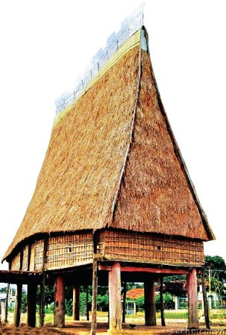
3. Make questions for the underlined parts in the passage.
Most of the ethnic minority peoples in the Central Highlands live in stilt houses. These houses are built on columns and beams. They have two or four roofs, and some have decorations on the peaks and the sides. The entrance is on the side.
The communal house is usually the largest, tallest and most elaborate building in the village. It is used for village meetings, receiving guests, or as a place of worship, and village festivities. Single men can sleep in this house.

Slide 6

What are these houses built on?
1……………………………………………………………………
2. …………………………………………………………………..
3. …………………………………………………………………..............................................
4. …………………………………………………………………..
5. …………………………………………………………………..
Where is the entrance?
Which house is the largest, tallest and most elaborate building in the village?
What is it used for?
Who can sleep in this house?

Slide 7
4. Each sentence has an error. Find and correct it.
1. They travel to a nearest town to go shopping.
2. Some ethnic minority children of this region are studying at the boarding school in a city.
3. Although they speak different languages, an ethnic groups in this region live near to one another.
4. In the past, some ethnic groups lived the semi-nomadic life.
5. All an ethnic peoples of Viet Nam have equality in every field.
key
a → the
a → the
an → the
the → a
an → the

Slide 8
5. Fill each gap with a, an, or the to complete the passage.
If you are in Ha Noi and you want to have (1) ______ overview of the ethnic groups of Viet Nam, you should visit the Museum of Ethnology. It is situated in Nguyen Van Huyen Street, Cau Giay District. The Museum is (2) ______ valuable centre for the exhibition and preservation of the cultural heritage of (3) ______ 54 ethnic groups in the whole country. There are thousands of objects and photographs representing ways of life and creative activities of these peoples. Moreover, typical houses have been taken from their original sites and rebuilt in (4) ______ museum gardens. These house model (5) ______ traditional architecture of ethnic minorities. The museum also has a lot of information about all (6) ______ different ethnic peoples in Viet Nam.
an
a
the
the
the
the

Slide 9

communication
6. GAME:
CULTURAL KNOWLEDGE CHALLENGE
Work in pairs. See how much you can remember about the cultural groups of Viet Nam. Take turns to ask each other questions about the topic. The person asking can look at the book. The first person to get five correct answers is the winner.

Slide 10

Example:
A: Are you ready?
B: Yes.
A: What is the population of the largest ethnic group?
B: About 74 million. It’s the Viet or Kinh.
A: Very good! Your turn.
B: OK. What is the population of the smallest group?
A: I think it's about 400 people. It’s the Odu group.
B: Exactly!

Slide 11
Finished! Now I can... | ✔ | ✔✔ | ✔✔✔
talk about different ethnic groups ask and answer different question types use articles: a, an, and the pronounce words containing clusters /sk/, /sp/, and /st/ correctly in isolation and in sentences write a paragraph about how to cook a traditional dish

Slide 12
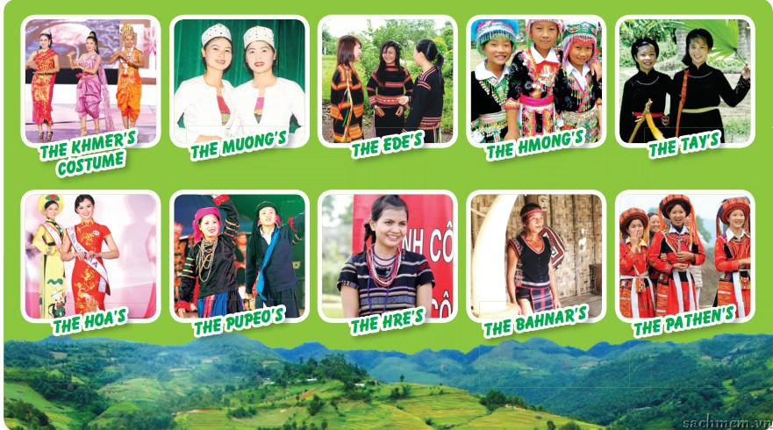
PROJECT
1. Look at the different costumes of some ethnic groups. Which costume do you like best? Why?
Ethnic Fashion Show!

Slide 13
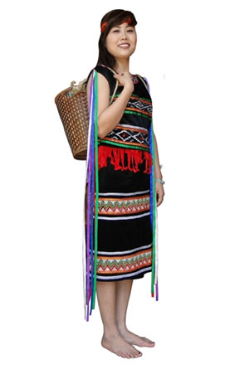
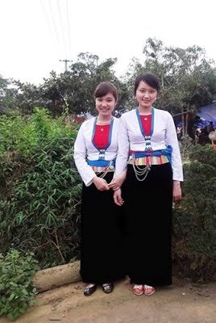
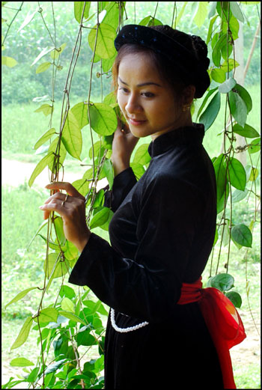
2. Design a costume based on an ethnic style you like, using cardboard, paper or cloth, and colours.
Ede
Muong
Tay

Slide 14
3. Organise an exhibition of the costume designs you have made among your group or class members. Talk about them.

Slide 15


