Slide 2
Unit 7
The world of mass media
LESSON 4
SPEAKING
Types of mass media

Slide 3
LESSON 4
SPEAKING
WARM-UP
Guessing game
- Task 1: Discuss and complete the table.
- Vocabulary
- Task 2: Discuss the most suitable type of media
CONTROLLED PRACTICE
LESS-CONTROLLED PRACTICE
- Task 3: Report the discussion
CONSOLIDATION
- Wrap-up
- Homework

Slide 4
WARM-UP
Guessing game
- Work as two groups.
- There are four questions, the answers of which provide four clues for the key word.
- Choose and answer the question.
- If you have a correct answer ➔ one point.
- If a team can guess the key word ➔ 5 points.
- The team with more points is the winner.

Slide 5

WARM-UP
WARM-UP
Answer the question in each puzzle.
1
2
3
4

Slide 6
WARM-UP
WARM-UP
Question 1
It’s an international computer network connecting other networks and computers that allows people to share information around the world.
What is it?
➔ (the) Internet
BACK

Slide 7
WARM-UP
WARM-UP
Question 2
It’s a piece of electrical equipment with a screen on which you can watch programmes with moving pictures and sounds.
What is it?
➔ TV/ television
BACK

Slide 8
WARM-UP
WARM-UP
Question 3
It’s a piece of equipment used for listening to programmes that are broadcast to the public. What is it?
➔ radio
BACK

Slide 9
WARM-UP
WARM-UP
Question 4
It’s a set of large printed sheets of paper containing news, articles, advertisements, etc. and published every day or every week.
What is it?
➔ printed newspaper
BACK

Slide 10

WARM-UP
WARM-UP
KEY WORD: MASS MEDIA

Slide 11
CONTROLLED PRACTICE
Work in pairs. Discuss the different types of mass media. Make notes in the table below.
1
 | Cost of creating content and advertising on it | Presentation style | audience and publicity | Reliable sources/ credible content
Television | Very high | Audio and visual | Very large | Generally reliable/credible
Printed newspapers
Leaflets and brochures
Emails
Social media

Slide 12
CONTROLLED PRACTICE
Work in pairs. Discuss the different types of mass media. Make notes in the table below.
1
 | Cost of creating content and advertising on it | Presentation style | Audience and publicity | Reliable sources / credible content
Television | Very high | Audio and visual | Very large | Generally reliable/credible
Print newspapers | Generally high | Visual only | Large | Generally reliable/credible
Leaflets and brochures | Not very high | Visual only | Medium | Not very reliable/credible
Emails | Free | Audio and visual | Large | Not very reliable/credible
Social media | Medium | Audio and visual | Very large | Not very reliable/credible

Slide 13


VOCABULARY
leaflet (n)
/ˈliːflət/
a printed sheet of paper or a few printed pages that are given free to advertise or give information about something

Slide 14

VOCABULARY
brochure (n)
/ˈbrəʊʃə(r)/
a small magazine or book containing pictures and information about something or advertising something

Slide 15

VOCABULARY
promotion (n)
/prəˈməʊʃn/
activities done in order to increase the sales of a product or service; a set of advertisements for a particular product or service

Slide 16
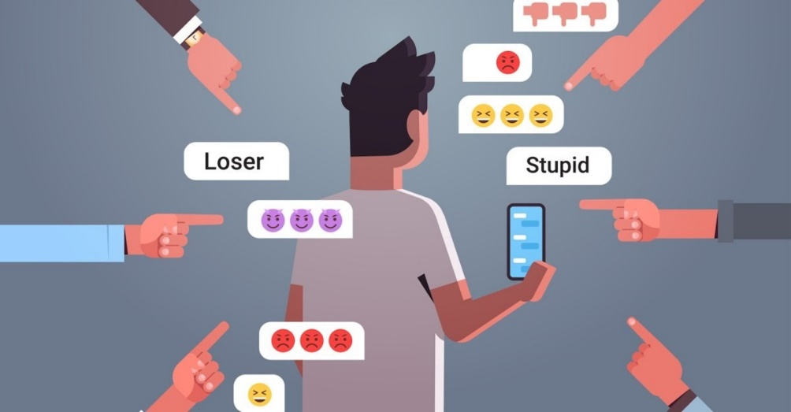
VOCABULARY
cyberbullying (n)
/ˈsaɪbəbʊliɪŋ/
the activity of using messages on social media, emails, text messages, etc. to frighten or upset somebody

Slide 17
VOCABULARY
Form | Pronunciation | Meaning | Vietnamese equivalent
1. leaflet (n) | /ˈliːflət/ | a printed sheet of paper or a few printed pages that are given free to advertise or give information about something | tờ rơi
2. brochure (n) | /ˈbrəʊʃə(r)/ | a small magazine or book containing pictures and information about something or advertising something | sách (nhỏ) quảng cáo
3. promotion (n) | /prəˈməʊʃn/ | activities done in order to increase the sales of a product or service; a set of advertisements for a particular product or servi | sự xúc tiến
4. cyberbullying (n) | /ˈsaɪbəbʊliɪŋ/ | the activity of using messages on social media, emails, text messages, etc. to frighten or upset somebody | bắt nạt qua mạng

Slide 18
CONTROLLED PRACTICE
Work in groups. Discuss the following situations and decide on the most suitable type of media to use in each situation. Provide reasons for your choice.
2
1. Your school’s music club is organising a small concert. You want to promote the event and expect an audience of 30-50 people.
Example:
A: I think we should write an event promotion email and send it to 100 people. I assume 30 per cent of them will show some interest.
B: Email is free of charge, but many people think email advertising or marketing is not credible. So I’m afraid they won’t pay much attention to email messages.
C: How about promoting it on social media? We can choose several social networks and create an event page for each one.
…….

Slide 19
CONTROLLED PRACTICE
Work in groups. Discuss the following situations and decide on the most suitable type of media to use in each situation. Provide reasons for your choice.
2
2. Your school’s social awareness club wants to raise awareness of cyberbullying among teenagers. You have some information and videos you want to share with as many students at your school as possible.
3. Your charity club is collecting books and winter clothes for children in disadvantaged areas. You want to inform as many people as possible about the activity.

Slide 20
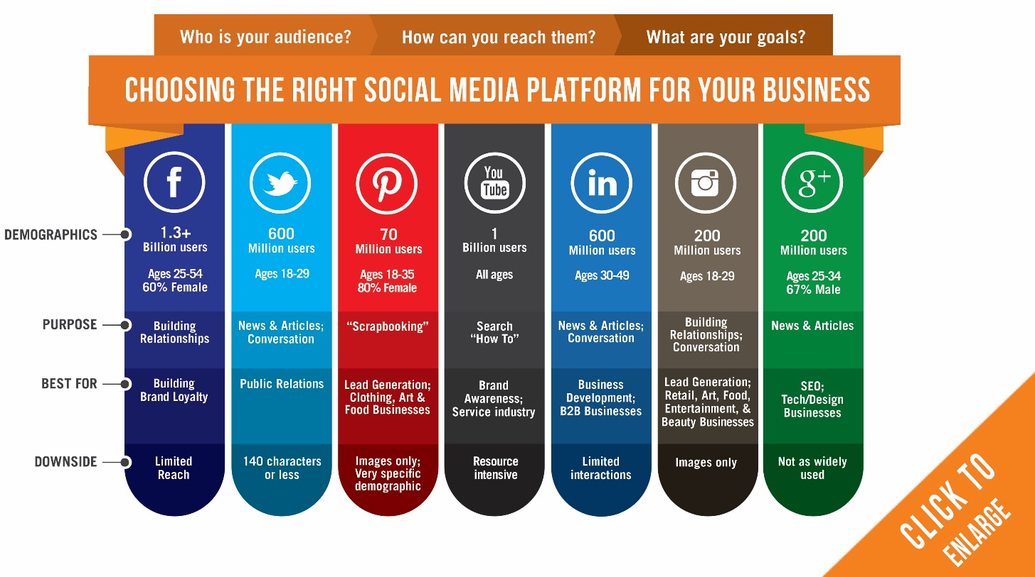
LESS-CONTROLLED PRACTICE
Report your answers to the whole class. Vote for the best idea for each situation.
3

Slide 21
CONSOLIDATION
1
Wrap-up
What have you learnt today?
An overview about different mass media types;
Vocabulary to talk about different mass media types.

Slide 22
CONSOLIDATION
2
Homework
- Do exercises in the workbook.
- Prepare for the next lesson – Listening.

Slide 23
Website: hoclieu.vn
Fanpage: facebook.com/www.tienganhglobalsuccess.vn

