Slide 1

UNIT 3: SHOPPING
Lesson 2.1 – Vocabulary & Listening
Page 23

Slide 2




Lesson 2.1
Unit 3 Lesson 2.1
LESSSON OUTLINE
Consolidation

Slide 3

Unit 3 Lesson 2.1
By the end of this lesson,
students will be able to:
- to practice and learn vocabulary related to complaints
- to practice listening for specific information
- to practice functional English (Finding the right person to speak)

Slide 4
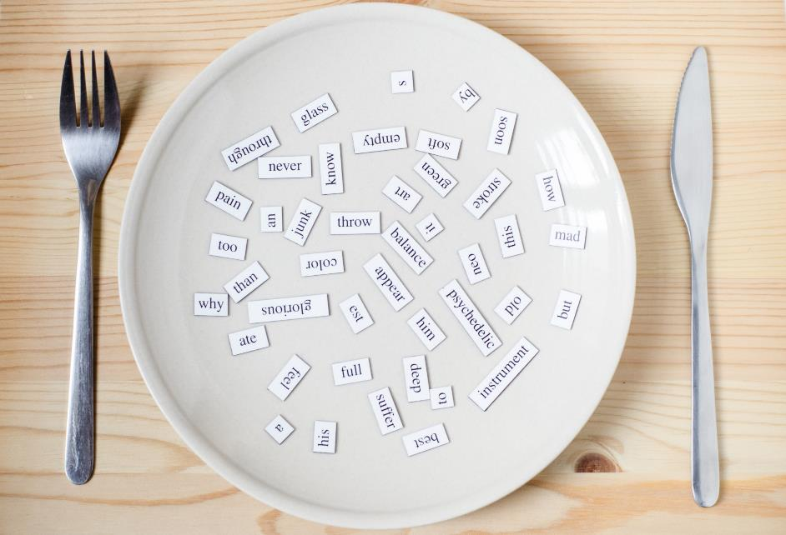
Unit 3 Lesson 2.1
New words
disconnect
overheat
receipt
warranty
restart
repair
crash

Slide 5


Unit 3 Lesson 2.1

Slide 6

Unit 3 Lesson 2.1
Work in pairs.
What do you do when the items you have just bought don’t work?
I will take it to the store that I bought it

Slide 7


Unit 3 Lesson 2.1

Slide 8


Unit 3 Lesson 2.1
a. Match the underlined words to the definitions. Listen and repeat.
a. Disconnect the old screen and connect the new one.
b. It might overheat if you use it for too long. If it does, let it cool down before you use it again.
c. Please keep your receipt. You'll need it if you want to return your laptop.
d. This TV comes with a two-year warranty. During that time, we'll fix it for free.
e. Why don't you restart your laptop? Sometimes it solves the problem.
f. My calculator has stopped working. I'm trying to repair it.
g. My computer crashed again! It was fine a minute ago, but now the screen is frozen and I can’t click on anything.
Notes:
Please, click on each phrase to hear the sound

Slide 9
Unit 3 Lesson 2.1
a. Match the underlined words to the definitions. Listen and repeat.
disconnect overheat receipt warranty restart repair crash
disconnect
1. _________ – break a connection between two things
2. _________ – suddenly stop working
3. _________ – become too hot
4. _________ – turn off and on
5. _________ – a paper showing what you bought, when you bought it, and how much it cost
6. _________ – fix something
7. _________ – a written promise from a company to fix or replace a broken product
crash
overheat
restart
receipt
repair
warranty
Notes:
Please, click on each phrase to hear the sound

Slide 10
Unit 3 Lesson 2.1
- crash /kræʃ/ (v) (máy tính) gặp sự cố
- disconnect /ˌdɪskəˈnekt/ (v) ngừng kết nối
- overheat /ˌoʊvərˈhiːt/ (v) trở nên quá nóng
- receipt /rɪˈsiːt/ (n) hoá đơn
- repair /rɪˈper/ (v) sửa chữa
- restart /riːˈstɑːrt/ (v) khởi động lại
- warranty /ˈwɔːrənti/ (n) bảo hành

Slide 11
Unit 3 Lesson 2.1
Extra Practice
WB, page 16
a. Fill in the missing letters.
1. r e __ __ __ r
2. __ v __ __ __ e __ __
3. __ __ s t __ __ __
4. __ e c __ __ __ __
5. __ a __ __ a __ __ __
6. __ r __ __ __
7. __ __ s __ o __ __ __ __ __
p a i
o e r h a r
r e a r t
r e i p t
w r r n t y
c a s h
d i c n n e c t
Notes:
Taken from TA 10 i-Learn Smart World WB, page 2

Slide 12
Unit 3 Lesson 2.1
Extra Practice
WB, page 16
Now, Fill in the blanks with the correct forms of the words in Task a.
disconnect overheat receipt warranty restart repair crash
crashes
1. Save your document. If the computer ___________________, you will be able to open it again.
2. My new laptop came with a three-year ____________________. If there's a problem, the store will fix it for free.
3. The fan switches on, so the computer doesn't ________________.
4. My phone stopped working. I'll have to ask the store to ______________________ it.
warranty
overheat
repair
Notes:
Taken from TA 10 i-Learn Smart World WB, page 2

Slide 13
Unit 3 Lesson 2.1
Extra Practice
WB, page 16
Extra Practice
WB, page 16
Now, Fill in the blanks with the correct forms of the words in Task a.
disconnect overheat receipt warranty restart repair crash
disconnect
5. Your phone battery is full. I'll ______________________ the charger for you.
6. So, the phone is 199 dollars, and you gave me two hundred dollars. Here's a dollar change and your _______________.
7. If the computer crashes, turn it off and then on again to ______________________ it.
receipt
restart
Notes:
Taken from TA 10 i-Learn Smart World WB, page 2

Slide 14
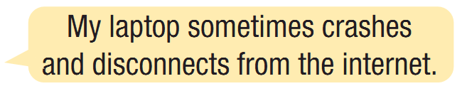
Unit 3 Lesson 2.1
b. In pairs:
Talk about what problems you've had with your devices by using the new words you have just learnt.

Slide 15



Slide 16
Unit 3 Lesson 2.1
Pre-Listening
What are you going to listen?
Listen to Jess talking to the manager of an electronics store
a. Listen to Jess talking to the manager of an electronics store. Why is she at the store?

Slide 17

Unit 3 Lesson 2.1
While-Listening
a. Listen to Jess talking to the manager of an electronics store. Why is she at the store?
She wants to get her money back.
Her laptop needs repairing.
✓

Slide 18
Unit 3 Lesson 2.1
Pre-Listening
b. Now, listen and complete the form.
What are you going to do?
→ Listen and complete the form
What are some key words in the question?
→ Customer name, Phone number, Item, Problem, Warranty, Note

Slide 19
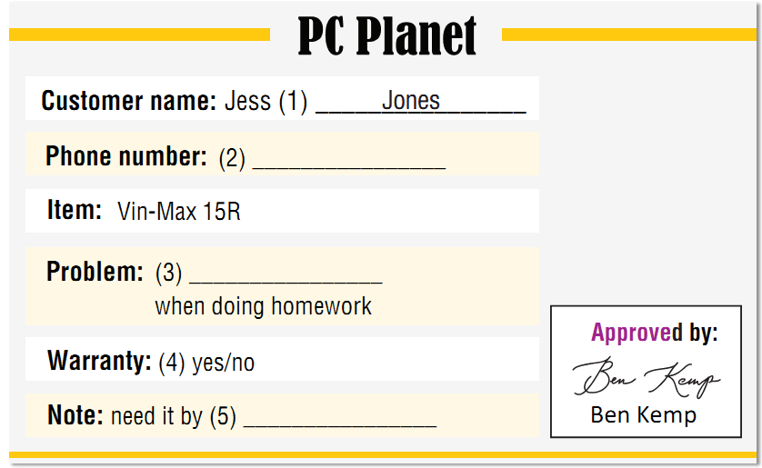
Unit 3 Lesson 2.1
While-Listening
What kind of word is needed?
numbers
a noun / gerund
Yes or No
a day / a date

Slide 20
Unit 3 Lesson 2.1
While-Listening
b. Now, listen and complete the form.
077-274-7641
overheats
Thursday

Slide 21
Unit 3 Lesson 2.1
Audio Scripts
Matt: Hi, welcome to PC Planet. How can I help?
Jess: Good morning, I'd like to speak to the manager, please.
Matt: Of course, one moment please.
Ben: Hi, I'm Ben. I'm the manager. How can I help today?
Jess: Hello, Ben. I have a problem with my laptop.
I bought it from here a few months ago.
Ben: OK, what's the problem?
Jess: It overheats when I do my homework. Like yesterday,
when I tried to save my essay, it became really hot
and crashed.
Ben: Sorry about that. We probably need to repair it. Can I
take your name, please?
Jess: Yes, it's Jess Jones. That's J-E-S-S J-O-N-E-S.

Slide 22
Unit 3 Lesson 2.1
Ben: OK. And can I take your phone number?
Jess: 077-274-7641.
Ben: And the problem is it overheats when you do your
homework, right? Anything else?
Jess: No, just that.
Ben: OK. Do you have your receipt?
Jess: Erm...yes. Here it is.
Ben: OK, it's still under warranty. We can repair it for free.
Jess: Great.
Ben: Thank you, Jess. We'll call you when your laptop is
ready. Probably on Thursday or Friday, OK?
Jess: Could you finish it by Thursday? I need to finish my
essay for Friday.
Ben: OK, I think we can finish it by then.
Jess: Great, thanks.
Audio Scripts

Slide 23
Unit 3 Lesson 2.1
Extra Practice
WB, page 16
a. Listen to Harry talking to the manager of a phone store. Why is he at the store?
What are you going to listen?
→ A conversation
Where are they?
→ At a phone store
What are you going to do?
→ Choose the best answer
Notes:
Taken from TA 10 i-Learn Smart World WB, page 2

Slide 24
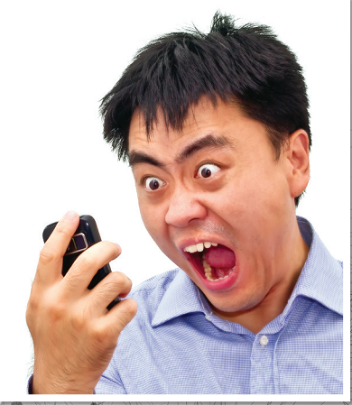
Unit 3 Lesson 2.1
Extra Practice
WB, page 16
a. Listen to Harry talking to the manager of a phone store. Why is he at the store?
✓
He wants them to repair his phone.
He wants a different phone.
Notes:
Taken from TA 10 i-Learn Smart World WB, page 2

Slide 25
Unit 3 Lesson 2.1
Extra Practice
WB, page 16
b. Now, listen and complete the form.
Use no more than two words or a number.
What are you going to do?
→ Listen and complete the form
How many words are need in each blank?
→ No more than two words or a number
What are some key words?
→ Customer name, Phone number, Item,
Problem, Warranty, Note
Notes:
Taken from TA 10 i-Learn Smart World WB, page 2

Slide 26

Unit 3 Lesson 2.1
Extra Practice
WB, page 16
b. Now, listen and complete the form. Use no more than two words or a number.
REPAIR FORM:
Customer name: Harry (1) _____________________
Phone number: (2) _____________________
Item: ZX21
Problem: (3) _____________________
then crashes
Warranty: (4) yes / no
Note: need it by (5) ________________________
Fletcher
0884-986-537
overheats
Thursday afternoon
Notes:
Taken from TA 10 i-Learn Smart World WB, page 2

Slide 27
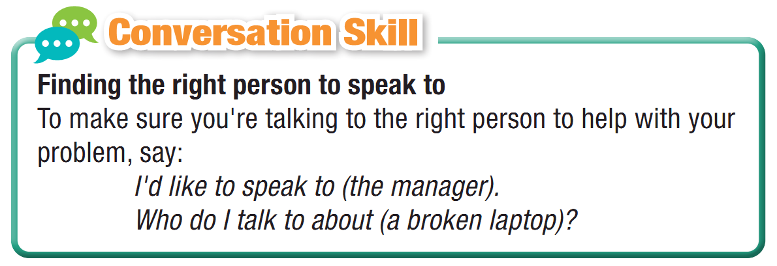
Unit 3 Lesson 2.1
Post - Listening
Read the Conversation Skill box and listen to Task b. audio again. Circle the phrase in the Conversation Skill box that you hear.

Slide 28
Post - Listening
d. Listen and repeat.

Slide 29

Unit 3 Lesson 2.1
Post - Listening
e. In pairs:
What would you do if you bought an expensive phone or laptop and it broke the next day?
How would you feel?
I would feel disappointed because ……

Slide 30

Consolidation

Slide 31
Unit 3 Lesson 2.1
Write a paragraph about your experience of shopping online. (100-120 words)

Slide 32
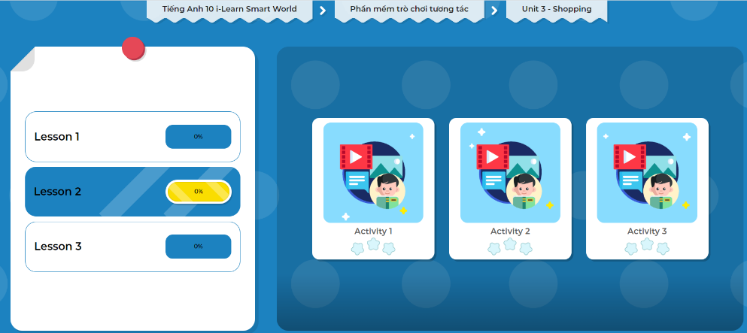
Let’s play!
Click here to play the games!

Slide 33

Unit 9 Lesson 2.1
WRAP-UP

Slide 34
Unit 3 Lesson 2.1
Consolidation
Today’s lesson
Vocabulary: complaints
Listening: for specific information
Speaking: starting a friendly conversation asking and answering about the problems of the items

Slide 35
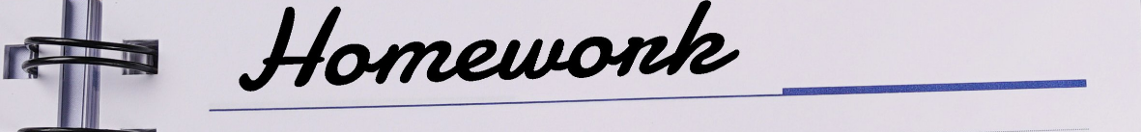
Unit 3 Lesson 2.1
Make sentences about complaints.
Do the exercises in WB on page 16.
Do the exercises in Tiếng Anh 10 i-Learn Smart World Notebook on page 16.
Prepare the next lesson - Grammar on page 24 in SB.
Play consolidation games in Tiếng Anh 10 i-Learn Smart World DHA App on www.eduhome.com.vn

Slide 36

Have a nice day!

