Slide 1

Unit 2: Fit for life
Progress Check
Page 42

Slide 2
Lesson Outline
Warm-up
Vocabulary
Grammar
Speaking
Consolidation
Wrap-up

Slide 3
Objectives
By the end of this lesson, students will be able to…
- test/consolidate vocabulary and grammar learnt throughout the unit.

Slide 4

WARM-UP

Slide 5
Choose the word whose underlined part is pronounced differently from that of the others.
1. A. level B. flippers C. helmet D. wetsuit
2. A. hoop B. door C. room D. food
3. A. washed B. looked C. added D. passed
/ˈlevəl/
/ˈflɪpərz/
/ˈhelmɪt/
/ˈwetsuːt/
/huːp/
/dɔːr/
/ru:m/
/fu:d/
/wɒʃt/
/lʊkt/
/ædɪd/
/pɑːst/

Slide 6
Choose the word whose main stress is placed differently from that of the others.
A. amazing B. exciting C. relaxing D. dangerous
2. A. punchbag B. snorkel C. respect D. product
3. A. excuse B. yoga C. tennis D. football
/əˈmeɪzɪŋ /
/ɪkˈsaɪtɪŋ/
/rɪˈlæksɪŋ/
/ˈdeɪndʒərəs/
/ˈpʌntʃbæɡ/
/ˈsnɔːkəl/
/rɪˈspekt/
/ˈprɒdʌkt/
/ɪkˈskjuːz/
/ˈjəʊɡə/
/ˈtenɪs/
/ˈfʊtbɔːl/

Slide 7
What vocabulary and grammar points you have learnt in this unit?
Vocabulary about sports and diseases.
Grammar: quantifiers, Past Simple, used to.

Slide 8

It’s time to learn …

Slide 9
Vocabulary
1. Complete the sentences with do, play or go and one of the words in the list.
• helmet • wetsuit • boxing gloves • hoop • mat
1 When you _______ rollerblading, you need rollerblades and a _______ .
2 When you _______ basketball, you need a ball and a _______ .
3 When you _______ yoga, you need a _______ .
4 When you _______ snorkelling, you need flippers, a snorkel and a _______ .
5 When you _______ kickboxing, you need a punchbag and ___________ .
go
helmet
play
hoop
do
mat
go
wetsuit
do
boxing gloves

Slide 10
2. Fill in each gap with sore, temperature, stomach ache, cough or headache.
1 Penny has a got a cold and a ______________ .
2 Steve ate too many sweets and now he has a _______________ .
3 Ann has got a _______________ throat. It hurts when she swallows.
4 Mike has got a ______________ . He worked on his computer too much.
5 Jane has got a _______________ . Her forehead is really hot.
cough
stomach ache
sore
headache
temperature

Slide 11
More Practice
Workbook p.22
4 ★ Fill in each gap with do, play or go.
1 ______ badminton
2 ______ rollerblading
3 ______ kickboxing
4 ______ snorkelling
5 ______ yoga
play
go
do
go
do

Slide 12
Grammar
3. Choose the correct option.
1 How many/much milk do we have?
2 I need to buy some/any bread at the supermarket.
3 There are only little/few grapes left.
4 We don’t have some/any orange juice for breakfast.
5 Can I have some/much water, please?
6 There are lot/lots of strawberries in the fridge.

Slide 13
4. Put the verbs in brackets into the Past Simple.
1 __________________ (where/you/see) the poster about sports day?
2 I ___________________ (go) to the British Museum last Sunday.
3 ___________________ (who/run) in a marathon last week?
4 The children ___________________ (not/want) to go to the cinema.
5 When ______________________ (she/leave)? An hour ago.
6 Who __________________ (Jane/watch) the race with? Susan.
7 ___________________ (when/Sam/lose) his bag?
8 She __________________ (fall) off a ladder last week.
Where did you see
went
Who ran
didn’t want
did she leave
did Jane watch
When did Sam lose
fell

Slide 14
5. Choose the correct option.
1 He used to/used play tennis at college.
2 Did they use/used to walk to school?
3 We used to go/went to basketball practice yesterday.
4 Sandra didn’t use/used to play badminton.

Slide 15
More Practice
Workbook p.23
8 ★ Write what Lia used to/didn’t use to do when she was five.
1 listen to music (✓) ___________________________________
2 have long hair (✗) ___________________________________
3 spend time in the garden (✓) ___________________________________
4 play computer games (✗) ___________________________________
5 go to the park with her mum (✓) ___________________________________
She used to listen to music.
She didn’t use to have long hair.
She used to spend time in the garden.
She didn’t use to play computer games.
She used to go to the park with her mum.

Slide 16
More Practice
Workbook p.23
9 ★★ Fill in each gap with the correct quantifier.
1 A: How _______ apples do you need to make the pie?
B: About five or six.
2 A: I’d really like some hot chocolate.
B: I’m afraid we haven’t got _______ milk.
3 A: Can you buy some cheese from the supermarket?
B: Sure. How _______ do you need?
4 A: Do you want sugar in your tea?
B: Yes, please. But just a _______ . I don’t want a lot.
5 A: There’s too _______ salt in this sauce.
B: I know. It tastes salty!
many
any
much
little
much

Slide 17
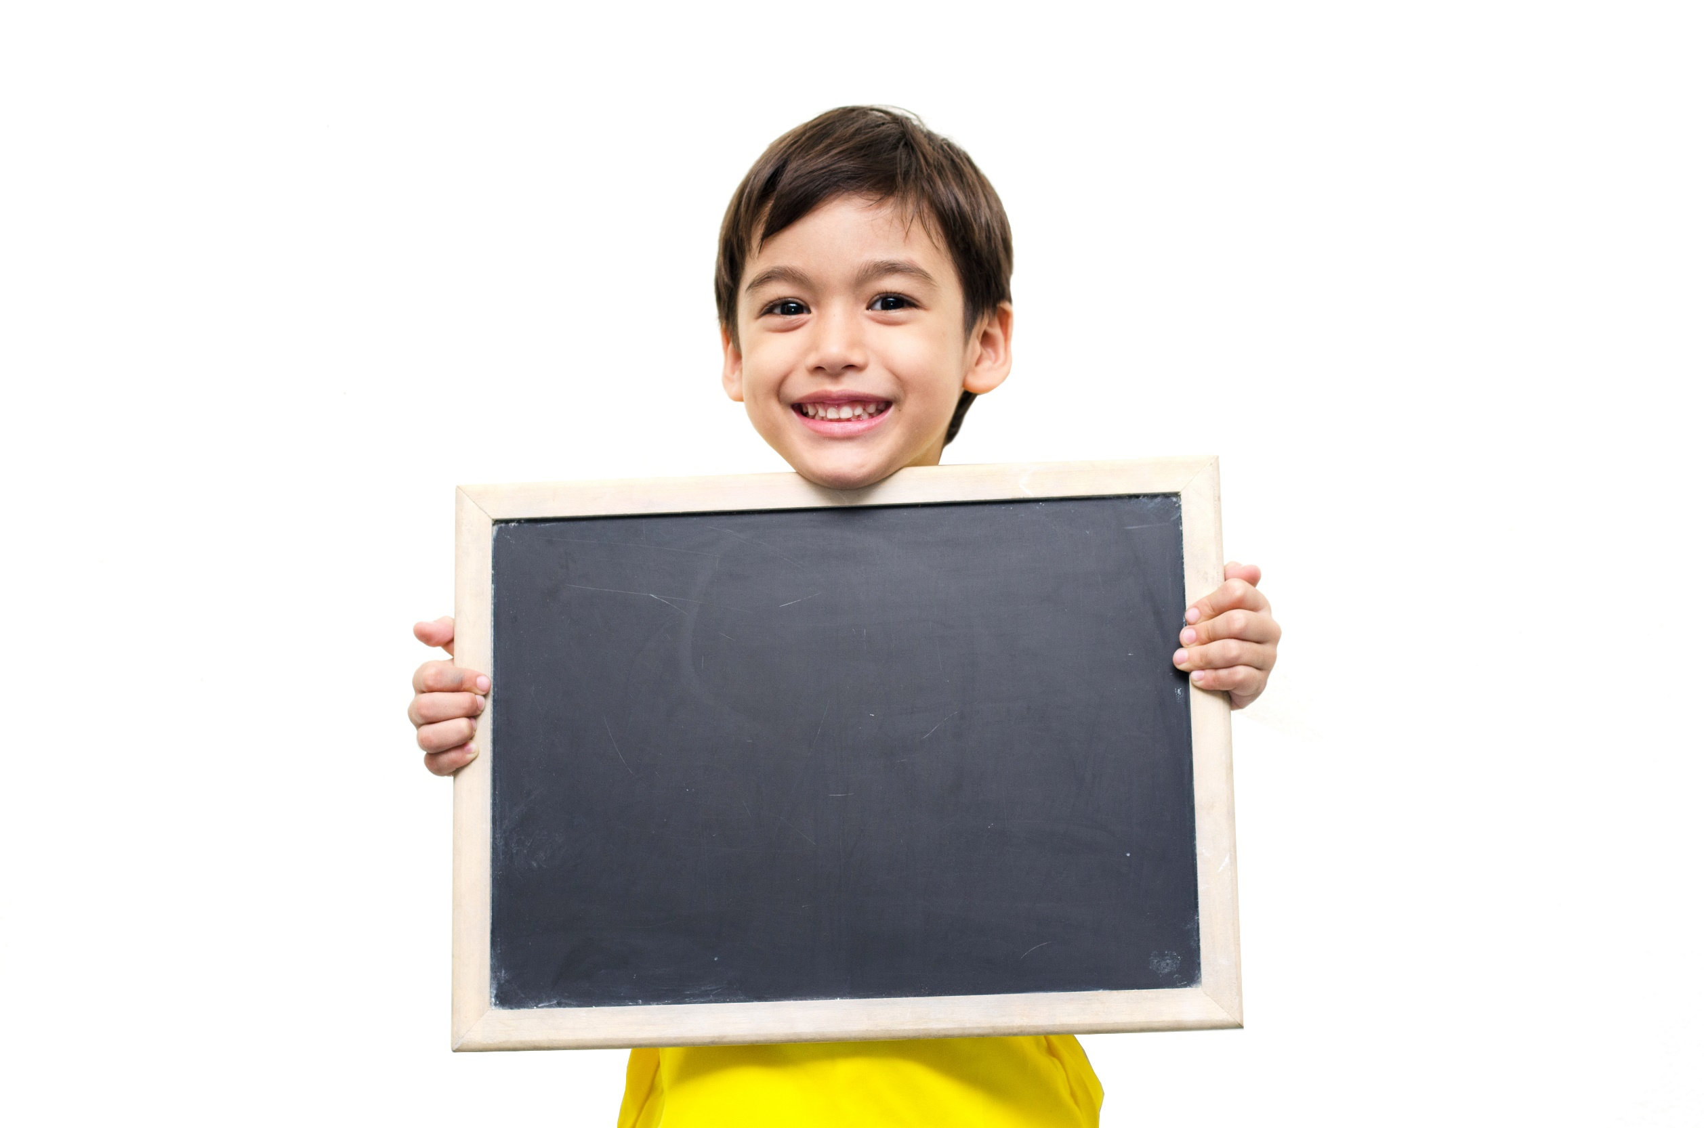
Speaking

Slide 18
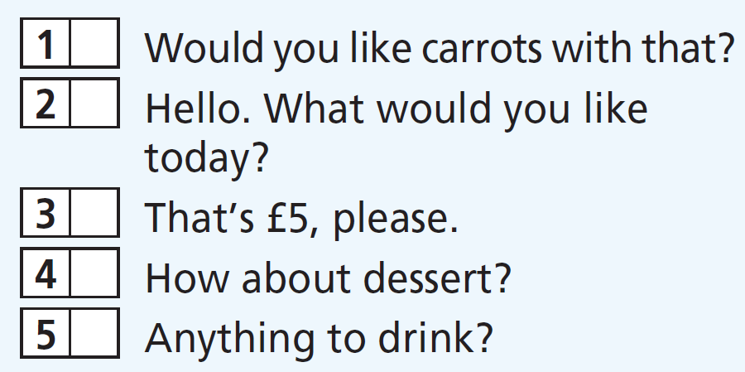
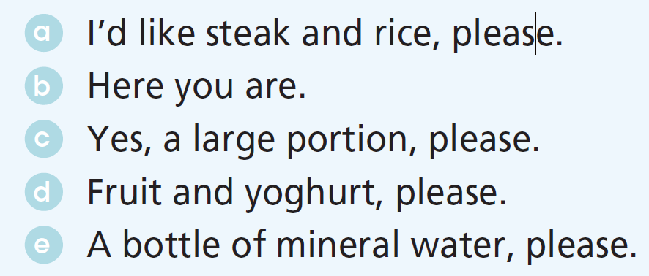
6. Match the sentences to make exchanges.
c
a
b
d
e

Slide 19
Work in pairs and practise the exchanges:
A: Would you like carrots with that?
B: Yes, a large portion, please.
A: Hello. What would you like today?
B: I’d like steak and rice, please.
A: That’s £5, please.
B: Here you are.
A: How about dessert?
B: Fruit and yoghurt, please.
A: Anything to drink?
B: A bottle of mineral water, please.

Slide 20

CONSOLIDATION

Slide 21
Write a paragraph (60-80 words) about a healthy lifestyle.

Slide 22

WRAP-UP

Slide 23
Today’s lesson
Vocabularies
Sports
Diseases
Grammar
Quantifiers
Past Simple
used to

Slide 24
Homework
Review the vocabularies and grammar and make sentences using them.
Do exercises in workbook on pages 24 & 25.
Prepare the next lesson (page 43 SB)
Do Unit 2 Test 2 in Bài Tập Bổ Trợ TA 7 Right on (pp. 22 & 23).

Slide 25
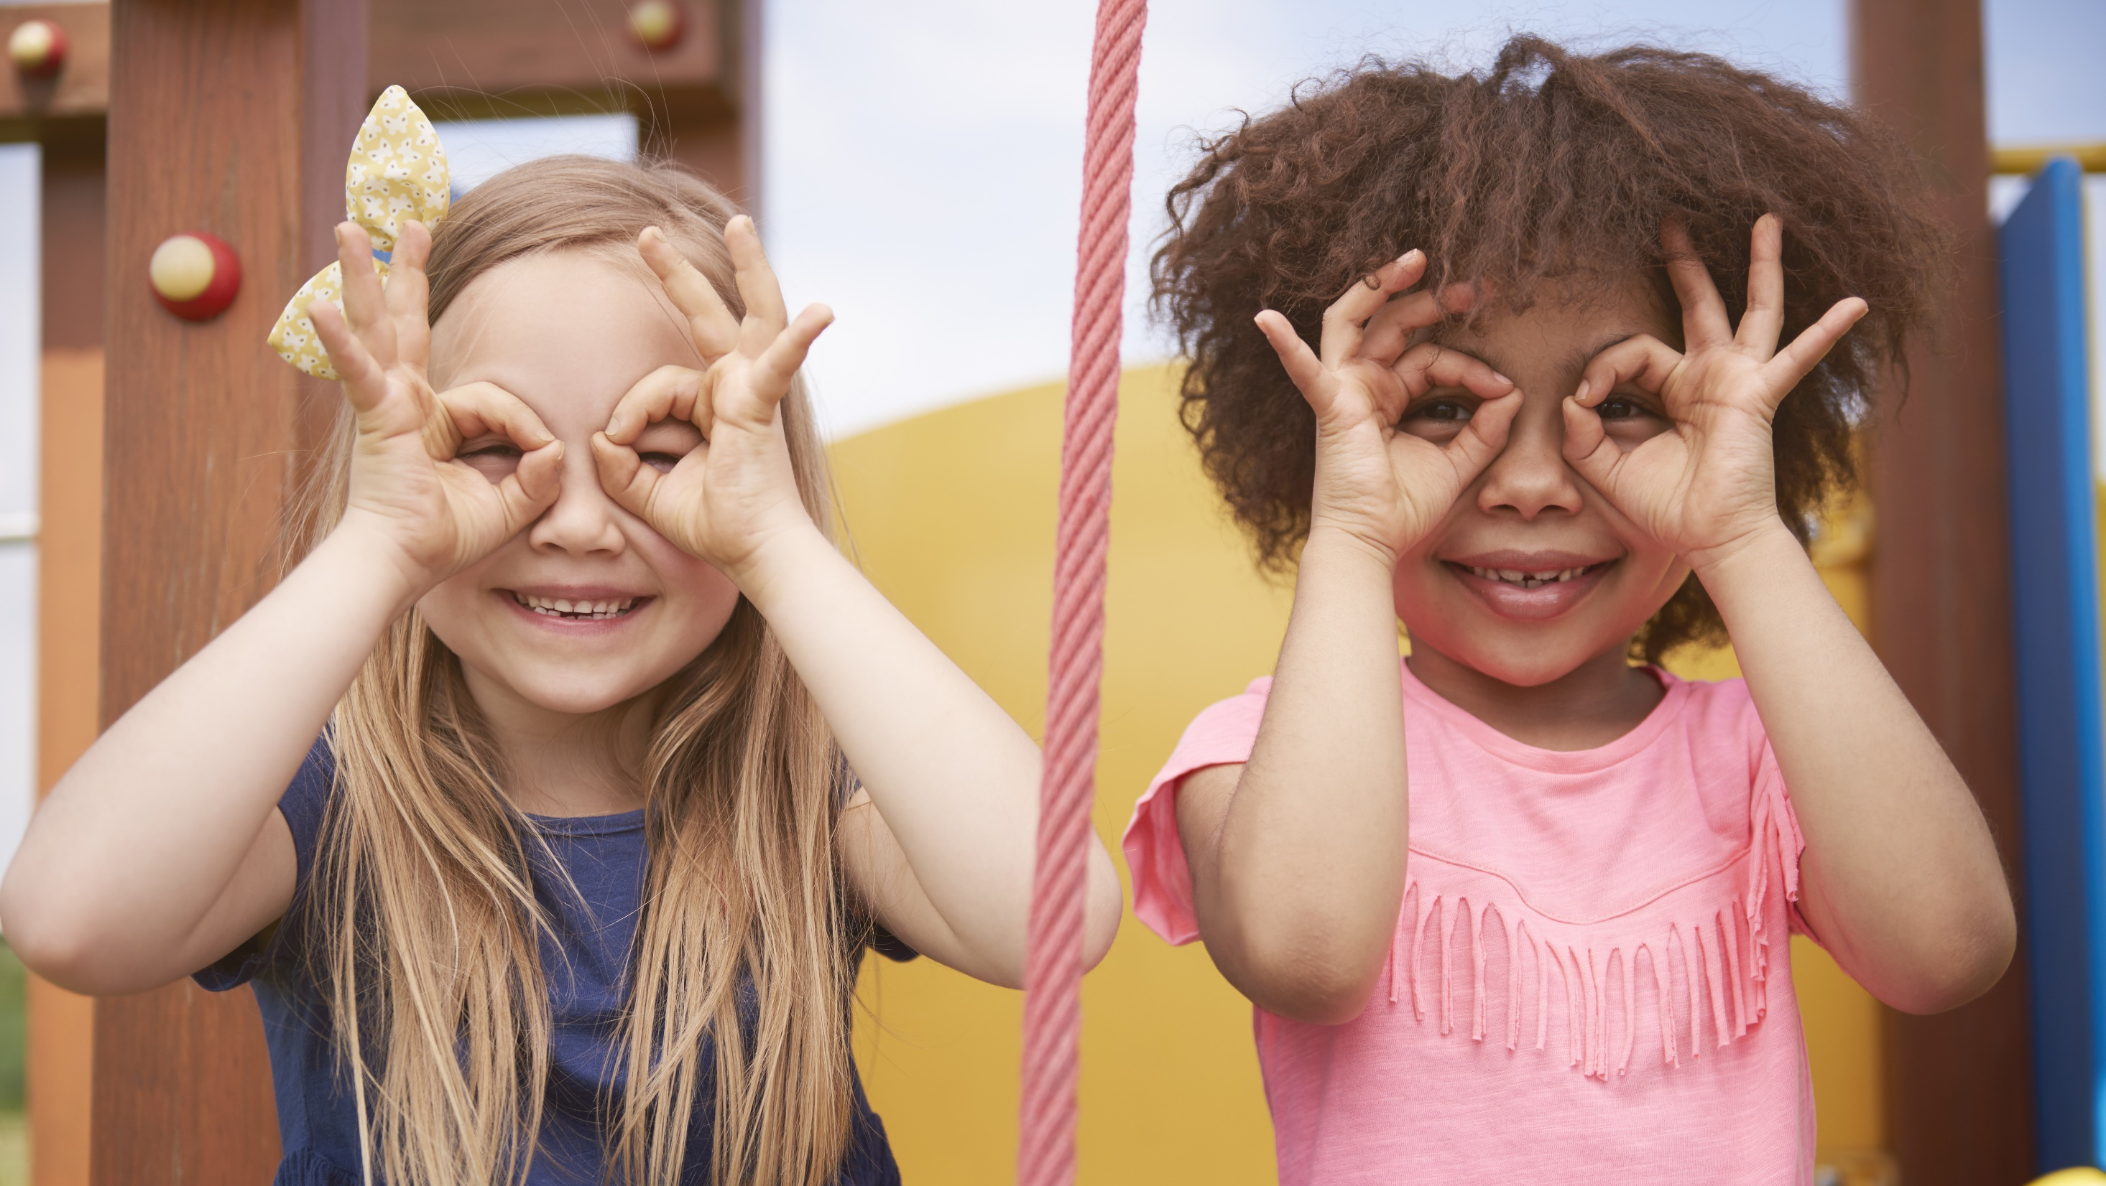
Enjoy your day!

