Slide 1

Unit 6: Education
Lesson 3.1: Listening & Reading
Page 50

Slide 2



LESSSON OUTLINE
Consolidation

Slide 3

By the end of this lesson, students will be able to…
practice listening and reading for main ideas and specific information.
be well-prepared for the writing activity in the next lesson.

Slide 4

WARM-UP

Slide 5


Work in pairs.
1. Do you know the building in the picture?
2. What do you think is good or bad about studying abroad?
Suggested answers:
1. Yes, it is Eiffel Tower in France.
2. I think it’s good because I can meet a lot of new people.

Slide 6


It’s listening time….

Slide 7
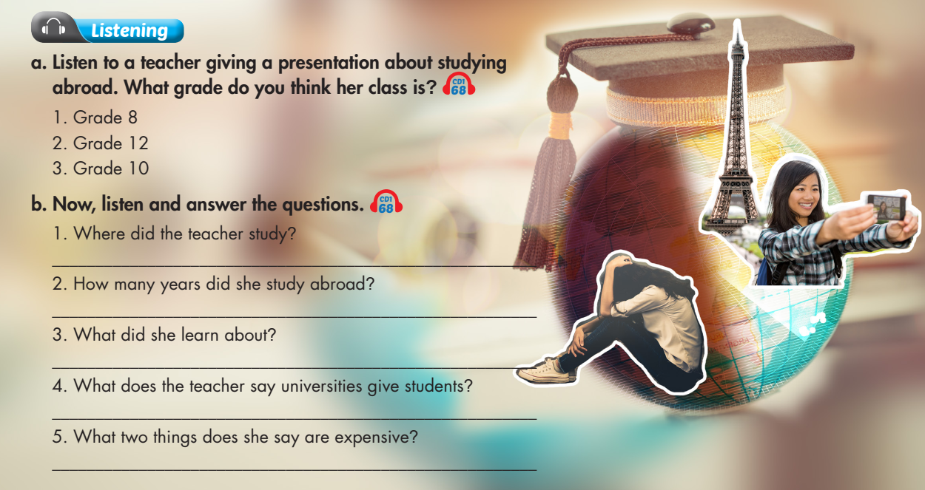

Slide 8
Pre – listening
Before listening
a. Underline the key words and guess what her grade is.
a. Listen to a teacher giving a presentation about studying abroad. What grade do you think her class is?
1. Grade 8 2. Grade 12 3. Grade 10

Slide 9


While - listening
Click on the icon to hear the sound
Listen the first time to recognize what her grade is.
W: Good morning, class. Today, I want to tell you about studying abroad. I know most of you want to go to university next year. Why not go to university in another country? I went to university in France. It was a great experience. I studied there for one year.
Her grade is Grade 12.

Slide 10
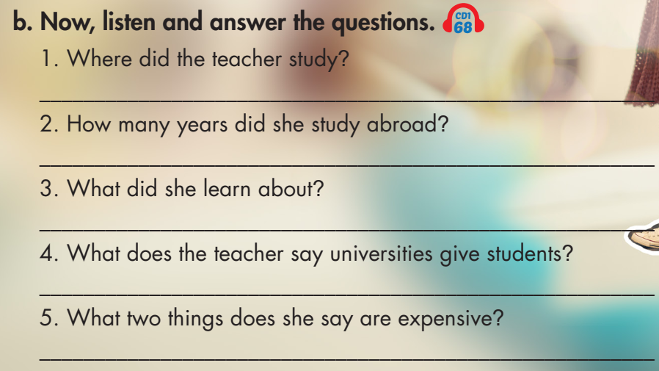
b. Underline the key words in each question and predict the answer.
Click on the icon to hear the sound

Slide 11
b. Now, listen and answer.
Click on the icon to hear the sound
1. Where did the teacher study?
France
I went to university in France.

Slide 12
b. Now, listen and answer.
Click on the icon to hear the sound
2. How many years did she study abroad?
One
I studied there for one year.

Slide 13
b. Now, listen and answer.
Click on the icon to hear the sound
3. What did she learn about?
French history
I learned so much about French history.

Slide 14
b. Now, listen and answer.
Click on the icon to hear the sound
4. What does the teacher say universities give students?
A map
But universities will give you a map and tell you good places to go.

Slide 15
b. Now, listen and answer.
Click on the icon to hear the sound
5. What two things does she say are expensive?
Apartment and plane tickets
It can also be very expensive to pay for your apartment and plane tickets.

Slide 16
Audio Scripts
Practice reading the presentation with your partner.
W: Good morning, class. Today, I want to tell you about studying abroad. I know most of you want to go to university next year. Why not go to university in another country? I went to university in France. It was a great experience. I studied there for one year. I could already speak some French, so I could make friends easily. I learned so much about French history. However, there are some things about studying abroad that you might find difficult. You won’t know your way around and might get lost. But universities will give you a map and tell you good places to go. It can also be very expensive to pay for your apartment and plane tickets. If anyone has any questions, please ask me.

Slide 17

Post - listening
Work in pairs.
Do you want to study abroad after high school? Why (not)?

Slide 18
Pre - reading
Underline the keywords and guess whether Anna has more good or bad experiences during her time in Spain.

Slide 19
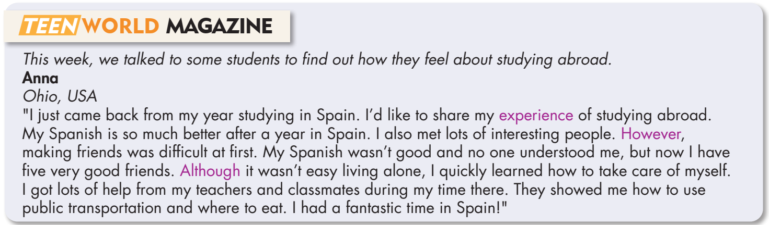
While - reading
Skim the article and underline the key words.
Answer: a. Good

Slide 20
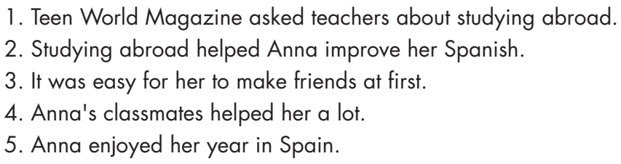
Pre - reading
Read the sentences and underline the key words.

Slide 21
While - reading
Now, read and write True or False.
1. Teen World Magazine asked teachers about studying abroad.
False

Slide 22
While - reading
Now, read and write True or False.
2. Studying abroad helped Anna improve her Spanish.
True

Slide 23
While - reading
Now, read and write True or False.
3. It was easy for her to make friends at first.
False

Slide 24
While - reading
Now, read and write True or False.
4. Anna's classmates helped her a lot.
True

Slide 25
While - reading
Now, read and write True or False.
5. Anna enjoyed her year in Spain.
True

Slide 26

Post - reading
Work in pairs.
Would you like to study abroad? What problems do you think you would have?

Slide 27

CONSOLIDATION

Slide 28
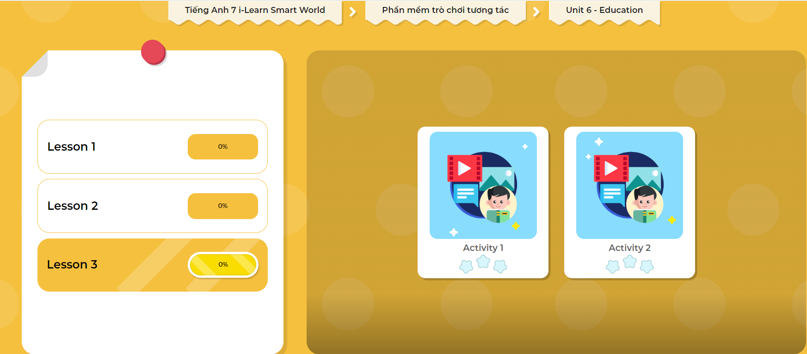
LET’S PLAY!
Click here to play the games

Slide 29

WRAP-UP

Slide 30
Today’s lesson
Listening:
- Listen for gist and choose the correct information.
Reading:
- Read for detail and specific information.

Slide 31
Homework
Do the Listening and Reading exercises in Tiếng Anh 7 i-Learn Smart World Workbook (page 36).
Do the exercises in Tiếng Anh 7 i-Learn Smart World Notebook (page 40).
Prepare the next lesson (page 51 SB).
Play the consolidation games in Tiếng Anh 7 i-Learn Smart World DHA App on www.eduhome.com.vn

Slide 32

Lesson 3
Stay positive and have a nice day!

