Slide 1

Unit 4: All things high-tech
Lesson: Progress Check
Page 76

Slide 2
Lesson Outline
Warm-up
Vocabulary
Grammar
Listening
Consolidation
Wrap-up

Slide 3
Objectives
By the end of this lesson, students will be able to…
- test/consolidate vocabulary and grammar learnt throughout the unit.
- practise test-taking skills (Listening, Writing).

Slide 4

WARM-UP

Slide 5
Extra Practise
Choose the word whose main stress is placed differently
from the others.
1. A. keyboard B. speaker C. router D. balloon
2. A. virtual B. online C. local D. alone
3. A. promise B. decide C. announce D. suggest
/ˈkiːbɔːd/
/ˈspiːkər/
/ˈruːtər/
/bəˈluːn/
/ˈvɜːtʃuəl/
/ˈɒnlaɪn/
/ˈləʊkəl/
/əˈləʊn/
/ˈprɒmɪs/
/dɪˈsaɪd/
/əˈnaʊns/
/səˈdʒest/

Slide 6
Choose the word whose underlined part is pronounced differently
from that of the other words.
A. photo B. console C. laptop D. poster
2. A. winner B. entry C. bedroom D. ending
3. A. affect B. happen C. open D. frighten
/ˈfəʊtəʊ/
/ˈkɒnsəʊl/
/ˈlæptɒp/
/ˈpəʊstər/
/ˈwɪnər/
/ˈentri/
/ˈbedrʊm/
/ˈendɪŋ/
/əˈfekt/
/ˈhæpən/
/ˈəʊpən/
/ˈfraɪtən/

Slide 7

It’s time to learn …

Slide 8

VOCABULARY

Slide 9
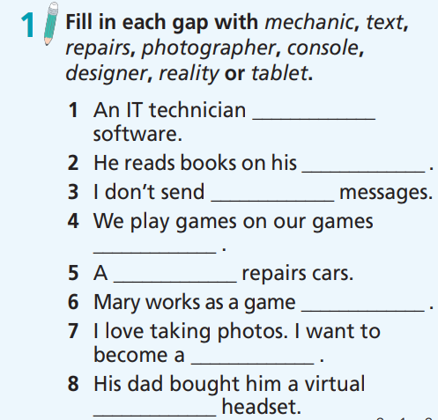
How many sentences are there?
Eight.
What are you going to do?
Fill in each gap with prompts.

Slide 10
Fill in each gap with mechanic, text, repairs, photographer, console, designer, reality or tablet.
repairs
1. An IT technician _____________ software.
2. He reads books on his _____________ .
3. I don’t send _____________ messages.
4. We play games on our games _____________ .
5. A _____________ repairs cars.
6. Mary works as a game _____________ .
7. I love taking photos. I want to become a _____________ .
8. His dad bought him a virtual _____________ headset.
tablet
text
console
mechanic
designer
photographer
reality

Slide 11
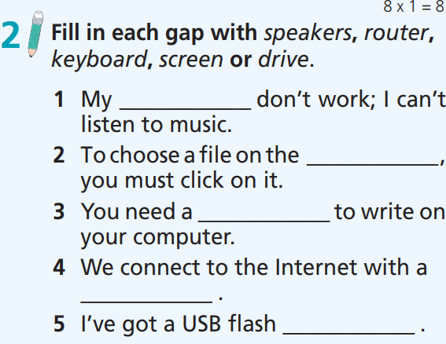
How many sentences are there?
Five.
What are you going to do?
Fill in each gap with prompts.

Slide 12
2 Fill in each gap with speakers, router, keyboard, screen or drive.
1. My _________ don’t work; I can’t listen to music.
2. To choose a file on the _________ , you must click on it.
3. You need a _________ to write on your computer.
4. We connect to the Internet with a _________.
5. I’ve got a USB ﬂash _________.
speakers
screen
keyboard
router
drive

Slide 13

Grammar

Slide 14
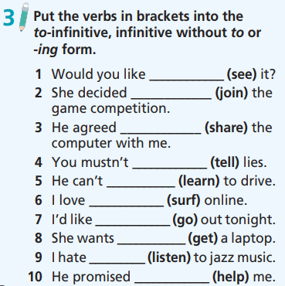
How many sentences are there?
There are ten.
What are you going to do?
Put the verbs in brackets into the to-infinitive, infinitive without to or -ing form.

Slide 15
3 Put the verbs in brackets into the to-infinitive, infinitive without to or -ing form.
to see
1. Would you like ____________ (see) it?
2. She decided ____________ (join) the game competition.
3. He agreed ____________ (share) the computer with me.
4. You mustn’t ____________ (tell) lies.
5. He can’t ___________ (learn) to drive.
6. I love ____________ (surf) online.
7. I’d like ____________ (go) out tonight.
8. She wants ___________ (get) a laptop.
9. I hate _________ (listen) to jazz music.
10. He promised ____________ (help) me.
to join
to share
tell
learn
surfing
to go
to get
listening
to help

Slide 16
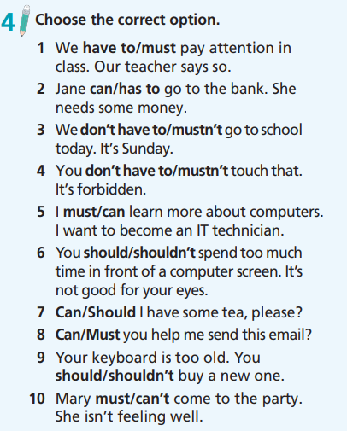
How many sentences are there?
There are ten.
What are you going to do?
Choose the correct option.

Slide 17
4 Choose the correct option.
1. We have to/must pay attention in class. Our teacher says so.
2. Jane can/has to go to the bank. She needs some money.
3. We don’t have to/mustn’t go to school today. It’s Sunday.
4 You don’t have to/mustn’t touch that. It’s forbidden.
5. I must/can learn more about computers. I want to become an IT technician.

Slide 18
4 Choose the correct option.
6. You should/shouldn’t spend too much time in front of a computer screen. It’s not good for your eyes.
7. Can/Should I have some tea, please?
8. Can/Must you help me send this email?
9. Your keyboard is too old. You should/shouldn’t buy a new one.
10. Mary must/can’t come to the party. She isn’t feeling well.

Slide 19
Listening

Slide 20
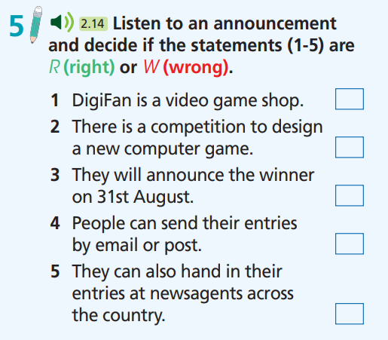
What are you going to listen?
An announcement.
And then?
Decide if the statements are
R (right) or W (wrong).

Slide 21

5 Decide if the statements are R (right) or W (wrong).
1. DigiFan is a video game shop.
2. There is a competition to design a new computer game.
3. They will announce the winner on 31st August.
4. People can send their entries by email or post.
5. They can also hand in their entries at newsagents across
the country.

Slide 22
1. DigiFan is a video game shop.
2. There is a competition to design a new computer game.
3. They will announce the winner on 31st August.
4. People can send their entries by email or post.
5. They can also hand in their entries at newsagents across
the country.
W
DigiFan, the magazine for gamers.
W
To win 10 video games, create your own video game character.
R
They’ll announce the results on the 31st of August.
R
Send your entries by email or post them…
W
You might see your character in newsagents across the country.

Slide 23
Audio script
Next on the show, something for video game fans. DigiFan, the magazine for gamers, is having a competition for its readers. To win 10 video games, create your own video game character. It can be anything: a person, an alien or a monster. You can draw your character or make a digital image of it. Entries have to be in before the 31st of July; they’ll announce the results on the 31st of August. An artist will draw the winning design and DigiFan will put it on the front of the magazine. There’s only one rule: your character must be completely new. It can’t be a character from another game. Send your entries by email or post them to DigiFan’s offices at 43 Holt House, Brentford. So get creative, gamers, and you might see your character in newsagents across the country.

Slide 24

CONSOLIDATION

Slide 25
Extra Practice
Grammar Bank, page 73
Put the verbs in brackets into to-infinitive, infinitive without to or -ing form.
A: Hey, Paul. Would you like 1) ____________ (come) to the cinema with me tonight?
B: Well, you know I usually love 2) ____________ (watch) films, but I’m very tired.
A: We can 3) ____________ (stay) in then.
B: Really? But don’t you want 4) ____________ (see) the film?
to come
watching
stay
to see

Slide 26
Extra Practice
Grammar Bank, page 73
Put the verbs in brackets into to-infinitive, infinitive without to or -ing form.
A: It’s OK. My brother would like 5) ____________ (watch) it, too. I’ll go with him.
B: Cool. Thanks, Jack.
A: It’s OK. I enjoy 6) ____________ (hang out) with you! Do you like 7) ____________ (play) computer games?
B: Sure! I’ve got a new one. You’re going to love it.
to watch
hanging out
playing

Slide 27

WRAP-UP

Slide 28
Today’s lesson
Vocabularies
- test/consolidate vocabulary
Grammar
- test/consolidate grammar points learnt throughout the unit.
Listening: for specific information.

Slide 29
Homework
Prepare the next lesson (page 77 SB).
Do Test 2 of Unit 4 in Bài Tập Bổ Trợ TA 7 Right on (pages 38 & 39).
Do the Speaking Test – Test 1 of Unit 4 in Bài Tập Bổ Trợ TA 7 Right on (page 80).

Slide 30

Have a nice day!

