Slide 3
Everyday English
City landmarks
Look at the picture. Listen and read the exclamations.
Work in pairs. Write the names of the landmarks under the correct pictures.
Work in pair. Look at the picture below and say what you think by using exclamations with What. You may use the suggestions below.
Write the names of the landmarks in 3 for the descriptions.
Work in pairs. Read the questions and circle the correct answers.

Slide 4
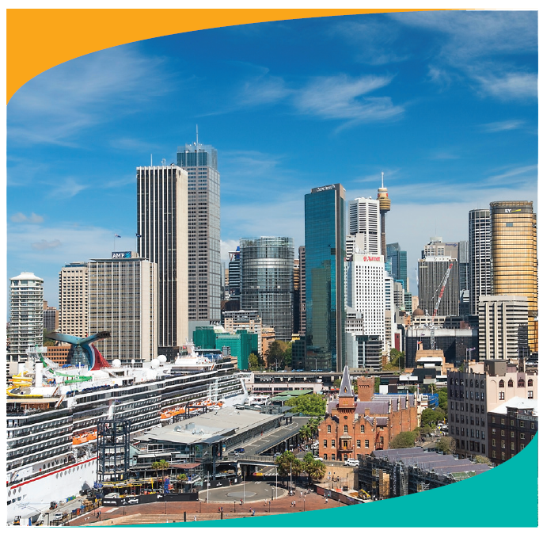
Look at the picture. Listen and read the exclamations.
Everyday English
Expressing exclamations with What
Notes:
Slide này không đúng.

Slide 5
Look at the picture. Listen and read the exclamations.
1.
What a nice city!
2.
What a clear sky!
3.
What tall buildings!

Slide 6
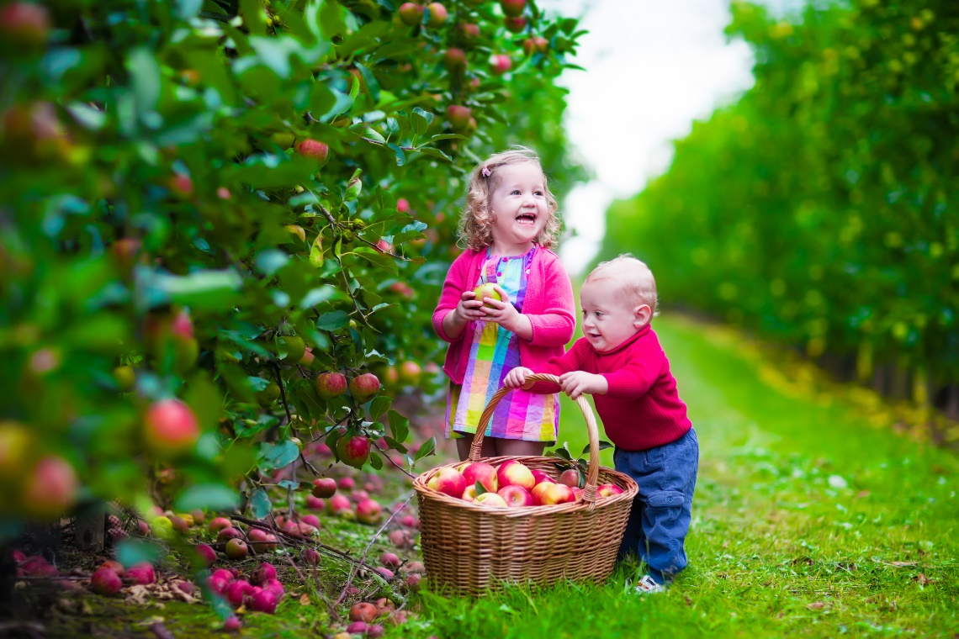
Work in pair. Look at the picture below and say what you think by using exclamations with What. You may use the suggestions below.
- happy / beautiful children
- colourful / nice picture
- sunny / beautiful weather
- small / cute boy
- beautiful / colourful apple trees

Slide 7
- happy / beautiful children
- colourful / nice picture
- sunny / beautiful weather
- small / cute boy
- beautiful / colourful apple trees
1.
2.
3.
4.
5.

Slide 8
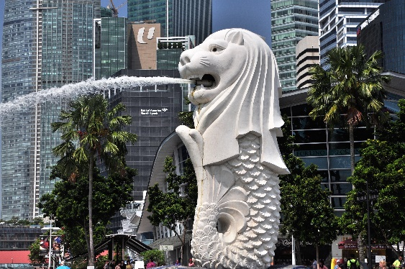
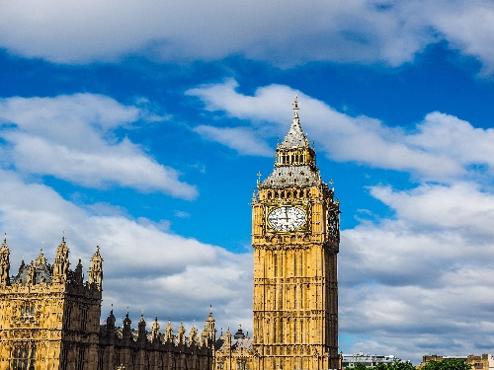
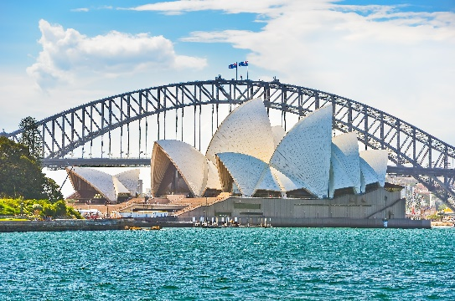
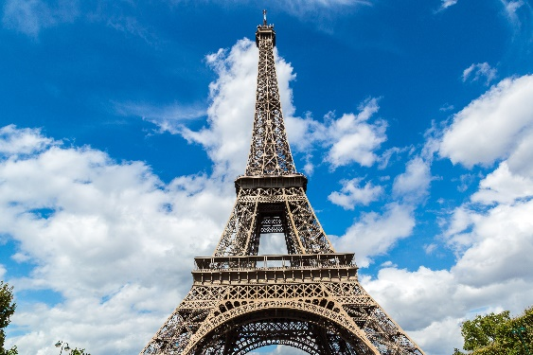
Work in pairs. Write the names of the landmarks under the correct pictures.
City landmarks
Eiffel Tower
Big Ben
Sydney Opera House
Merlion
1.
Merlion
2.
Big Ben
Sydney Opera
House
Eiffel Tower
3.
4.
Notes:
City landmarks phải ở trên mục 3

Slide 9
Write the names of the landmarks in 3 for the descriptions.
This tower is on the bank of the River Thames in London. In the tower, there’s a big clock and a bell.
This famous tower is in Paris. Every year, millions of visitors climb to its top to see the whole view of Paris.
1.
Big Ben
3.
Eiffel Tower
It’s a theatre on Sydney Harbour. Its roofs are white and look like shells. Visitors from all over the world come to see it.
Merlion
2.
Sydney Opera House
4.
It has the head of a lion and the body of a fish. It’s a famous landmark in Singapore.

Slide 10
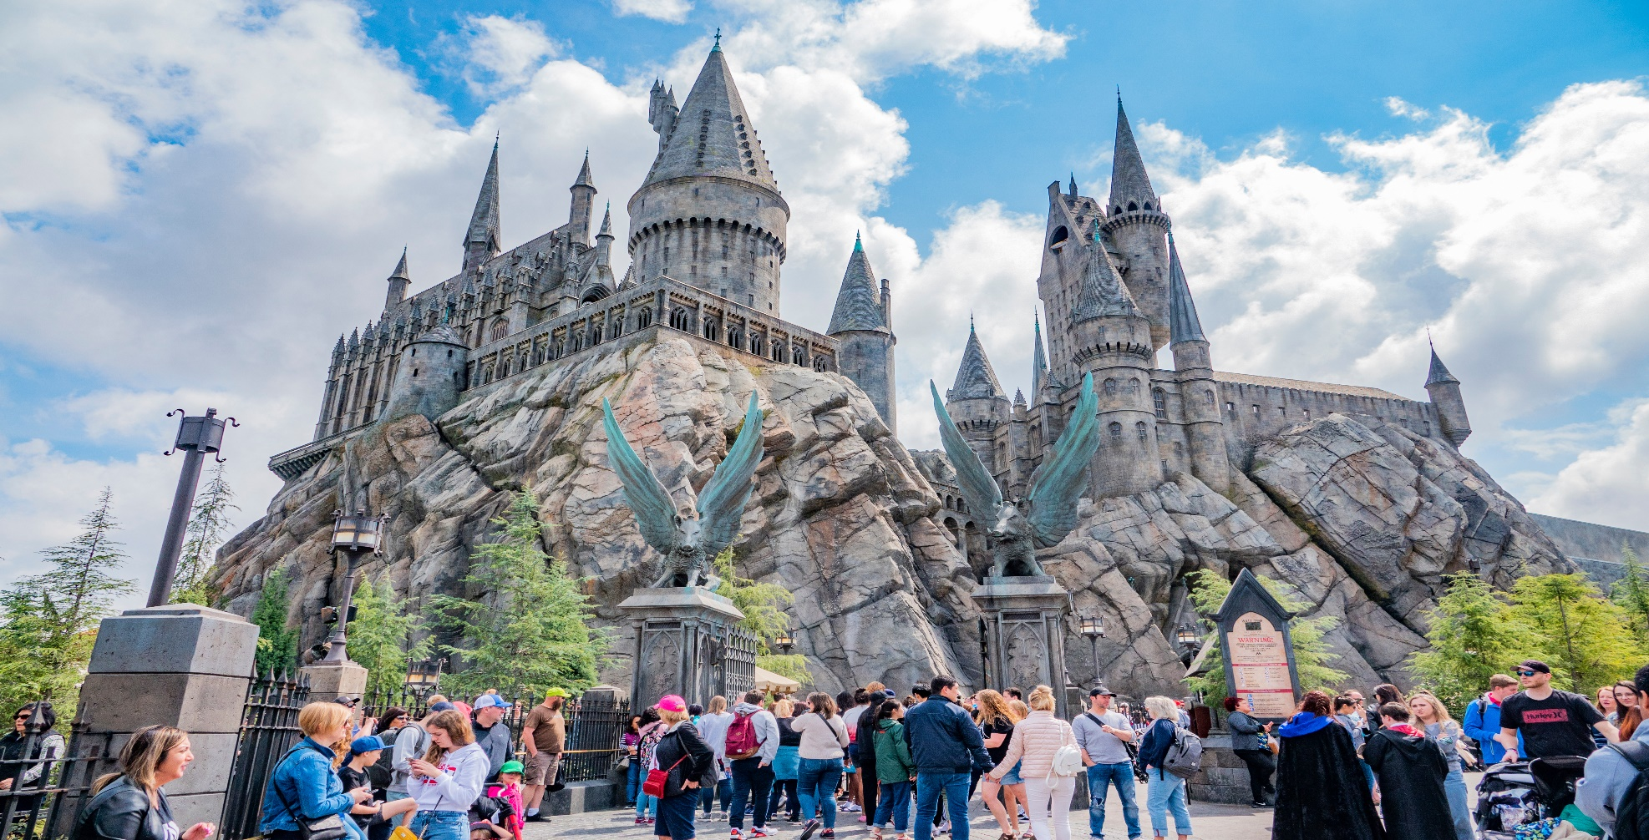
Work in pairs. Read the questions and circle the correct answers.

Slide 11
1.
Which city is nearer to Ha Noi than the others?
A.
Berlin
B.
Bangkok
C.
Tokyo
2.
The people of Quang Nam are proud of their ancient town, .
A.
Hoi An
B.
Sa Pa
C.
Bach Ma
3.
Phnom Penh is the capital city of .
A.
Indonesia
B.
The Philippines
C.
Cambodia
4.
For children, California is famous for its .
A.
Disneyland Park
B.
Golden Gate Bridge
C.
national parks

