Slide 1

Unit Entertainment
Lesson 6: Right on!
Page 115

Slide 2
Lesson Outline
Warm-up
Vocabulary
Project
Consolidation
Wrap-up

Slide 3
Objectives
By the end of this lesson, students will be able to…
- categorise travel activities.
- give a presentation on being a smart traveller.

Slide 4

WARM-UP

Slide 5
Work in pairs. Ask and answer the question:
What do you often do before you travel to a new place?

Slide 6

It’s time to learn …

Slide 7

Project

Slide 8
Vocabulary:
• waste water (v phr.): lãng phí nước
• ask before taking photos (v phr.): hỏi trước khi chụp hình
• know how to read a map (v phr.): biết cách đọc bản đồ
• learn about the local culture (v phr.): tìm hiểu về văn hoá địa phương
• take pebbles and shells from beach (v phr.): nhặt đá cuội và vỏ sò ở bãi biển
• treat animals badly (ride elephants, walk lions) (v phr.): đối xử tệ với động vật
• know how to swim (v phr.): biết bơi
• drop litter (v phr.): vứt rác bừa bãi

Slide 9

Task 1: What should smart travellers do? Put the ideas in the list under the correct headings. Write in your notebook.
• waste water
• ask before taking photos
• know how to read a map
• learn about the local culture
• take pebbles and shells from beach
• treat animals badly (ride elephants, walk lions)
• know how to swim
• drop litter
Should | Shouldn’t
• ask before taking photos
• waste water
• know how to read a map
• take pebbles and shells from beach
• learn about the local culture
• treat animals badly (ride elephants, walk lions)
• know how to swim
• drop litter

Slide 10
2 In your notebook, use the ideas from Exercise 1 and your own ideas to create a leaflet for smart travellers.
Suggested Answer
Are you a smart traveller? Follow these rules and you can be.
Smart Travellers
should:
• ask before taking photos
• know how to read a map
• learn about the local culture
• know how to swim
shouldn’t:
• waste water
• take pebbles and shells from the beach
• treat animals badly (ride elephants, walk lions)
• drop litter

Slide 11


3. How can one be a smart traveller? Give the class a presentation.

Slide 12
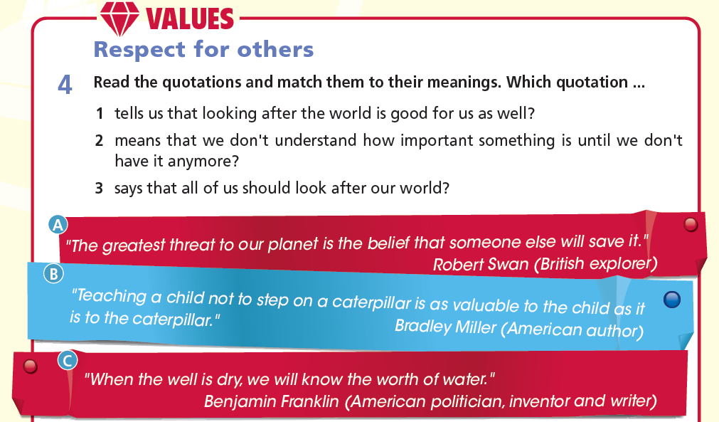

Slide 13

4 Read the quotations and match them to their meanings. Which quotation ...
A. "The greatest threat to our planet is the belief that someone else will save it."
Robert Swan (British explorer)
3 says that all of us should look after our world.
B. "Teaching a child not to step on a caterpillar is as valuable to the child as it is to the caterpillar."
Bradley Miller (American author)
1 tells us that looking after the world is good for us as well.
C. "When the well is dry, we will know the worth of water."
Benjamin Franklin (American politician, inventor, and writer)
2 means that we don't understand how important something is until we don't have it anymore.

Slide 14

5. Find another quotation about respecting our world, the people, and the animals in it. Use the key words environment quotations.

Slide 15
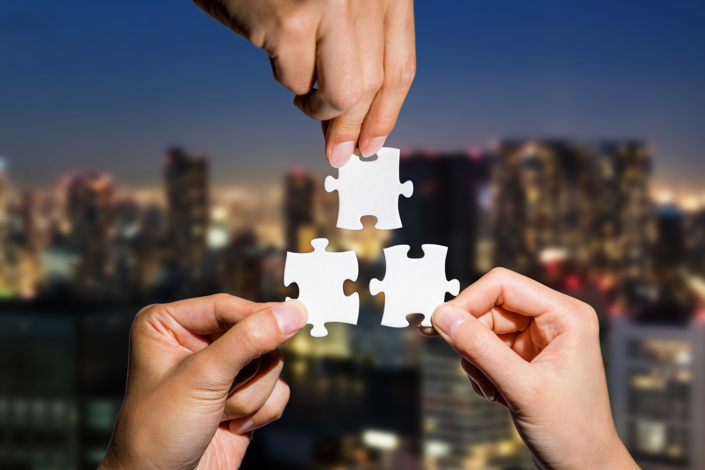
CONSOLIDATION

Slide 16
Write a paragraph (about 40-60 words) to give advice to visitors who come to your school.

Slide 17
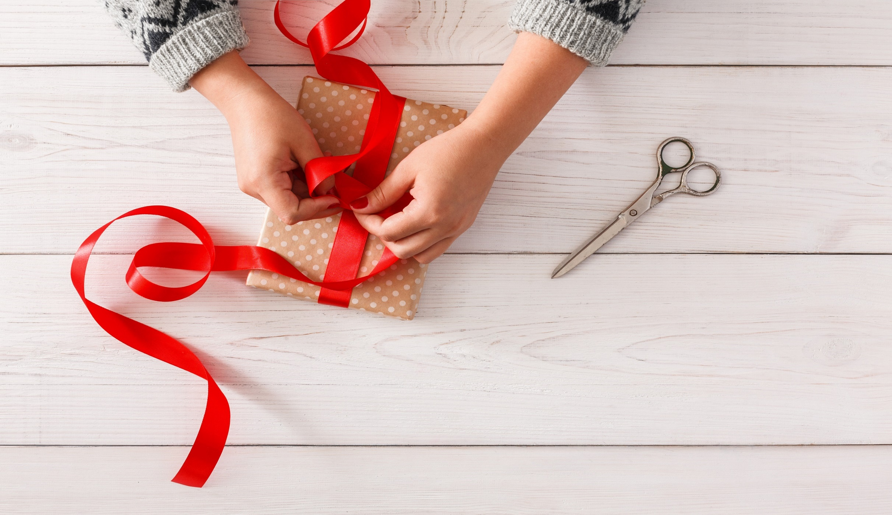
WRAP-UP

Slide 18
Today’s lesson
Project
Smart travellers

Slide 19
Homework
Practise the vocabularies and make sentences using them.
Do the exercises in TA 6 Right on WB (p. 72).
Prepare the next lesson (p. 116 SB).

Slide 20
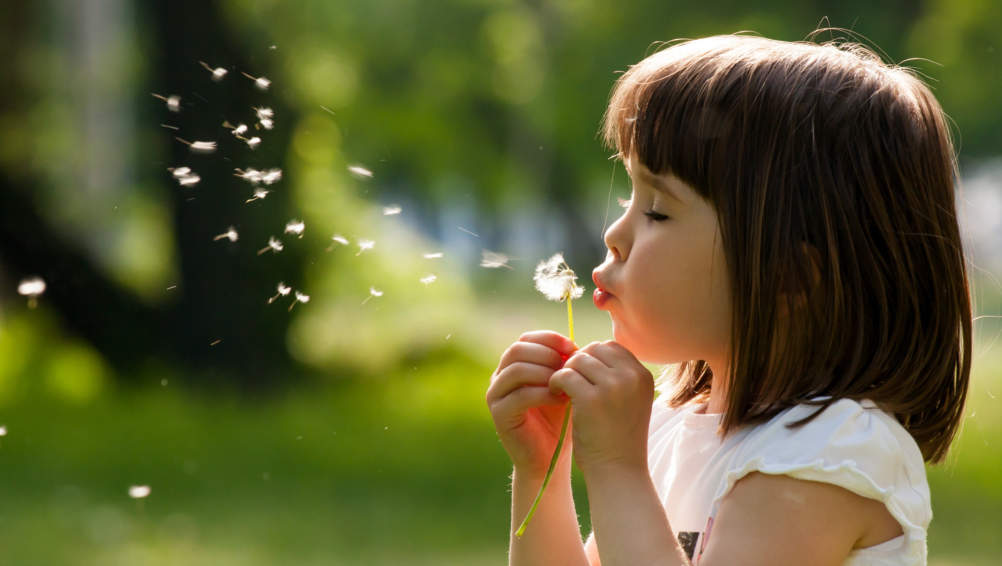
Enjoy your day!

