Slide 1


Slide 2
LOOKING BACK and PROJECT
Unit
5
GLOBAL WARMING
Unit
FAMILY LIFE
LESSON 8
Student Book – page 60 + 61

Slide 3
LESSON 8
LOOKING BACK AND PROJECT
WARM-UP
- Pronunciation: Listen and underline the stressed words.
- Vocabulary: Choose the correct word or phrase to complete each sentence.
- Grammar: Rewrite the sentences using present or past participle clauses.
LOOKING BACK
PROJECT
- What we can do every day to help limit global warming.
CONSOLIDATION
- Wrap up
- Homework

Slide 4

WARM-UP
Climate Change Quiz

Slide 5


1/ True or False: The overwhelming majority of scientists agree that climate change is real and caused by humans.
True
False

Slide 6
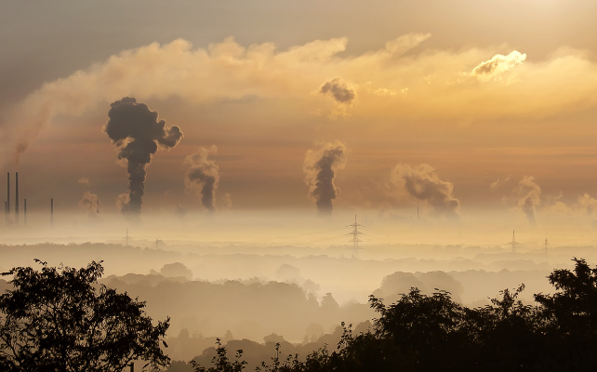
2/ Which of these countries emits the most carbon dioxide?
USA
UK
China
Russia

Slide 7
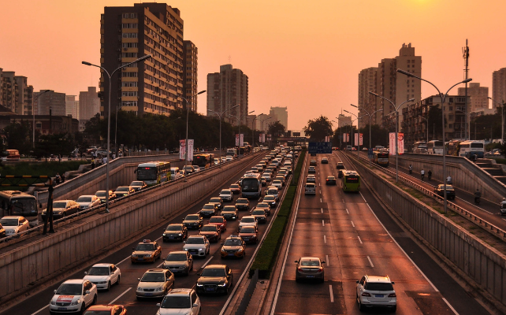
3/ What percentage of the global greenhouse gas emissions does the transportation sector emit?
1%
14%
33%
70%

Slide 8

4/ Globally, which of the following economic sectors emits the largest percentage of greenhouse gas emissions?
Transportation
Buildings
Industry
Electricity & heat production

Slide 9
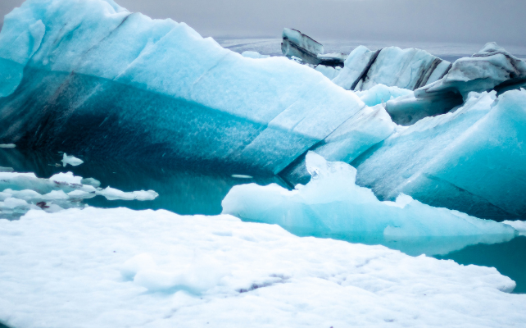
5/ Which has been the hottest year on record?
2016
2020
All of the above
None of the above

Slide 10


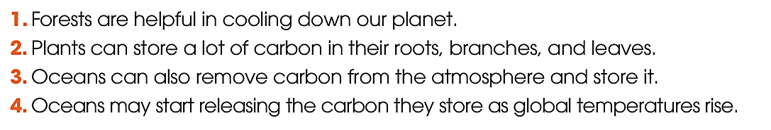


LOOKING BACK
1
Listen and underline the stressed words. Then practise saying the sentences with a natural rhythm.

Slide 11

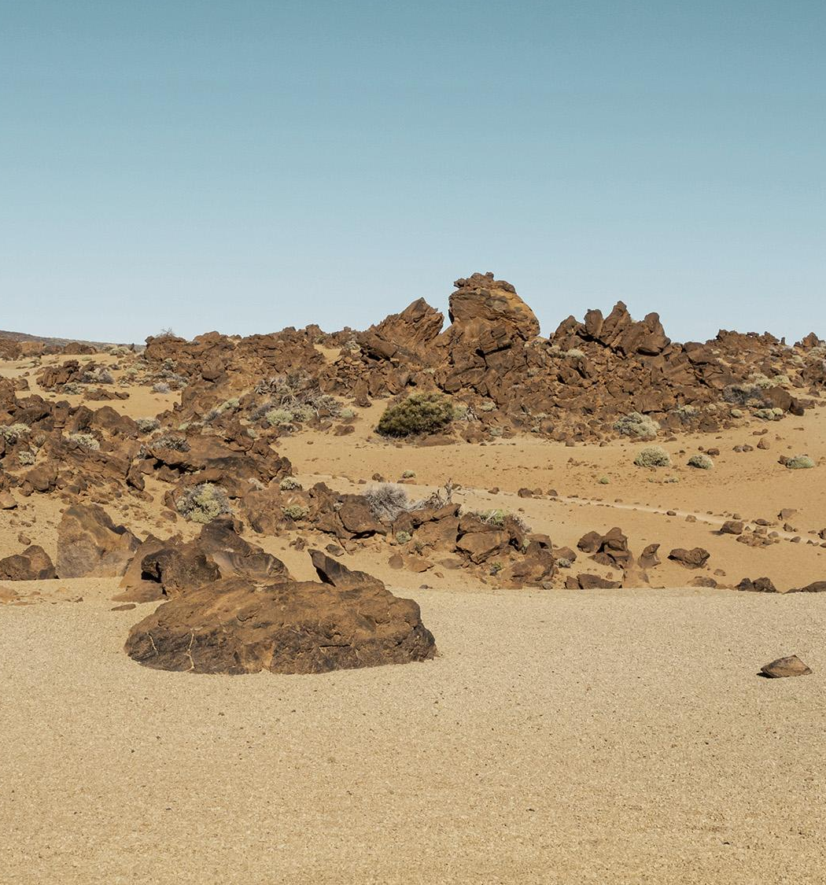
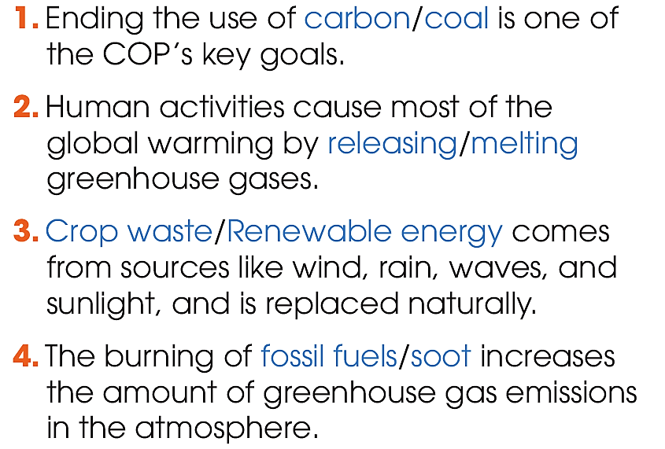
LOOKING BACK
2
Choose the correct word or phrase to complete each sentence.

Slide 12
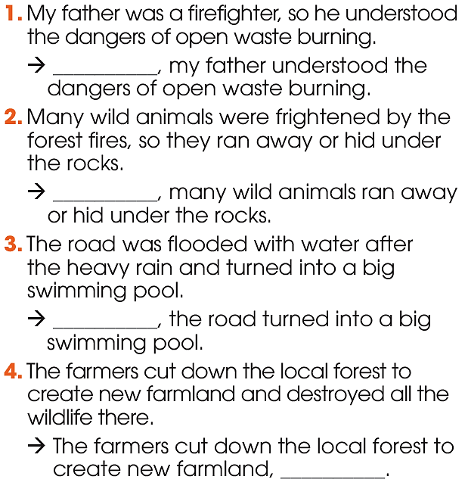

LOOKING BACK
3
Rewrite the sentences using present or past participle clauses.

Slide 13
LOOKING BACK
ANSWER KEYS:
Being a firefighter, my father understood the dangers of open waste burning.
Frightened by the forest fires, many wild animals ran away or hid under the rocks.
Flooded with water after the heavy rain, the road turned into a big swimming pool.
4. The farmers cut down the local forest to create new farmland, destroying all the wildlife there.

Slide 14
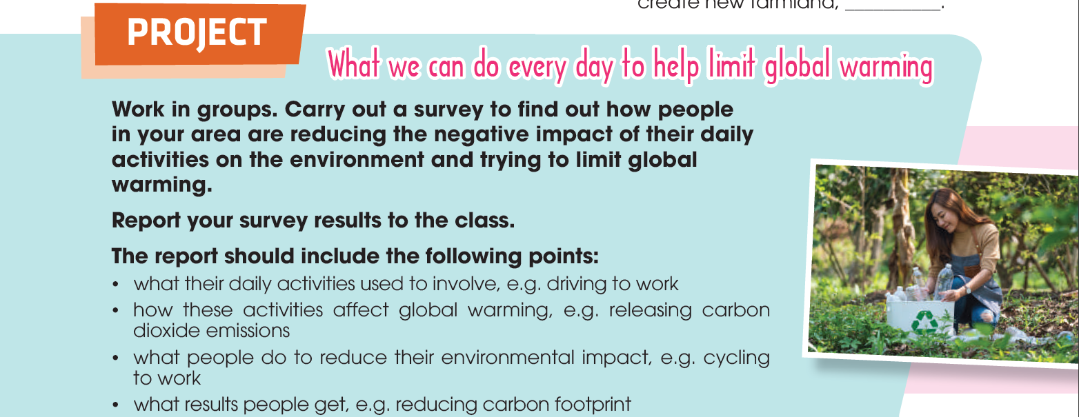
PROJECT

Slide 15
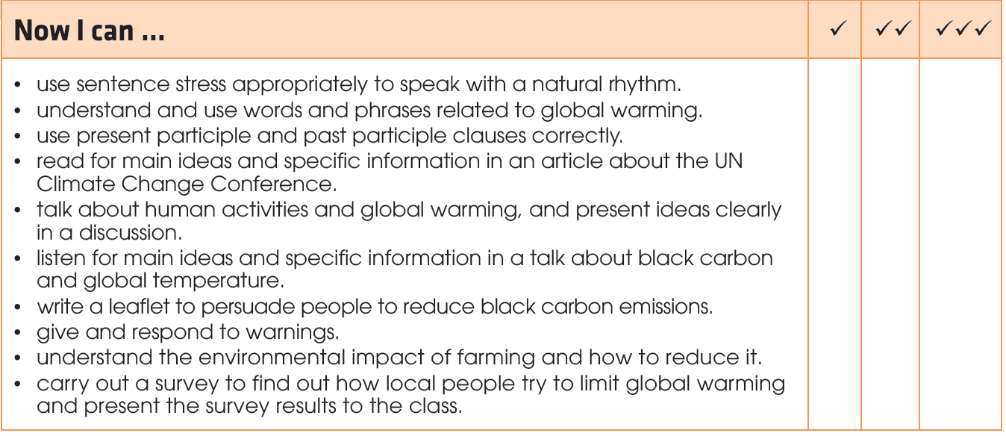
PROJECT

Slide 16
What have you learnt today?
CONSOLIDATION
1
Wrap-up
Review the vocabulary and grammar of Unit 5.
Apply what you have learnt (vocabulary and grammar) into practice through a project.
Carry out a survey to find out how local people reduce their environmental impact and present the survey results to the class.

Slide 17

CONSOLIDATION
2
Do exercises in the workbook.
Prepare for Unit 6.
Homework

Slide 18

Website: hoclieu.vn
Fanpage: facebook.com/tienganhglobalsuccess.vn/

