Slide 1
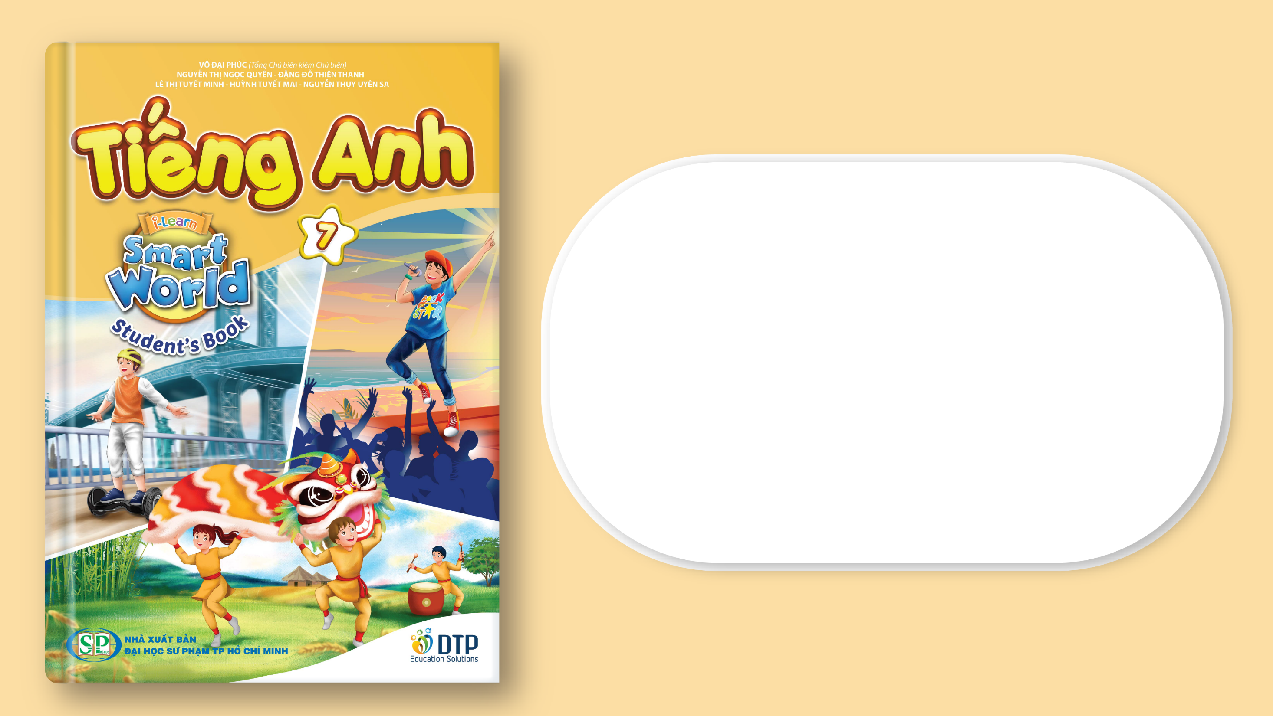
Unit 5: Food and Drinks
Lesson 3.2: Writing
Page 43

Slide 2



Lesson 3.2
LESSON OUTLINE
Consolidation

Slide 3

By the end of this lesson, students will be able to…
write food blogs.
talk about unusual dishes from your hometown.

Slide 4

WARM-UP

Slide 5

Work in groups.
What are some special dishes in your hometown?
Have you ever tried them?
Given a chance, would you like to try unusual dishes?

Slide 6


It’s writing time….

Slide 7
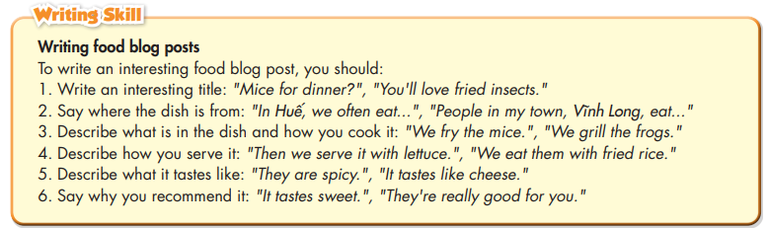
Pre - writing
a. Read about writing food blog posts. Then, read Long’s blog and circle the six points listed below.

Slide 8
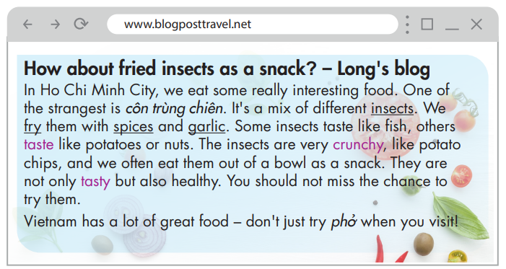

Slide 9
Write an interesting title
How about fried insects as a snack?
How about fried insects as a snack? – Long's blog
In Ho Chi Minh City, we eat some really interesting food. One of the strangest is côn trùng chiên. It's a mix of different insects. We fry them with spices and garlic. Some insects taste like fish, others taste like potatoes or nuts. The insects are very crunchy, like potato chips, and we often eat them out of a bowl as a snack. They are not only tasty but also healthy. You should not miss the chance to try them. Vietnam has a lot of great food – don't just try phở when you visit!

Slide 10
2. Say where the dish is from.
In Ho Chi Minh City
How about fried insects as a snack? – Long's blog
In Ho Chi Minh City, we eat some really interesting food. One of the strangest is côn trùng chiên. It's a mix of different insects. We fry them with spices and garlic. Some insects taste like fish, others taste like potatoes or nuts. The insects are very crunchy, like potato chips, and we often eat them out of a bowl as a snack. They are not only tasty but also healthy. You should not miss the chance to try them. Vietnam has a lot of great food – don't just try phở when you visit!

Slide 11
3. Describe what is in the dish and how you cook it.
a mix of different insects
We fry them with spices and garlic.
How about fried insects as a snack? – Long's blog
In Ho Chi Minh City, we eat some really interesting food. One of the strangest is côn trùng chiên. It's a mix of different insects. We fry them with spices and garlic. Some insects taste like fish, others taste like potatoes or nuts. The insects are very crunchy, like potato chips, and we often eat them out of a bowl as a snack. They are not only tasty but also healthy. You should not miss the chance to try them. Vietnam has a lot of great food – don't just try phở when you visit!

Slide 12
4. Describe how you serve it.
We often eat them out of a bowl as a snack.
How about fried insects as a snack? – Long's blog
In Ho Chi Minh City, we eat some really interesting food. One of the strangest is côn trùng chiên. It's a mix of different insects. We fry them with spices and garlic. Some insects taste like fish, others taste like potatoes or nuts. The insects are very crunchy, like potato chips, and we often eat them out of a bowl as a snack. They are not only tasty but also healthy. You should not miss the chance to try them. Vietnam has a lot of great food – don't just try phở when you visit!

Slide 13
5. Describe what it tastes like.
Some insects taste like fish, others taste like potatoes or nuts./ very crunchy.
How about fried insects as a snack? – Long's blog
In Ho Chi Minh City, we eat some really interesting food. One of the strangest is côn trùng chiên. It's a mix of different insects. We fry them with spices and garlic. Some insects taste like fish, others taste like potatoes or nuts. The insects are very crunchy, like potato chips, and we often eat them out of a bowl as a snack. They are not only tasty but also healthy. You should not miss the chance to try them. Vietnam has a lot of great food – don't just try phở when you visit!

Slide 14
6. Say why you recommend it.
They are not only tasty but also healthy.
How about fried insects as a snack? – Long's blog
In Ho Chi Minh City, we eat some really interesting food. One of the strangest is côn trùng chiên. It's a mix of different insects. We fry them with spices and garlic. Some insects taste like fish, others taste like potatoes or nuts. The insects are very crunchy, like potato chips, and we often eat them out of a bowl as a snack. They are not only tasty but also healthy. You should not miss the chance to try them. Vietnam has a lot of great food – don't just try phở when you visit!

Slide 15
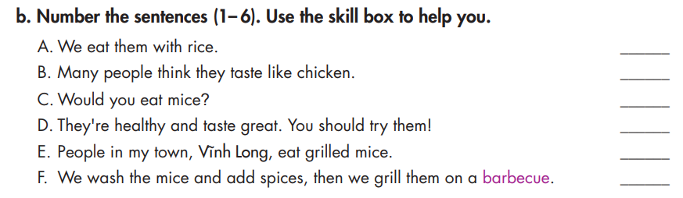

Slide 16
We eat them with rice.
Describe how you serve it.
Many people think they taste like chicken.
Describe what it tastes like.
Write an interesting title.
Would you eat mice?
Say why you recommend it.
They're healthy and taste great. You should try them!
Say where the dish is from.
People in my town, Vĩnh Long, eat grilled mice.
Describe what is in the dish and how you cook it.
We grill them on a barbecue.

Slide 17
Answer
4
5
1
6
2
3

Slide 18
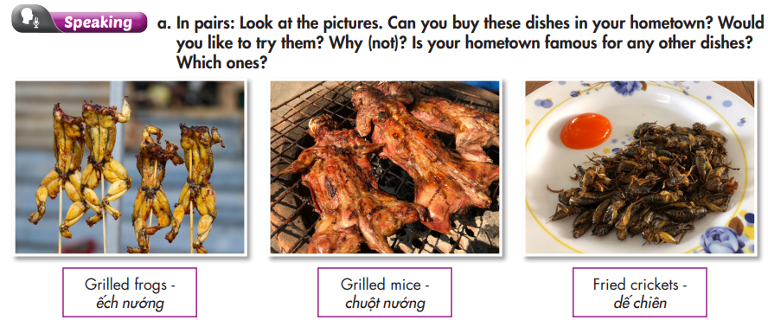

Slide 19
­Work in pairs
Can you buy these dishes from your hometown?
Would you like to try them?
Only grilled frogs. But if I could, I would like to try them all since I love experiencing new things.
Is your hometown famous for any other dishes?
Yes, my hometown is famous for ………………….

Slide 20
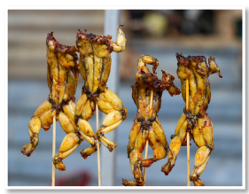
b. Now, choose one of the food in the pictures or your own idea, then make notes.
Where is the dish from? | Ho Chi Minh City
What is the name of the dish? | grilled frog
What is in the dish? How do people cook it? | frogs and spices, grill it on a barbecue
What do you eat with it? | fried rice
What does it taste like? | a mix of chicken and fish

Slide 21

While - writing
Use the information in Task b to write the blog.
Where is the dish from?
It is from Ho Chi Minh City……
It’s called “ếch nướng” - grilled frog.
What is the name of the dish?
We wash the frogs and add spices, then we grill them on a barbecue.
What is in the dish? How do people cook it?

Slide 22
While - writing
We often eat it with
What do you eat with it?
We eat it with fried rice.
It tastes like a mix of chicken and fish.
What does it taste like??
Think of an interesting title.
You'll Love Grilled Frog!

Slide 23

Now, write a food blog post using the information above or your own ideas. Use the Feedback form to help you. Write 60 to 80 words.
Sample answer:
You'll Love Grilled Frog!
In Ho Chi Minh City, it's common to see people eat ếch nướng. It's a frog and we usually grill it on a barbecue. We cook the whole frog and eat it with fried rice. It tastes like a mix of chicken and fish. The meat is soft and it's healthy, too. If you come to Ho Chi Minh City, you have to try it!

Slide 24
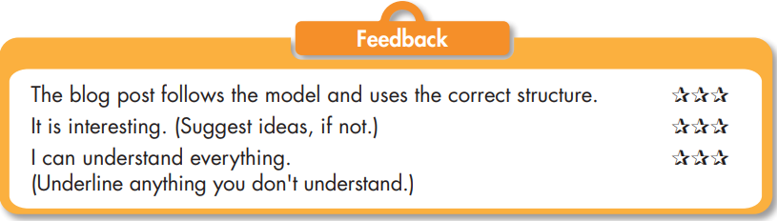

Slide 25

CONSOLIDATION

Slide 26
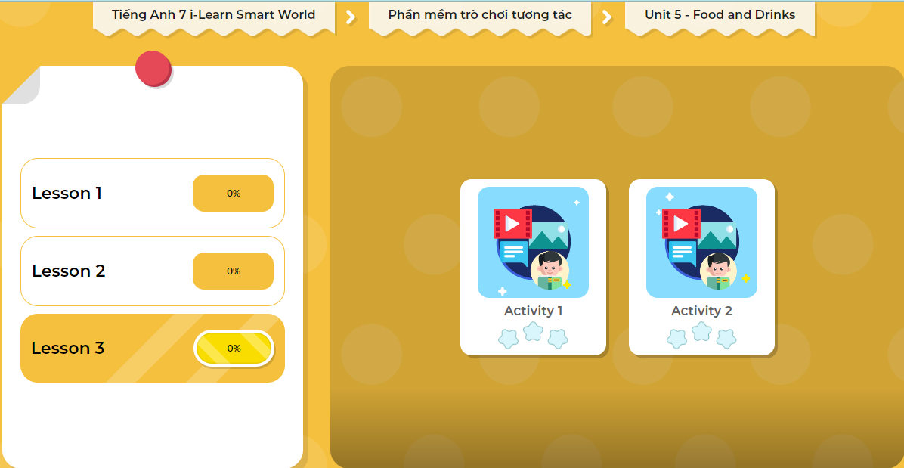
LET’S PLAY!
Click here to play the games

Slide 27

WRAP-UP

Slide 28
Today’s lesson
Writing:
- Understand how to write food blog posts.
Practice writing food blog posts.
Speaking:
- Talk about a dish from your hometown.

Slide 29
Homework
Do the Writing skill on page 31 WB.
Complete the writing notes in Tiếng Anh 7 i-Learn Smart World Notebook on page 33.
Prepare Review Unit 5 (pages 94 & 95 SB).
Play the consolidation games in Tiếng Anh 7 i-Learn Smart World DHA App on www.eduhome.com.vn

Slide 30

Lesson 3
Stay positive and have a nice day!

