Slide 2



Unit
7
TELEVISION
LESSON 7: LOOKING BACK & PROJECT
1

Slide 3
LESSON 7: LOOKING BACK & PROJECT
LESSON 1: GETTING STARTED
WARM-UP
Mini-talk
Task 1: Put the words in the box in the correct column. Add more words if you can. T
Task 2: Use the words in the box to complete the text.
Task 3: Complete each question with a suitable question word.
Task 4: Use the conjunctions provided to connect the sentences.
LOOKING BACK
PROJECT
How important is TV to you?
CONSOLIDATION
Wrap-up
Homework

Slide 4



WARM-UP
MINI-TALK
What is your favourite TV programme?
Could you give me some adjectives to describe it?
Can you tell me what it is about?

Slide 5
LOOKING BACK
1
Put the words in the box in the correct column. Add more words if you can.
educational English in a Minutes popular wildlife
sports interesting animated films funny
Programmes | Adjectives describing programmes
sports
English in a Minutes
educational
funny
wildlife
animated films
interesting
popular

Slide 6
LOOKING BACK
2
Use the words in the box to complete the text.
VTV1 is a popular TV channel in Viet Nam. It attracts many (1) ____ because it has interesting programmes. The (2) ____ programmes show tigers and giraffes in nature. People watch races or football matches on (3) ____ programmes. Comedies make people laugh because they are (4) ____. Game shows are both fun and (5) ____.
viewers funny educational sports animal

Slide 7
LOOKING BACK
2
Use the words in the box to complete the text.
VTV1 is a popular TV channel in Viet Nam. It attracts many
(1) viewers because it has interesting programmes. The (2) ____ programmes show tigers and giraffes in nature. People watch races or football matches on (3) ____ programmes. Comedies make people laugh because they are (4) ____. Game shows are both fun and (5) ____.
funny educational sports animal

Slide 8
LOOKING BACK
2
Use the words in the box to complete the text.
VTV1 is a popular TV channel in Viet Nam. It attracts many
(1) viewers because it has interesting programmes. The (2) animal programmes show tigers and giraffes in nature. People watch races or football matches on (3) ____ programmes. Comedies make people laugh because they are (4) ____. Game shows are both fun and (5) ____.
funny educational sports

Slide 9
LOOKING BACK
2
Use the words in the box to complete the text.
VTV1 is a popular TV channel in Viet Nam. It attracts many
(1) viewers because it has interesting programmes. The (2) animal programmes show tigers and giraffes in nature. People watch races or football matches on (3) sports programmes. Comedies make people laugh because they are (4) ____. Game shows are both fun and (5) ____.
funny educational

Slide 10
LOOKING BACK
2
Use the words in the box to complete the text.
VTV1 is a popular TV channel in Viet Nam. It attracts many
(1) viewers because it has interesting programmes. The (2) animal programmes show tigers and giraffes in nature. People watch races or football matches on (3) sports programmes. Comedies make people laugh because they are (4) funny. Game shows are both fun and (5) ____.
educational

Slide 11
LOOKING BACK
2
Use the words in the box to complete the text.
VTV1 is a popular TV channel in Viet Nam. It attracts many
(1) viewers because it has interesting programmes. The (2) animal programmes show tigers and giraffes in nature. People watch races or football matches on (3) sports programmes. Comedies make people laugh because they are (4) funny. Game shows are both fun and (5) educational.

Slide 12
LOOKING BACK
3
Complete each question with a suitable question word.
1. – ___________ days a week do you go to class?
– I go to class five days a week.
2. – ___________ did you watch on TV last night?
– I watched The Fox Teacher.
3. – ___________ do you like the Wildlife programme?
– Because I love animals.
How many
What
Why

Slide 13
LOOKING BACK
3
Complete each question with a suitable question word.
4. – ___________ is your favourite person on TV?
– I like Minh Phong in The Gift of Music.
5. – ___________ hours a day do you watch TV?
– About half an hour a day. I watch more at the weekend.
Who
How many

Slide 14
LOOKING BACK
4
Use the conjunctions provided to connect the sentences.
1. Ocean Life is on at 7.30. Laughing out Loud comes next at 8.00. (and)
→ Ocean Life is on at 7.30, and Laughing out Loud comes next at 8.00.
2. I like The Seven Kitties very much. I watch it every day. (so)
→ I like The Seven Kitties very much, so I watch it every day.
3. BBC One is a British channel. VTV1 is a Vietnamese channel. (but)
→ BBC One is a British channel, but VTV1 is a Vietnamese channel.

Slide 15
LOOKING BACK
4
Use the conjunctions provided to connect the sentences.
4. Along the Coast is a famous TV series. I don't like it. (but)
→ Along the Coast is a famous TV series, but I don't like it.
5. I have a lot of homework tonight. I can't watch Eight Feet Below. (so)
→ I have a lot of homework tonight, so I can't watch Eight Feet Below.

Slide 16


PROJECT
5
How important is TV to you?

Slide 17
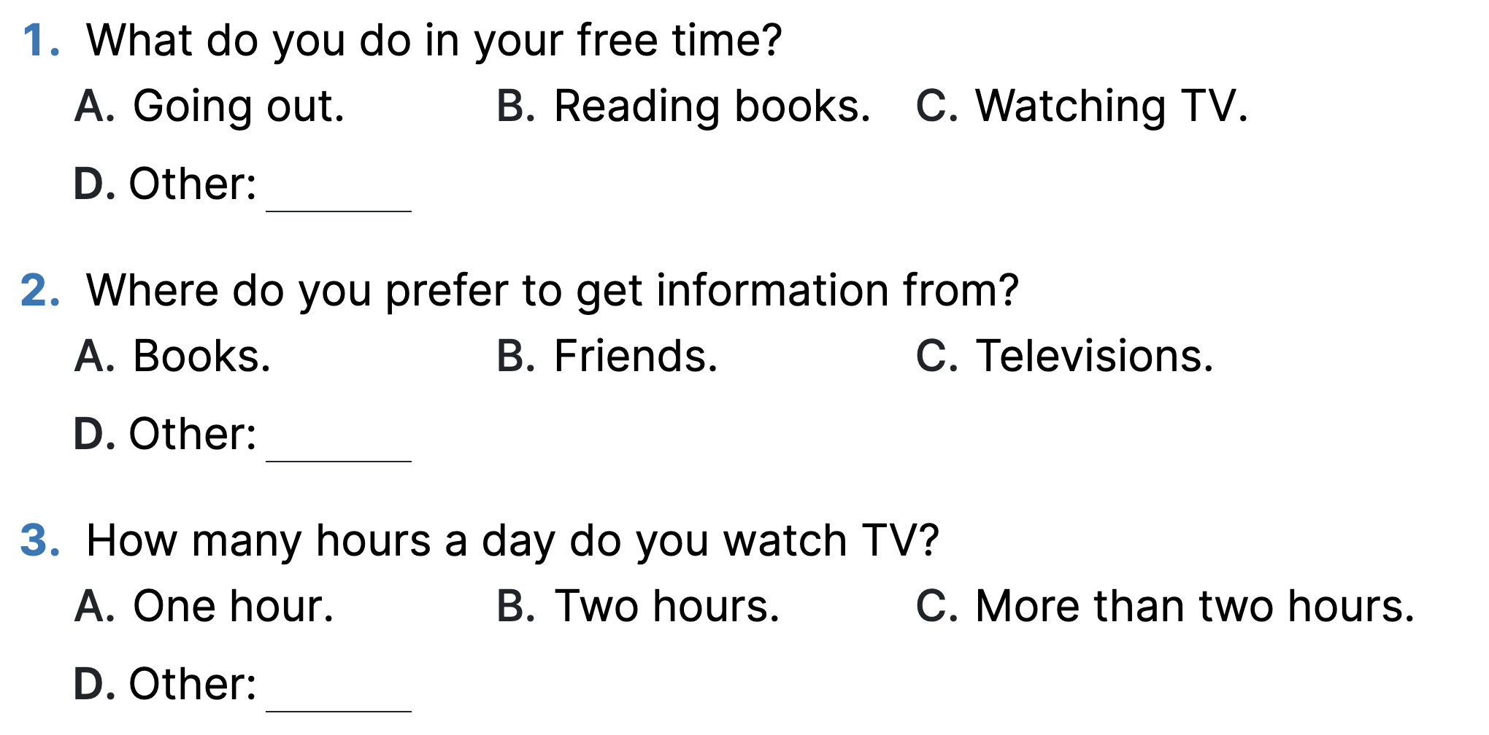
PROJECT
5
How important is TV to you?

Slide 18
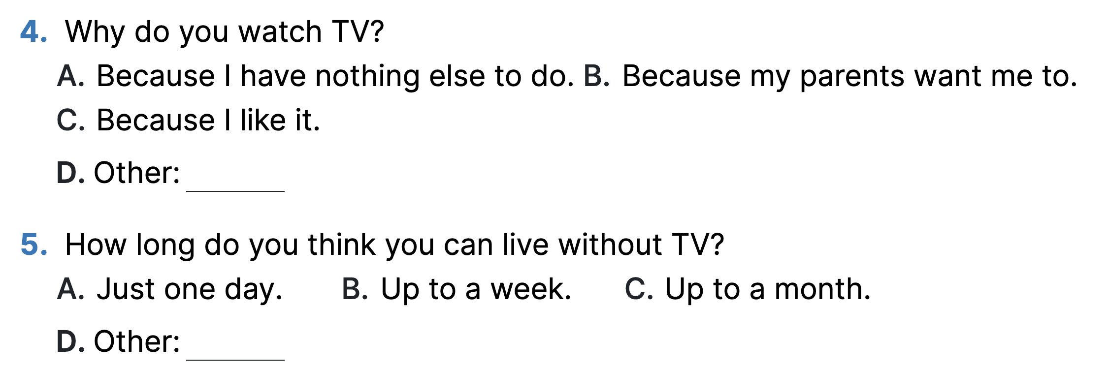
PROJECT
5
How important is TV to you?

Slide 19

CONSOLIDATION
1
Wrap-up
What have we learnt in this lesson?
Vocabulary
Grammar
Project

Slide 20

CONSOLIDATION
2
Homework
Prepare for the next lesson: Unit 8 – Getting started.

Slide 21






Website: hoclieu.vn
Fanpage: facebook.com/www.tienganhglobalsuccess.vn/

