Slide 1

Unit 1: My World
Lesson 1f: Skills
Page 22

Slide 2
Lesson Outline
Warm-up
Reading
Consolidation
Wrap-up

Slide 3
Objectives
By the end of this lesson, students will be able to…
- predict content, to listen/ read for details and specific information.
learn and use some vocabularies related to the topic.

Slide 4

WARM-UP

Slide 5
What do you do when you…?
greet someone
=> shake hands, nod your heads, …
like something
=> thumbs up, clap hands, …
- agree with someone
=> nod your heads, …

Slide 6
Choose the word whose underlined part pronounced differently from that of the other words.
1. A. butter B. tomb C. comb D. lamb
/ˈbʌtər/ /tuːm/ /kəʊm/ /læm/
2. A. choose B. cook C. look D. book
/tʃuːz/ /kʊk/ /lʊk/ /bʊk/
3. A. mechanic B. Christmas C. headache D. handkerchief
/məˈkænɪk/ /ˈkrɪsməs/ /ˈhedeɪk/ /ˈhæŋkətʃiːf/

Slide 7

It’s time to learn …

Slide 8

Reading

Slide 9
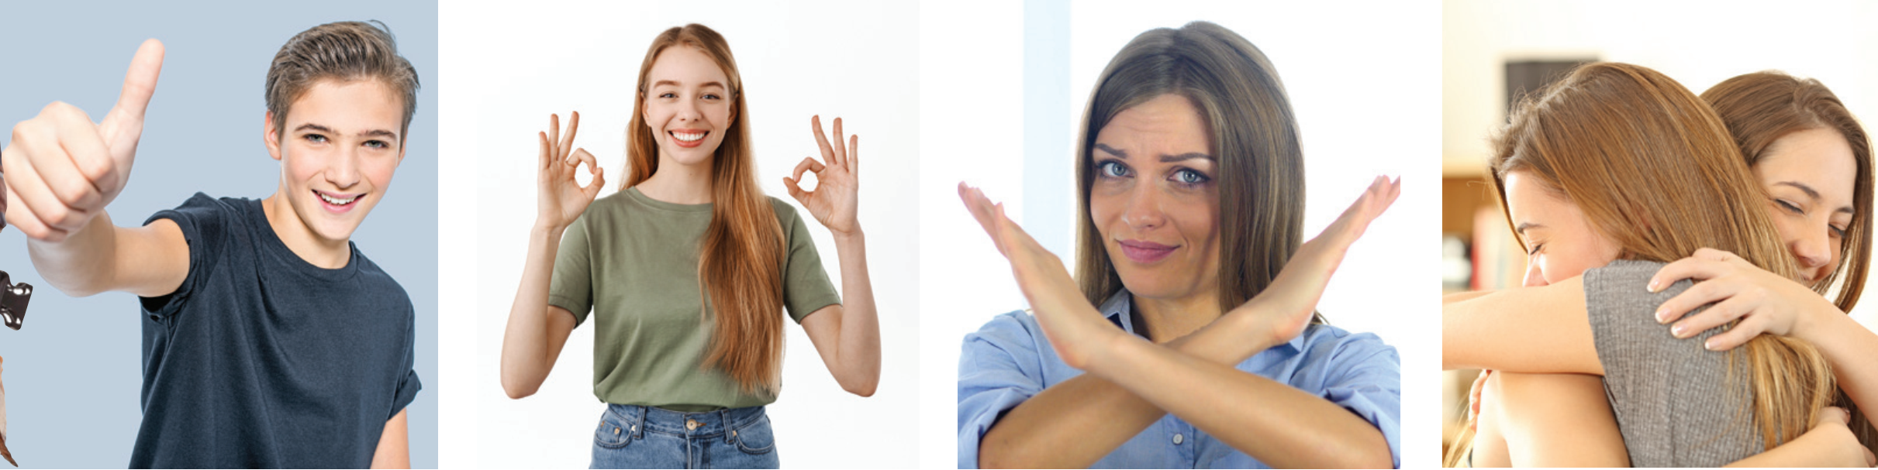
Pre-reading
The blog post is about how different gestures mean different things in countries around the world.

Slide 10
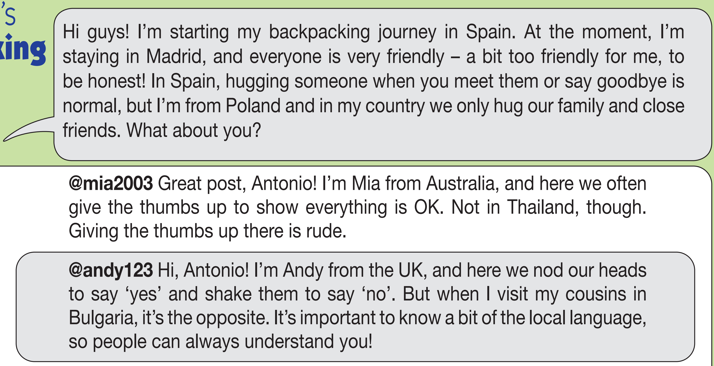

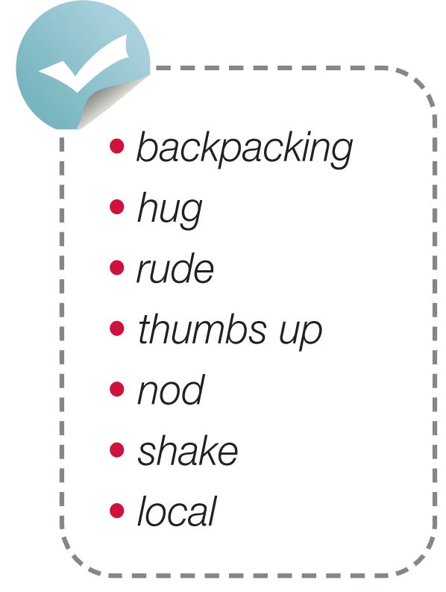
Pre-reading
Find these words in the text, try to guess their meanings.

Slide 11

Vocabulary
Listen and repeat.
backpacking /ˈbækpækɪŋ/ (n) du lịch (bụi)
hug /hʌɡ/ (v,n) ôm/cái ôm
rude /ruːd/ (adj) thô lỗ, khiếm nhã
thumbs up /θʌmz ʌp/ (n) hành động giơ ngón tay cái lên
nod /nɒd/ (v) gật (đầu)
shake /ʃeɪk/ (v) lắc (đầu)
local /ˈləʊkəl/ (adj) thuộc về địa phương

Slide 12
Check vocabulary
Rub out and remember
nod
shake
backpacking
rude
hug
thumbs up
local
gật (đầu)
lắc (đầu)
du lịch (bụi)
thô lỗ, khiếm nhã
ôm/cái ôm
hành động giơ ngón tay cái lên
thuộc về địa phương

Slide 13
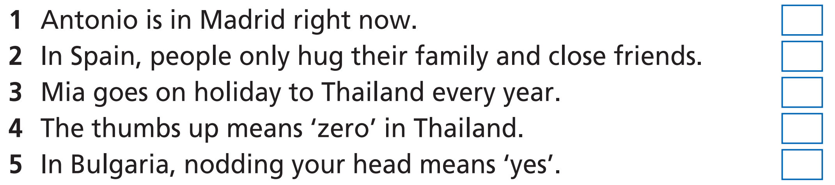
While-reading
First, underline the key words.

Slide 14
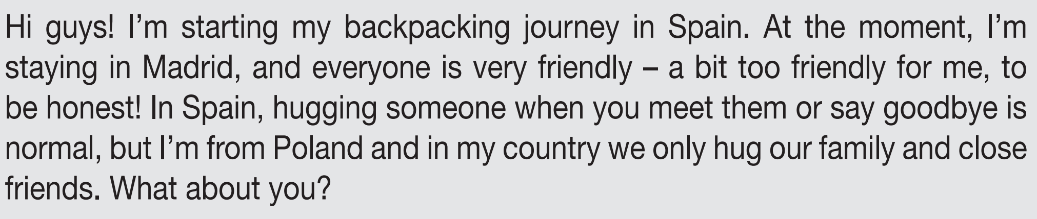
Now, read again and check the answers.
R
W

Slide 15
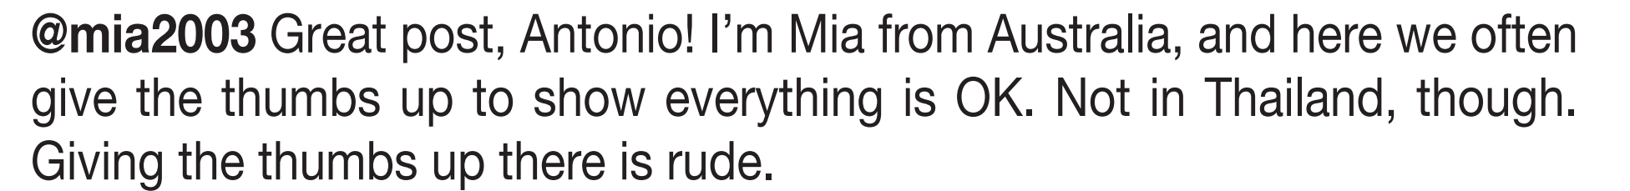
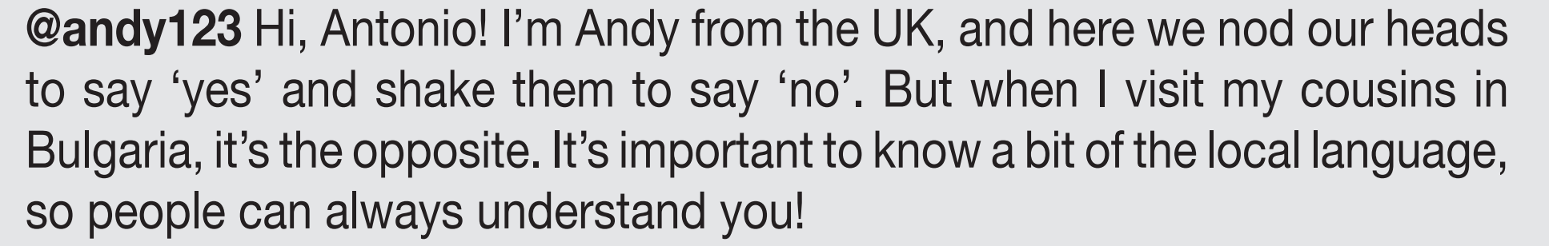
Now, read again and check the answers.
DS
W
W

Slide 16
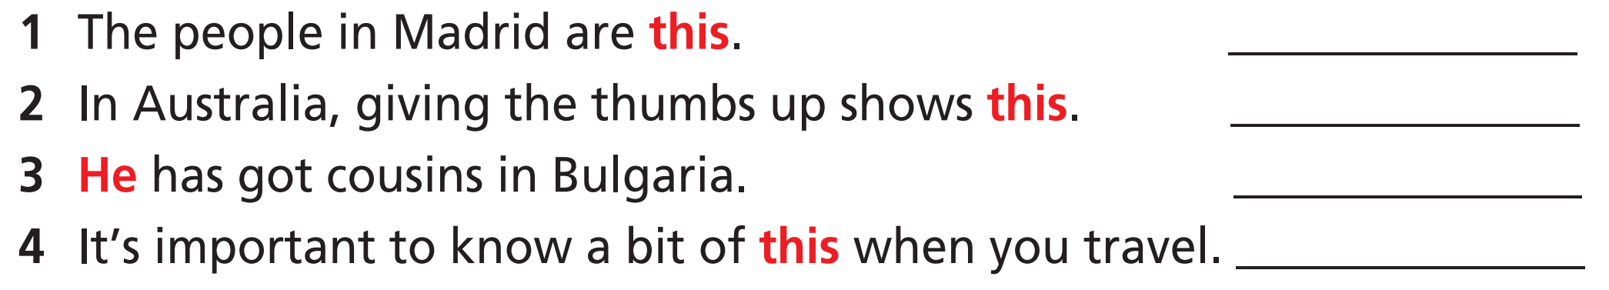
very friendly
everything is OK
Andy
the local language

Slide 17
Post-reading
example
In our country, we only hug our family and close friends. The thumbs up means everything is OK. We nod our heads to say “yes” and shake them to say “no”.

Slide 18

CONSOLIDATION

Slide 19
Write a paragraph (60-80 words) about the gestures people use in your country.

Slide 20

WRAP-UP

Slide 21
Today’s lesson
Vocabularies
backpacking
hug
rude
thumbs up
nod
shake
local
Skills
Listen/ Read for details and specific information

Slide 22
Homework
Practise the vocabularies and make sentences using them.
Do the exercises in TA 7 Right on WB (page 15)
Prepare the next lesson (page 23 SB)

Slide 23

Lesson 3
Stay positive and have a nice day!

