Slide 2
1. In the “ Road runner and Coyote” cartoons, what famous sound does the Road runner make?
A
Ping! Ping!
B
Aooga ! Aooga!
C
Beep! Beep!
D
Vroom! vroom
Trả lời

Slide 3
2.Where should chocking victims place their hands to indicate to others that they need help?
A
Over the eyes
B
On the knees
On the hips
Around the throat
C
D
Trả lời

Slide 4
3. Which of these dance names is used to describe a fashionable dot?
A
Hora
B
Swing
C
Lambada
D
Polka
Trả lời

Slide 5
4. What language would you say “ ello- hay” to greed your friend?
A
Bull latin
B
Dog latin
C
Pig latin
D
Duck latin
Trả lời

Slide 6
$2000
5. What part of s chicken is commonly called the “ drumstick”?
A
Breast
B
Leg
Wing
C
D
Gizzard
Trả lời

Slide 7
$3000
6. What is the only position on a football team that can be “ sacked”?
A
Quarterback
B
Center
C
Tight end
Wide receiver
D
Trả lời

Slide 8
$4000
7.What god of love is often depicted as a chubby winged infant with a bow and arrow?
A
C
Zeus
Mercury
B
Cupid
poseidon
D
Trả lời

Slide 9
8. What Steven Spielberg film climaxes at a place called Devil’s Tower?
A
E.T.The Extra-Terrestrial
B
Close encounters of the Thirdkind
Jurassic Park
Raiders of the Lost Ark
C
D
Trả lời

Slide 10
9. How many ethnic groups in Vietnam?
A
50
B
51
53
54
C
D
Trả lời

Slide 11
10. Which country does not border the sea?
A
Laos
B
China
C
Vietnam
Thailand
D
Trả lời

Slide 12
11 . In what U.S town did the famous 1881 shoot – out at the O. K. Corral take place?
A
Laramie
B
El paso
C
Dodge city
D
Tombstone
Trả lời

Slide 13
12. Which of the following months has no U. S federal holiday?
A
February
B
August
C
September
D
October
Trả lời

Slide 14
13. What mythological beast is reborn from its own ashes?
Minotaur
B
Dragon
A
C
Golem
D
Phonenix
Trả lời

Slide 15
14. Who develop the first effective vaccine against polio?
A
Jonas Salk
B
Niels Bohr
C
Louis Pasteur
Albert Sabin
D
Trả lời

Slide 16
15. Which of the following is not a monotheistic religion?
A
Islam
B
Judaism
C
Hindulsm
D
Christianity
Trả lời

Slide 17
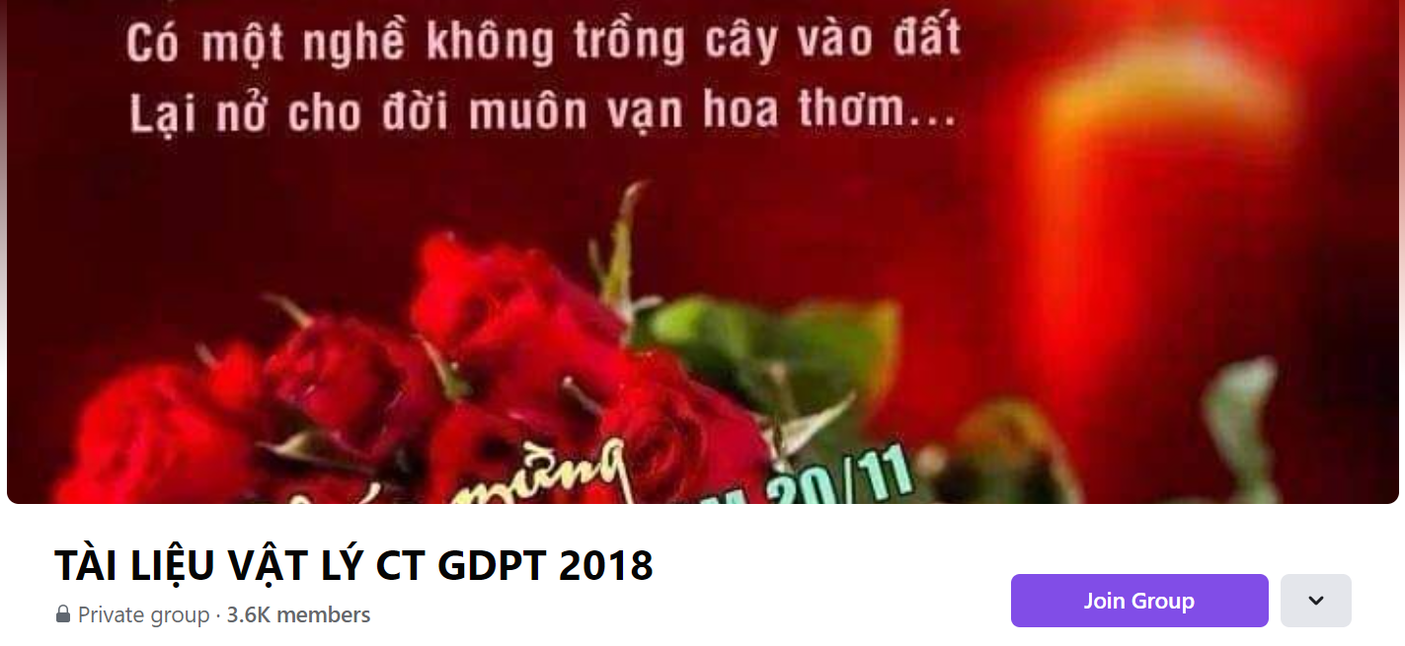
SƯU TẦM: ĐOÀN VĂN DOANH, NAM TRỰC, NAM ĐỊNH
LINK NHÓM DÀNH CHO GV BỘ MÔN VẬT LÝ TRAO ĐỔI TÀI LIỆU VÀ CHUYÊN MÔN CT 2018
https://www.facebook.com/groups/299257004355186

