Slide 2
Unit 8
WILDLIFE CONSERVATION
LESSON I
GETTING STARTED
At a rescue centre

Slide 3
LESSON I
GETTING STARTED
WARM-UP
A video
PRESENTATION
Vocabulary
Task 1: Listen and read.
Task 2: true - false
Task 3: Match each word with its meaning.
Task 4: Complete the sentences.
PRACTICE
PRODUCTION
GW: making presentations
CONSOLIDATION
Wrap-up
Homework

Slide 4

WARM-UP
Notes:
https://www.youtube.com/watch?v=e-yAO267tvE

Slide 5
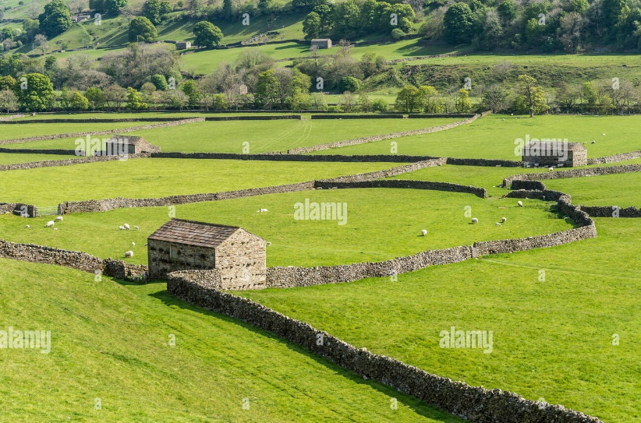

PRESENTATION
enclosure (n)
/ɪnˈkləʊʒə/
an area surrounded by a wall or fence, and used for a particular purpose

Slide 6
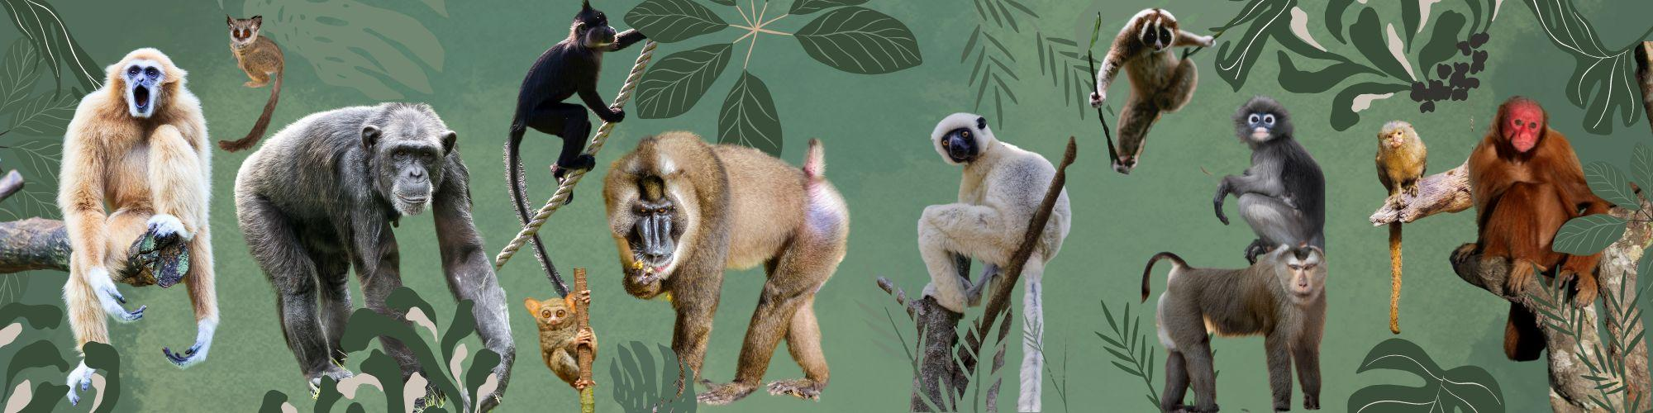
PRESENTATION
primate (n)
/ˈpraɪmeɪt/
a member of the group of animals that includes humans and monkeys

Slide 7

PRESENTATION
house (v)
/haʊz/
provide someone with a place to live

Slide 8
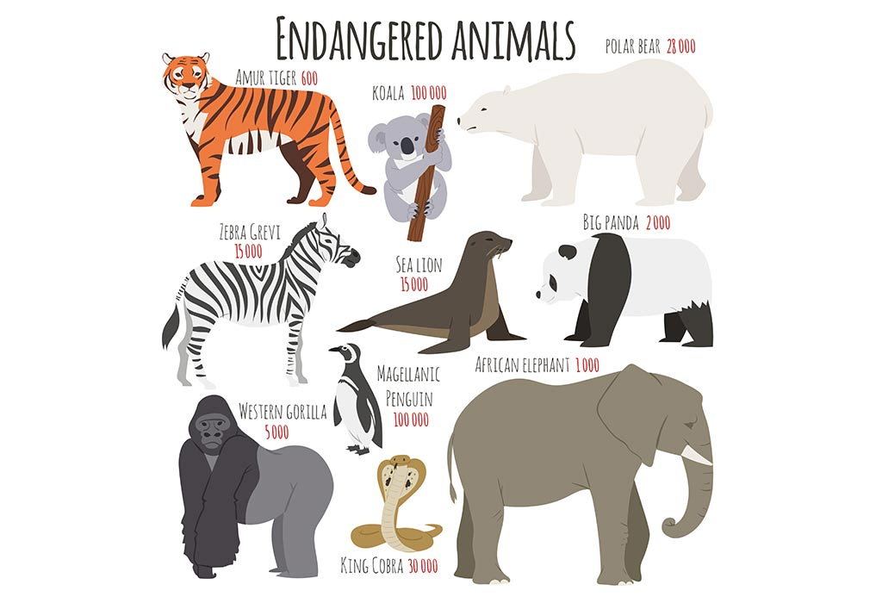
PRESENTATION
endangered (adj)
/ɪnˈdeɪndʒəd/
at risk of no longer existing

Slide 9
PRESENTATION
Form | Pronunciation | Meaning | Vietnamese equivalent
1. enclosure (n) | /ɪnˈkləʊʒə/ | an area surrounded by a fence, used for a particular purpose | mảnh đất đã được rào lại
2. primate (n) | /ˈpraɪmeɪt/ | a member of the group of animals that includes humans and monkeys | linh trưởng
3. house (v) | /haʊz/ | provide someone with a place to live | cung cấp chỗ ở
4. endangered (adj) | /ɪnˈdeɪndʒəd/ | at risk of no longer existing | gặp nguy hiểm

Slide 10
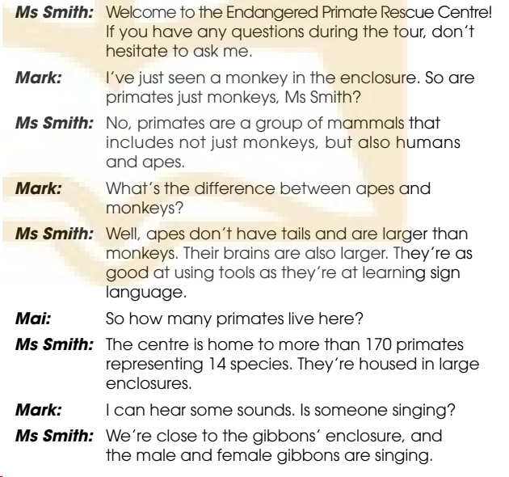
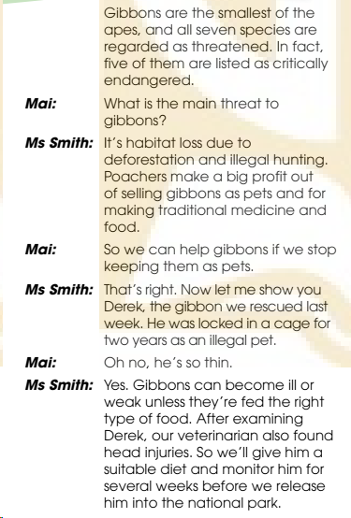
PRACTICE
1
Listen and read.

Slide 11
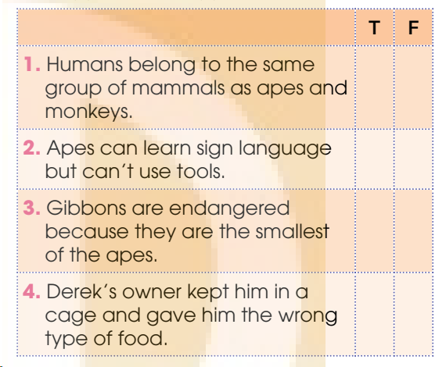
PRACTICE
2
Read the conversation again and decide whether the statements are true (T) or false (F)
T
F
F
T

Slide 12
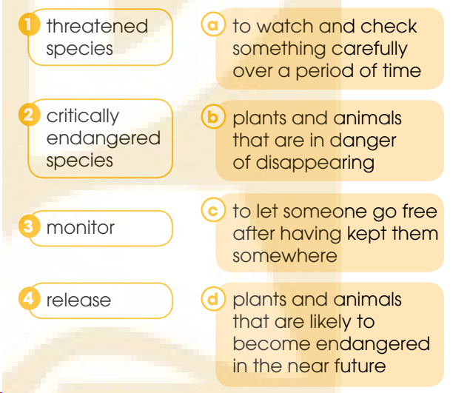
PRACTICE
3
Match the words and phrases with their meanings.
1 - d
2 - b
3 - a
4 - c

Slide 13
PRACTICE
4
Complete the sentences with words from 1.
_____________________________________,
don’t hesitate to ask.
2. Apes are as good at using tools
________________________________________.
3. We can help gibbons
________________________________________.
4. ________________________________________
unless they’re fed the right type of food.
If you have any questions during the tour
as they’re at learning sign language
if we stop keeping them as pets
Gibbons can become ill or weak

Slide 14
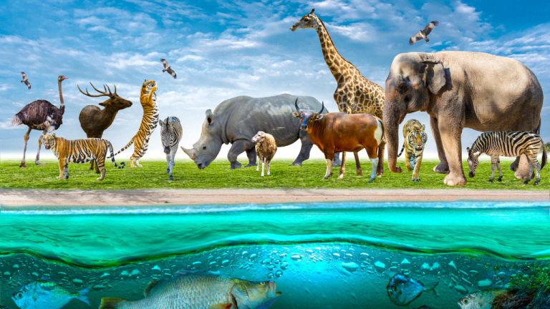
PRODUCTION
Make a presentation about ways to protect the wildlife.

Slide 15
CONSOLIDATION
1
Wrap-up
What have you learnt today?
Some lexical items about green living
Reading for specific information
Verbs with prepositions

Slide 16
CONSOLIDATION
2
Homework
Do exercises in the workbook.
Prepare materials for the project in Lesson 8.

Slide 17
Website: hoclieu.vn
Fanpage: facebook.com/www.tienganhglobalsuccess.vn

