Slide 1

Unit 8: The World around Us
Lesson 1.3: Pronunciation & Speaking
Page 64

Slide 2
Lesson Outline
Warm-up
Pronunciation
Practice
Speaking
Consolidation
Wrap-up

Slide 3
Objectives
By the end of this lesson, students will be able to…
Pronunciation: practice pronouncing gerund
Speaking: practice making arrangement for a class trip.

Slide 4

WARM UP

Slide 5
Work in pairs.
Choose the word whose main stress is placed
differently from the others.
A. village B. fashion C. dessert D. history
/ˈvɪlɪdʒ/ /ˈfæʃn/ /dɪˈzɝːrt/ /ˈhɪstri/
A. performance B. adventure C. assistant D. comedy
/pərˈfɔːrməns/ /ədˈventʃər/ /əˈsɪstənt/ /ˈkɑːmədi/
3. A. hospital B. apartment C. literature D. general
/ˈhɑːspɪtl/ /əˈpɑːrtmənt/ /ˈlɪtrətʃər/ /ˈdʒenrəl/

Slide 6

Work in pairs.
Choose the word whose underlined part is
pronounced differently from that of the other words.
1. A. talent B. puppet C. dinner D. kitchen
/ˈtælənt/ /ˈpʌpɪt/ /ˈdɪnər/ /ˈkɪtʃən/
2. A. brown B. north C. town D. cow
/braʊn/ /nɔːrθ/ /taʊn/ /kaʊ/
3. A. run B. pull C. push D. put
/rʌn/ /pʊl/ /pʊʃ/ /pʊt/

Slide 7
Choose five among these words and write down on a piece of paper.
rafting canyon cave hiking kayaking campsite activity beautiful dangerous climbing vacation fishing
T reads out the words one by one in any order. If the students have written down one of the words teacher calls out, they cross it off. When students have crossed off all five words, they say “Bingo”.
T can ask students to read aloud their list of words.

Slide 8
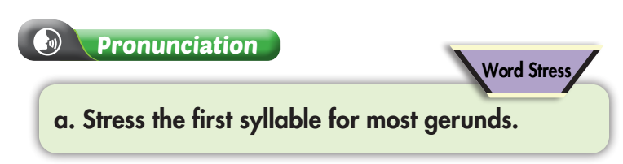
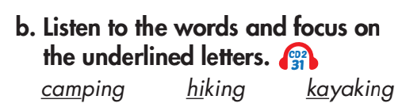


Slide 9

Wrong: the stress is on the second syllable

Slide 10
Practice pronouncing the following gerunds with your friend
fishing climbing hiking rafting
kayaking swimming following sleeping

Slide 11
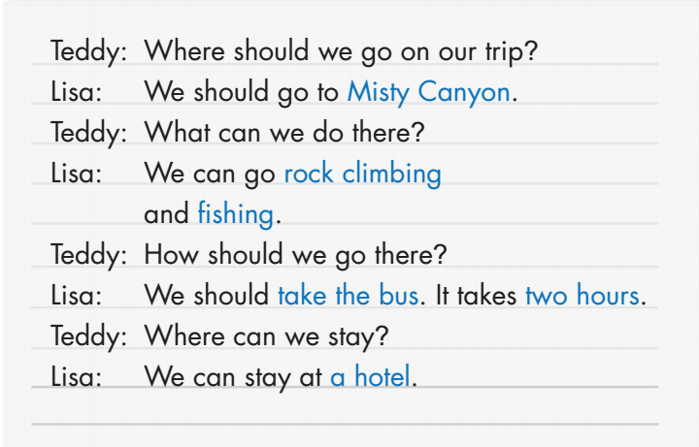
Gray Caves/Red River Canyon
hiking/rafting
kayaking/swimming
go by car – three hours
go by train – one hour
a campsite/a hotel

Slide 12
Teddy: Where should we go on our trip?
Lisa: We should go to __________.
Teddy: What can we do there?
Lisa: We can go __________
and __________.
Teddy: How should we go there?
Lisa: We should __________. It takes __________.
Teddy: Where can we stay?
Lisa: We can stay at __________.
Gray Caves/
Red River Canyon
Gray Caves
hiking
hiking/rafting
kayaking
kayaking/swimming
go by car – three hours
go by train – one hour
go by car
three hours
a campsite
a campsite/a hotel

Slide 13
Teddy: Where should we go on our trip?
Lisa: We should go to __________.
Teddy: What can we do there?
Lisa: We can go __________
and __________.
Teddy: How should we go there?
Lisa: We should __________. It takes __________.
Teddy: Where can we stay?
Lisa: We can stay at __________.
Gray Caves/
Red River Canyon
Red River Canyon
hiking/rafting
rafting
swimming
kayaking/swimming
go by car – three hours
go by train – one hour
go by train
one hour
a hotel
a campsite/a hotel

Slide 14

A: Where should we go on our trip?
B: We should go to __________.
A: What can we do there?
A: We can go __________ and __________.
B: How should we go there?
A: We should __________. It takes __________.
A: Where can we stay?
B: We can stay at a __________.

Slide 15

Speaking

Slide 16
Pre-Speaking
Complete the following sentences with given words.
Where/going to go?
→ Where are we going to go?
What/do there?
→ What can we do there?
How long/get there?
→ How long does it take to get there?
Where/stay?
→ Where can we stay?

Slide 17
Pre-Speaking
Match the questions with the answers
We can go rafting and go swimming.
Where are we going to go?
What can we do there?
We can stay at a campsite or a hotel by the river.
How long does it take to get there?
We are going to go to Ha Long Bay.
Where can we stay?
It takes about 3 hours by car.

Slide 18
Where are we going to go?
→ We are going to go to Ha Long Bay.
What can we do there?
→ We can go rafting and go swimming.
How long does it take to get there?
→ It takes about 3 hours by car.
Where can we stay?
→ We can stay at a campsite or a hotel by the river.

Slide 19
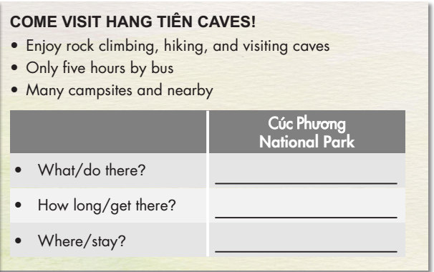
Student A answers Student B's questions about Hang Tiên Caves, then asks Student B questions about Cúc Phương National Park and completes the table.

Slide 20
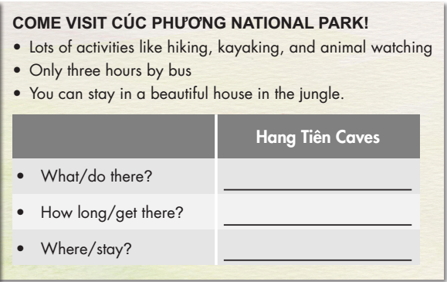
Student B answers Student A's questions about Cúc Phương National Park, then asks Student A questions about Hang Tiên Caves and completes the table.

Slide 21

CONSOLIDATION

Slide 22
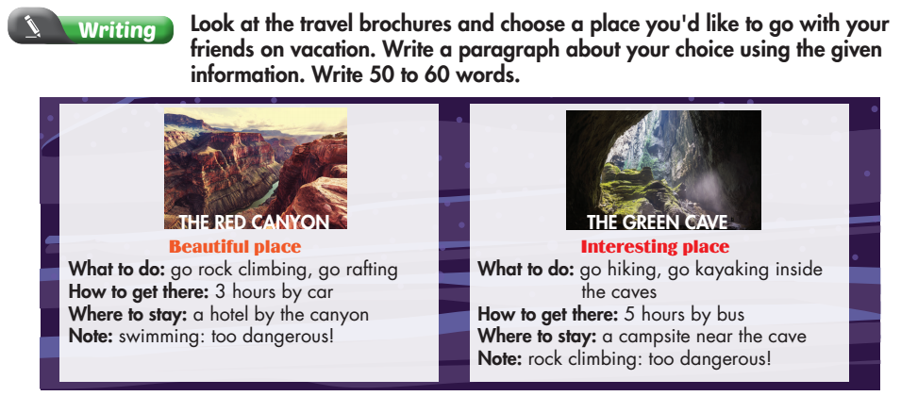
WB-p.45

Slide 23
I think we should go to The Red Canyon. It’s a beautiful place. We can ____________ there. It takes about ________ by _________ to get there. We can stay _________________. We can’t ___________. It’s too dangerous.

Slide 24
I think we should go to The Red Canyon. It’s a beautiful place. We can go rock climbing and rafting there. It takes about three hours by car to get there. We can stay at a hotel by the canyon. We can’t go swimming. It’s too dangerous.

Slide 25

WRAP-UP

Slide 26
Today’s lesson
Pronunciation:
practice pronouncing gerund.
Speaking:
practice making arrangement for a class trip.

Slide 27
Homework
Review the vocabularies and grammar and make sentences using them.
Do the exercises on page 45 WB.
Prepare the next lesson (page 65 - SB).
Play the consolidation games in Tiếng Anh 6 i-Learn Smart World DHA App on www.eduhome.com.vn

Slide 28
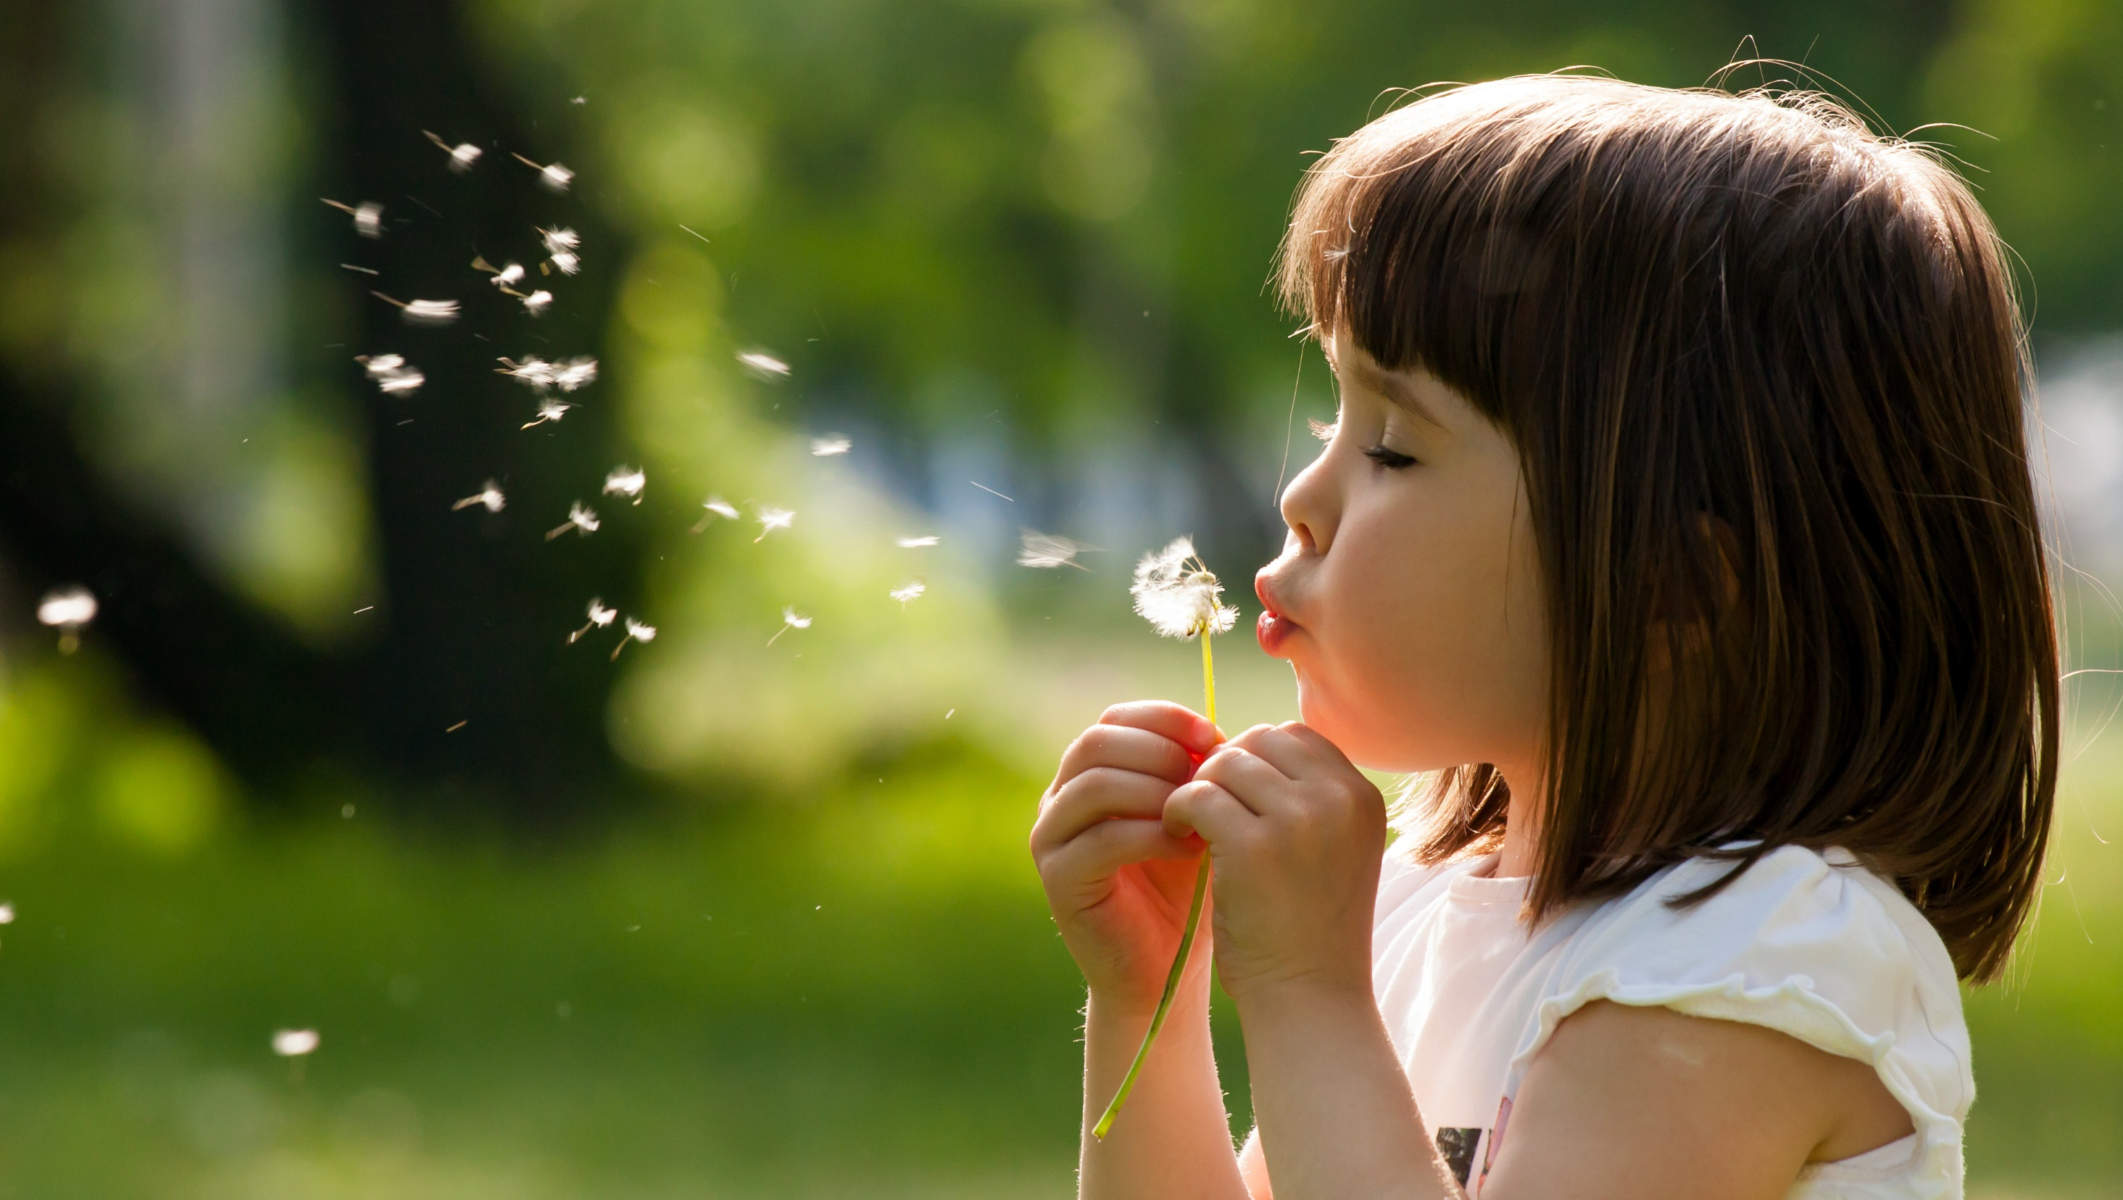
Enjoy your day!

