Slide 1

Unit 10: Energy Sources
Lesson 2.2: Grammar
Page 80

Slide 2


LESSON OUTLINE
Consolidation

Slide 3

By the end of this lesson, students will be able to…
use and to add similar ideas.
use but to add different or unexpected information.

Slide 4

and / but

Slide 5

WARM-UP

Slide 6

Work in pairs
Read and analyze the following sentences.
1. Solar power plants are clean and cheap to run.
2. Solar power plants are cheap to run, but they aren’t cheap to build.
→ What is the difference between “and” and “but”?

Slide 7



Slide 8
PRESENTATION
and / but

Slide 9
Lead in
Read, look, and match.
We use “but”
to add similar ideas.
We use “and”
to add different / unexpected information.

Slide 10

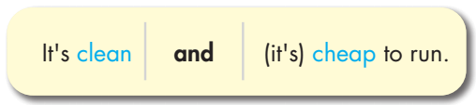
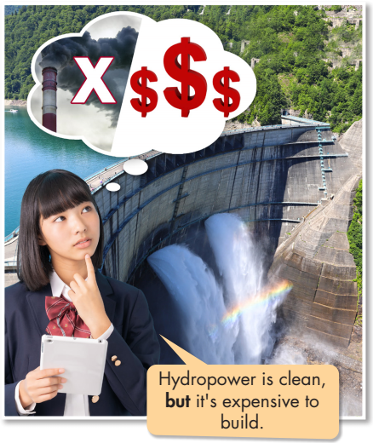
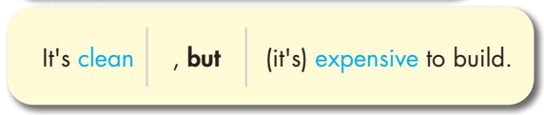
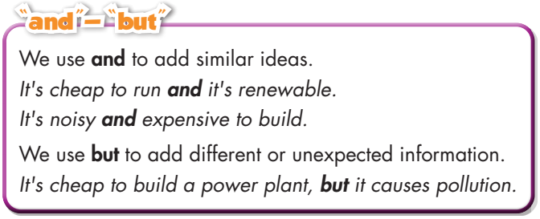
comma

Slide 11
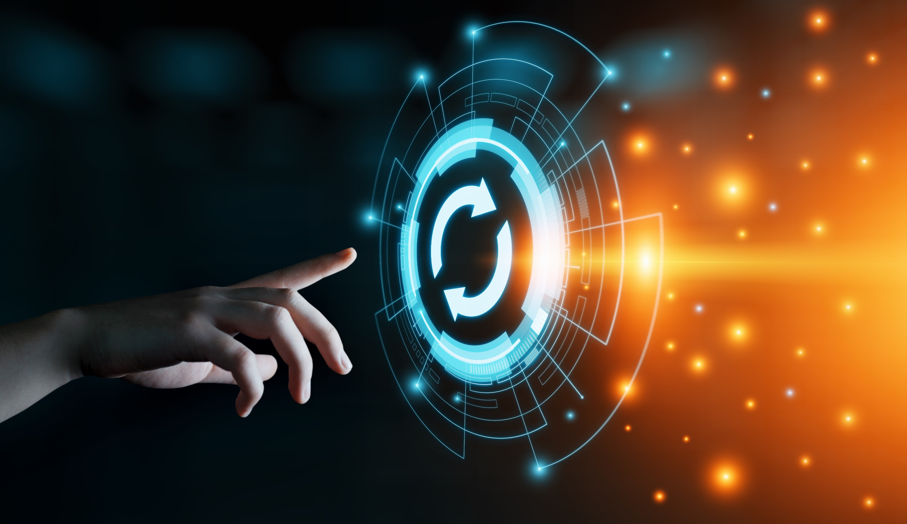
PRACTICE

Slide 12
Remember to use and/but
1. Coal/ cheap/ easy/ use
Coal is cheap and easy to use.
2. Hydropower/ clean/ cheap
Hydropower is clean and cheap.
3. Wind power/ clean/ renewable/ noisy
Wind power is clean and renewable, but (it's) noisy.

Slide 13
Remember to use and/but
4. Natural gas/ cheap/ non-renewable
Natural gas is cheap, but (it's) non-renewable.
5. Motorbikes/ popular/ cheap/ pollution
Motorbikes are popular and cheap, but they cause pollution.
6. Microwave ovens/ convenient/ save money
Microwave ovens are convenient and they save money.

Slide 14
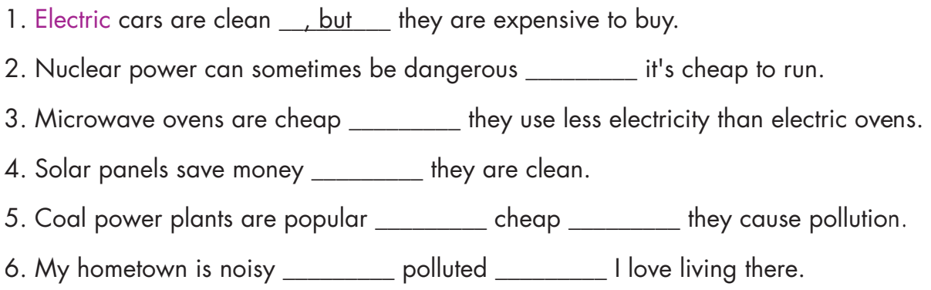
, but
and
and
and
, but
and
, but

Slide 15
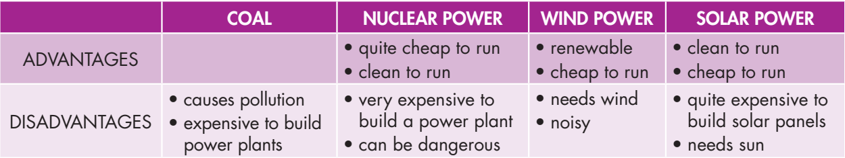
Extra Practice
WB, page 59
For example: Coal causes pollution and it is expensive to build power plants.

Slide 16
Extra Practice
WB, page 59
2. Nuclear power is quite cheap and clean to run, but it is very expensive to build a power plant.
3. Wind power is renewable and it is cheap to run.
4. Wind power needs wind and it is noisy.
5. Solar power is clean and cheap to run, but it is quite expensive to build solar panels.

Slide 17

Extra Practice
WB, page 59
1. run./ to/ Nuclear/ is/ cheap/ to/ power/ and/ clean
2. , but/ expensive/ solar panels./ Solar power/ is/ it’s/ to build/ to run/ quite/ clean
Nuclear power is cheap and clean to run.
Solar power is clean to run, but it’s quite expensive to build solar panels.

Slide 18
Extra Practice
WB, page 59
3. a power plant./ clean/ , but/ it’s/ build/ to/ expensive/ Hydropower/ is/ to run
4. build/ Natural/ run/ cheap/ to/ gas/ is/ to/ cheap/ a power plant./ and/ it's
5. be/ Wind power/ is/ to/ noisy./ run/ , but/ wind turbines/ cheap/ can
Hydropower is clean to run, but it’s expensive to build a power plant.
Natural gas is cheap to run and it’s cheap to build a power plant.
Wind power is cheap to run, but wind turbines can be noisy.

Slide 19

PRODUCTION

Slide 20
Airplanes are fast and convenient, but they cause pollution.
Cars are convenient, but they are expensive.
Bicycles are clean, cheap, and good for our health.

Slide 21

CONSOLIDATION

Slide 22
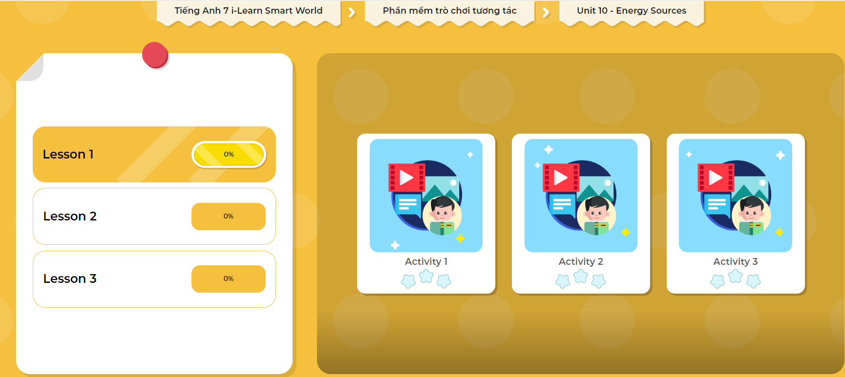
LET’S PLAY!
Click here to play the games

Slide 23

What sources of energy does your city/town use? What are their advantages and disadvantages? Write 60 to 80 words.

Slide 24

WRAP-UP

Slide 25
Today’s lesson
Grammar:
- Use “and” to add similar ideas.
- Use “but” to add different or unexpected information.
Speaking & Writing:
- Talk and write about the advantages and disadvantages of energy sources.

Slide 26
Homework
Practice making sentences using and/but.
Complete the grammar notes in Tiếng Anh 7 i-Learn Smart World Notebook on page 63.
Prepare the next lesson (page 81 SB).
Play the consolidation games in Tiếng Anh 7 i-Learn Smart World App on www.eduhome.com.vn

Slide 27

Lesson 3
Stay positive and have a nice day!

