Slide 1

Unit 7: Transportation
Lesson 1.2: Grammar
Page 53

Slide 2


LESSON OUTLINE
Consolidation

Slide 3

By the end of this lesson, students will be able to…
practice ordering adjectives and using Possessive pronouns correctly.

Slide 4
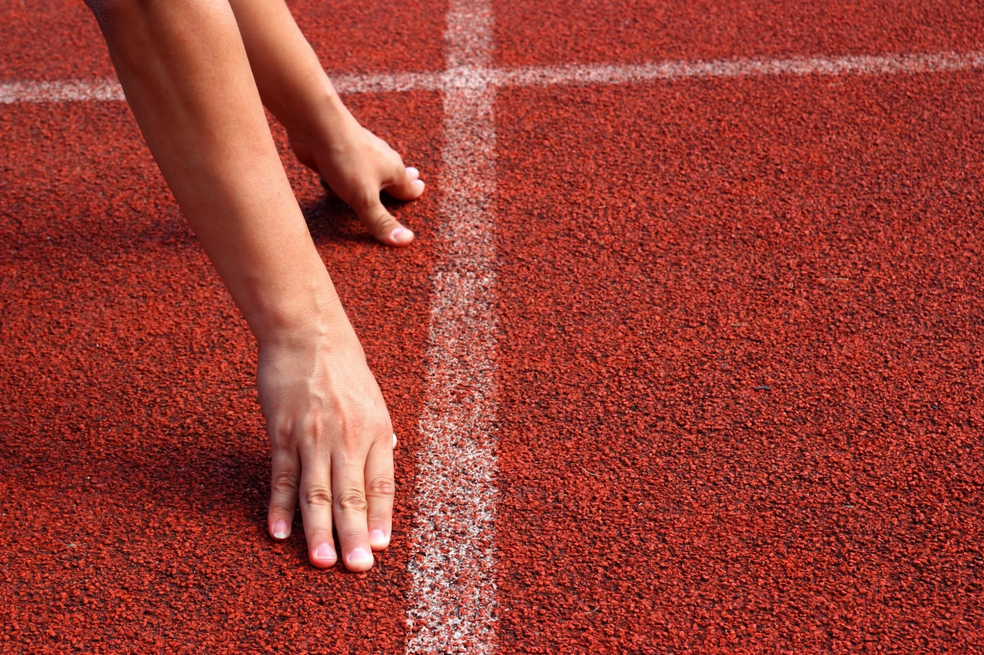
WARM-UP

Slide 5

Work in pairs
1. Do you have a suitcase? Can you describe it?
2. What color is your backpack? Is it new or old?
3. Can you describe your favorite T-shirt?

Slide 6
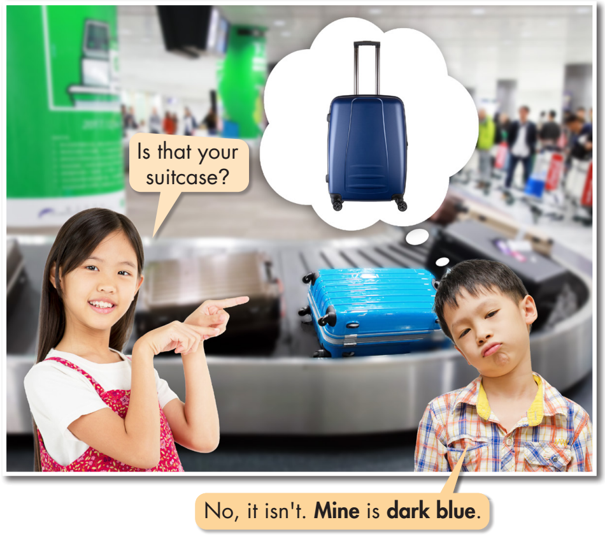

a. Listen and repeat.
Click on the icon to hear the sound

Slide 7

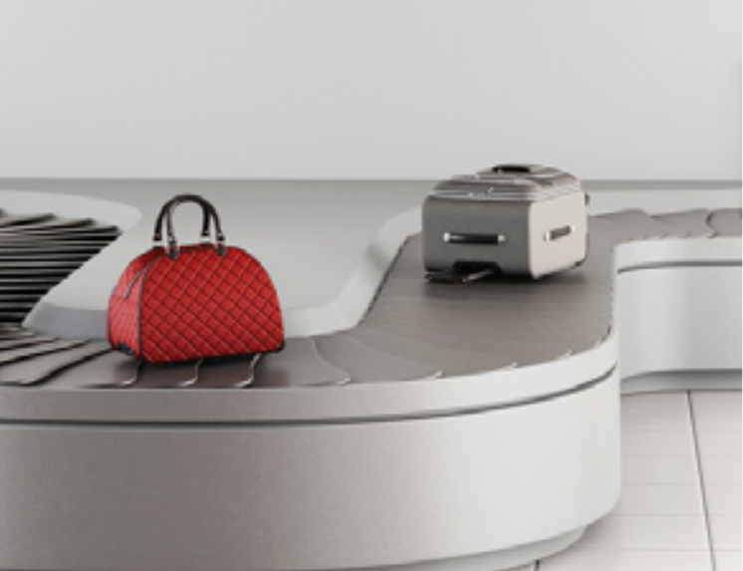
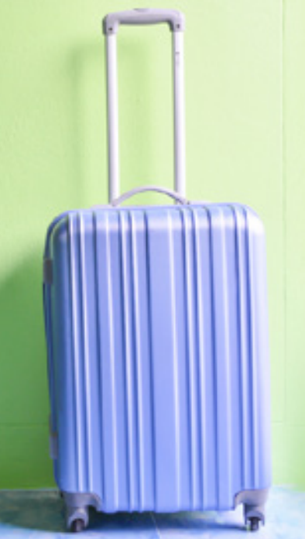
Work in pairs
No, it isn’t. Mine is a small light blue suitcase.
Is that your suitcase?

Slide 8
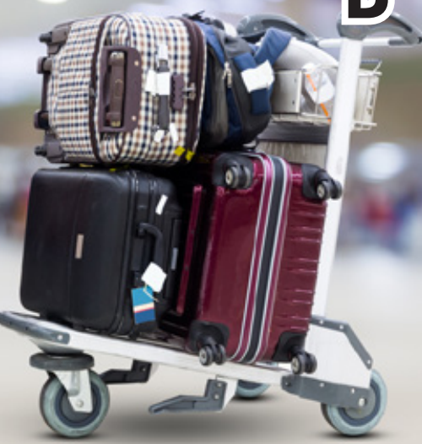
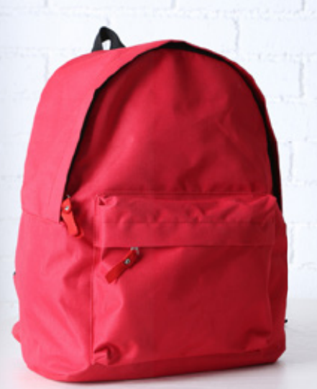
Work in pairs
No, it isn’t. Mine is a small new red backpack.
Is that your luggage?

Slide 9
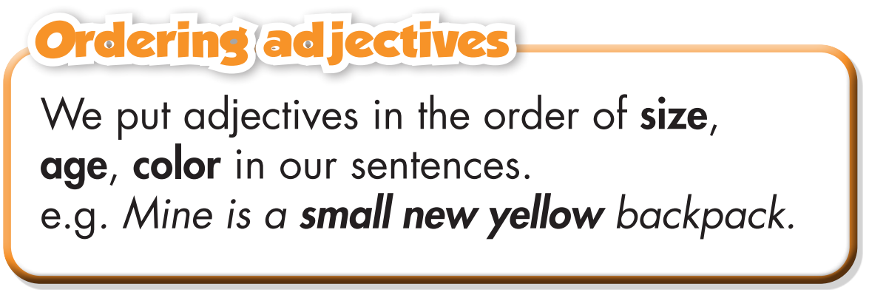
I have a small new red backpack.
Notes:
GV click vào từng cụm nghe âm thanh

Slide 10
I have a small light blue suitcase.
Notes:
GV click vào từng cụm nghe âm thanh

Slide 11
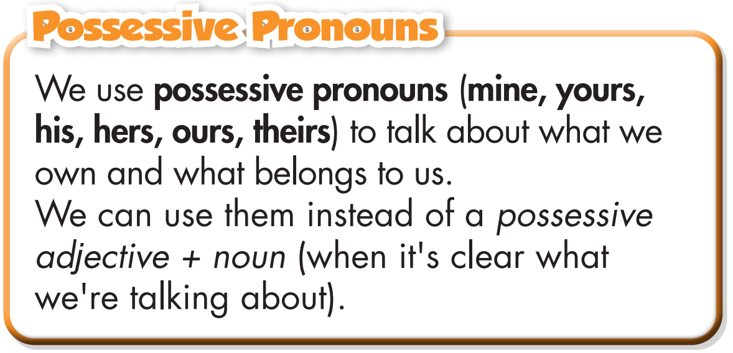
Chúng ta dùng đại từ sở hữu để nói về những gì chúng ta sở hữu hoặc những gì thuộc về chúng ta.
Chúng ta có thể dùng các đại từ sở hữu thay cho một tính từ sở hữu + danh từ (khi đã rõ chúng ta đang nói về cái gì).

Slide 12
Examples:
Is that blue backpack yours?
My backpack is red. → Mine is red.
Whose passports are these?
They're our passports. → They're ours.
Is this her backpack?
No, her backpack is dark brown.
→ No, hers is dark brown.

Slide 13
b. Fill in the blanks with the correct order of adjectives.
Read the sentences and fill in the blanks by yourself.
He's wearing a ___________________ T-shirt. (white/large)
He wants to buy a ___________________ suitcase. (new/orange/large)
Mine is a ___________________ bag. (dark blue/small/new)
She's carrying a ___________________ backpack. (small/brown/old)
I have a ___________________ suitcase. (medium-sized/dark red/old)
Mine is the ___________________ handbag. (old/yellow/small)

Slide 14
b. Fill in the blanks with the correct order of adjectives.
Share your answers with your friends.
He's wearing a ___________________ T-shirt. (white/large)
He wants to buy a ___________________ suitcase. (new/orange/large)
Mine is a ___________________ bag. (dark blue/small/new)
She's carrying a ___________________ backpack. (small/brown/old)
I have a ___________________ suitcase. (medium-sized/dark red/old)
Mine is the ___________________ handbag. (old/yellow/small)
large white
large new orange
small new dark blue
small old brown
medium-sized old dark red
small old yellow

Slide 15
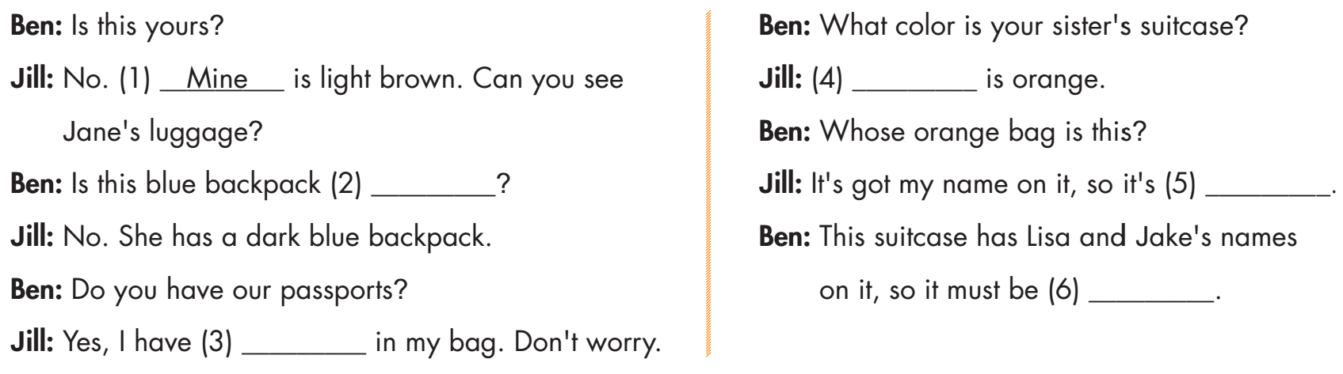
c. Fill in the blanks with the correct possessive pronouns to complete the conversation.
Read the conversation and fill in the blanks by yourself.

Slide 16
c. Fill in the blanks with the correct possessive pronouns to complete the conversation.
Check the answers with your partner. Practice the conversation.
Hers
hers
mine
theirs
ours

Slide 17
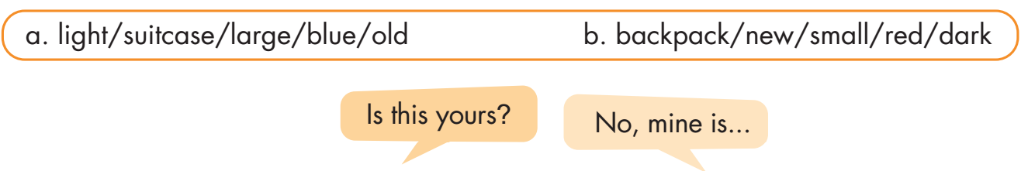
d. In pairs: Ask your partner about the luggage. Use the prompts.
a.
b.
A: Is this yours?
A: Is this yours?
B: No, mine is a large old light blue suitcase.
B: No, mine is a small new dark red backpack.

Slide 18
Extra Practice
WB, page 39
a. Fill in the blanks using possessive pronouns..
Read the conversation and fill in the blanks by yourself.
(Mia and her friends are standing at the baggage claim at Maple Airport.)
Mia: Let's go and get our luggage! That big orange backpack is
(1) ____________.
Jane: I have a blue suitcase. Look! That's (2) ____________.
Mia: We need to get John and Matt's luggage.
Jane: Is that (3) ____________?
Mia: Yes, it is.

Slide 19
Extra Practice
WB, page 39
a. Fill in the blanks using possessive pronouns..
(A moment later)
Liz: Do you see my suitcase? I have a brown one.
Jane: Is that (4) ____________?
Liz: That's right! It's (5) _______________. Oh, where's Tom?
Jane: He's in the bathroom. What luggage does he have?
Liz: He has a red backpack.
Jane: Is that (6) ____________?
Mike: No, that's his sister's backpack. His is bigger than (7) ____________.
Oh, I think his backpack is the one next to the green suitcase.
Mia: Do you have the boarding passes? We need to show our boarding passes at customs.
Jane: Tom has (8) ____________ in his bag.
Mike: All right. Let's go to customs.

Slide 20
Extra Practice
WB, page 39
a. Fill in the blanks using possessive pronouns.
Check the answers with your partner. Practice the conversation.
(Mia and her friends are standing at the baggage claim at Maple Airport.)
Mia: Let's go and get our luggage! That big orange backpack is
(1) ____________.
Jane: I have a blue suitcase. Look! That's (2) ____________.
Mia: We need to get John and Matt's luggage.
Jane: Is that (3) ____________?
Mia: Yes, it is.
mine
mine
theirs

Slide 21
Extra Practice
WB, page 39
a. Fill in the blanks using possessive pronouns.
(A moment later)
Liz: Do you see my suitcase? I have a brown one.
Jane: Is that (4) ____________?
Liz: That's right! It's (5) _______________. Oh, where's Tom?
Jane: He's in the bathroom. What luggage does he have?
Liz: He has a red backpack.
Jane: Is that (6) ____________?
Mike: No, that's his sister's backpack. His is bigger than (7) ____________.
Oh, I think his backpack is the one next to the green suitcase.
Mia: Do you have the boarding passes? We need to show our boarding passes at customs.
Jane: Tom has (8) ____________ in his bag.
Mike: All right. Let's go to customs.
yours
mine
his
hers
ours

Slide 22
Extra Practice
WB, page 39
b. Circle the correct answers.
Read the sentences and choose the correct words by yourself.
Finn has a new gray/gray new backpack.
Mine is the yellow old/old yellow one.
What luggage/luggage's do you have?
I have a big purple/purple big suitcase.
Katy has a white big new/big new white suitcase.
Matt has a new backpack. His/He is green.
Kate's carrying a purse. Her/Hers is new.
Alice has a small old blue/an old small blue bag.

Slide 23
Extra Practice
WB, page 39
b. Circle the correct answers.
Check the answers with your partner.
Finn has a new gray/gray new backpack.
Mine is the yellow old/old yellow one.
What luggage/luggage's do you have?
I have a big purple/purple big suitcase.
Katy has a white big new/big new white suitcase.
Matt has a new backpack. His/He is green.
Kate's carrying a purse. Her/Hers is new.
Alice has a small old blue/an old small blue bag.

Slide 24

CONSOLIDATION

Slide 25
Extra Practice
WB, page 39
Writing: Look at the picture. Which luggage does the Brown family have? Write questions and answers in full sentences, then rewrite the answers using possessive pronouns.
What luggage does Mr. Brown have?
He has an old brown suitcase.
His is an old brown suitcase.
2. ____________________________?
_________________________
_________________________
3. ____________________________?
_________________________
_________________________
4. ____________________________?
_________________________
_________________________

Slide 26
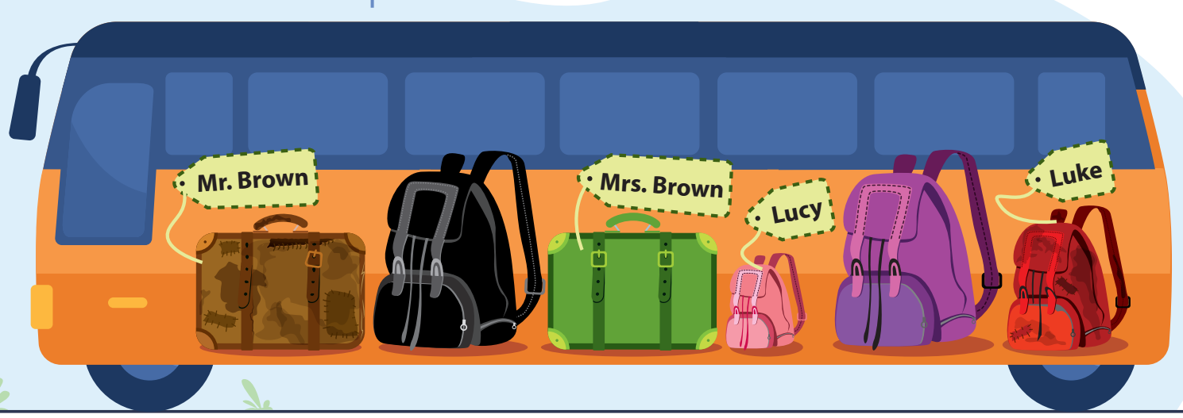
Extra Practice
WB, page 39
Writing: Look at the picture. Which luggage does the Brown family have? Write questions and answers in full sentences, then rewrite the answers using possessive pronouns.

Slide 27
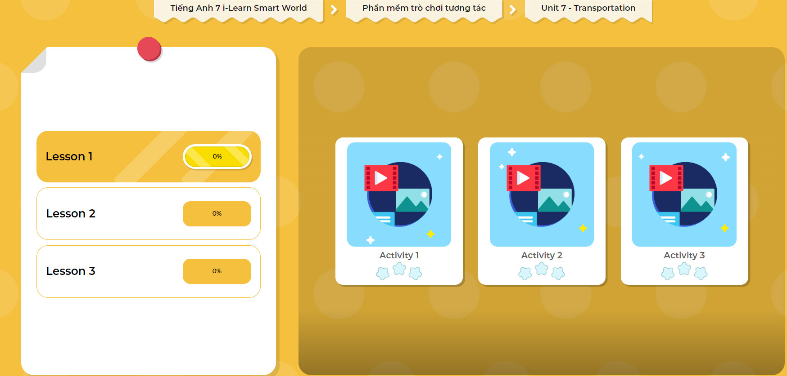
Click on the picture below to play the games.

Slide 28

WRAP-UP

Slide 29
Today’s lesson
Grammar:
Ordering adjectives: we put adjectives in the order of size, age, color in our sentences.
Possessive pronouns are used to talk about what we own, and we use them instead of a possessive adjective + noun.

Slide 30
Homework
Learn by heart vocabularies and make sentences using them.
Do the writing exercise in Tiếng Anh 7 i-Learn Smart World Workbook on page 39.
Complete the grammar notes in Tiếng Anh 7 i-Learn Smart World Notebook on page 43.
Play consolation games in Tiếng Anh 7 i-Learn Smart World DHA App on www.eduhome.com.vn
Prepare the next lesson (page 54 SB).

Slide 31

Lesson 3
Stay positive and have a nice day!

