Slide 1

Unit 3: Friends
Lesson 3.1: Vocabulary & Listening
Page 28

Slide 2
Lesson Outline
Warm-up
Vocabulary
Listening
Useful language
Consolidation
Wrap-up

Slide 3
Objectives
By the end of this lesson, students will be able to…
- describe someone’s character.
- ask and answer about personal characteristics.

Slide 4

WARM-UP

Slide 5
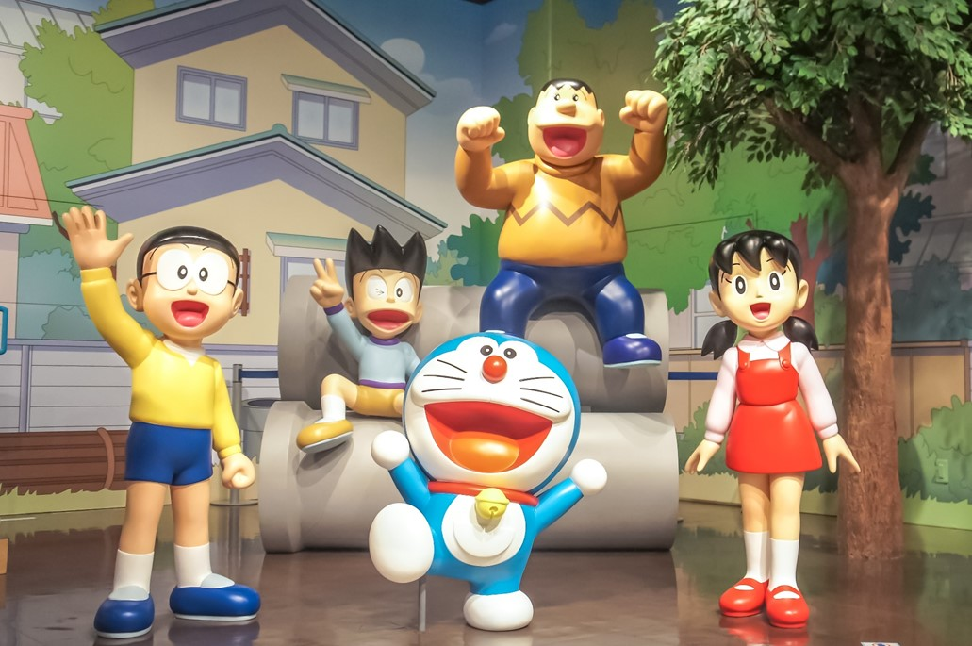
Look at the picture
Name the characters
Say the characteristics of each character
ID: 238876258

Slide 6

ID: 261898355
In the Doraemon comic, Doraemon is kind. Nobita is lazy. Shizuka is very friendly and helpful. Suneo is selfish, and Gian is naughty.
ID: 238876258

Slide 7
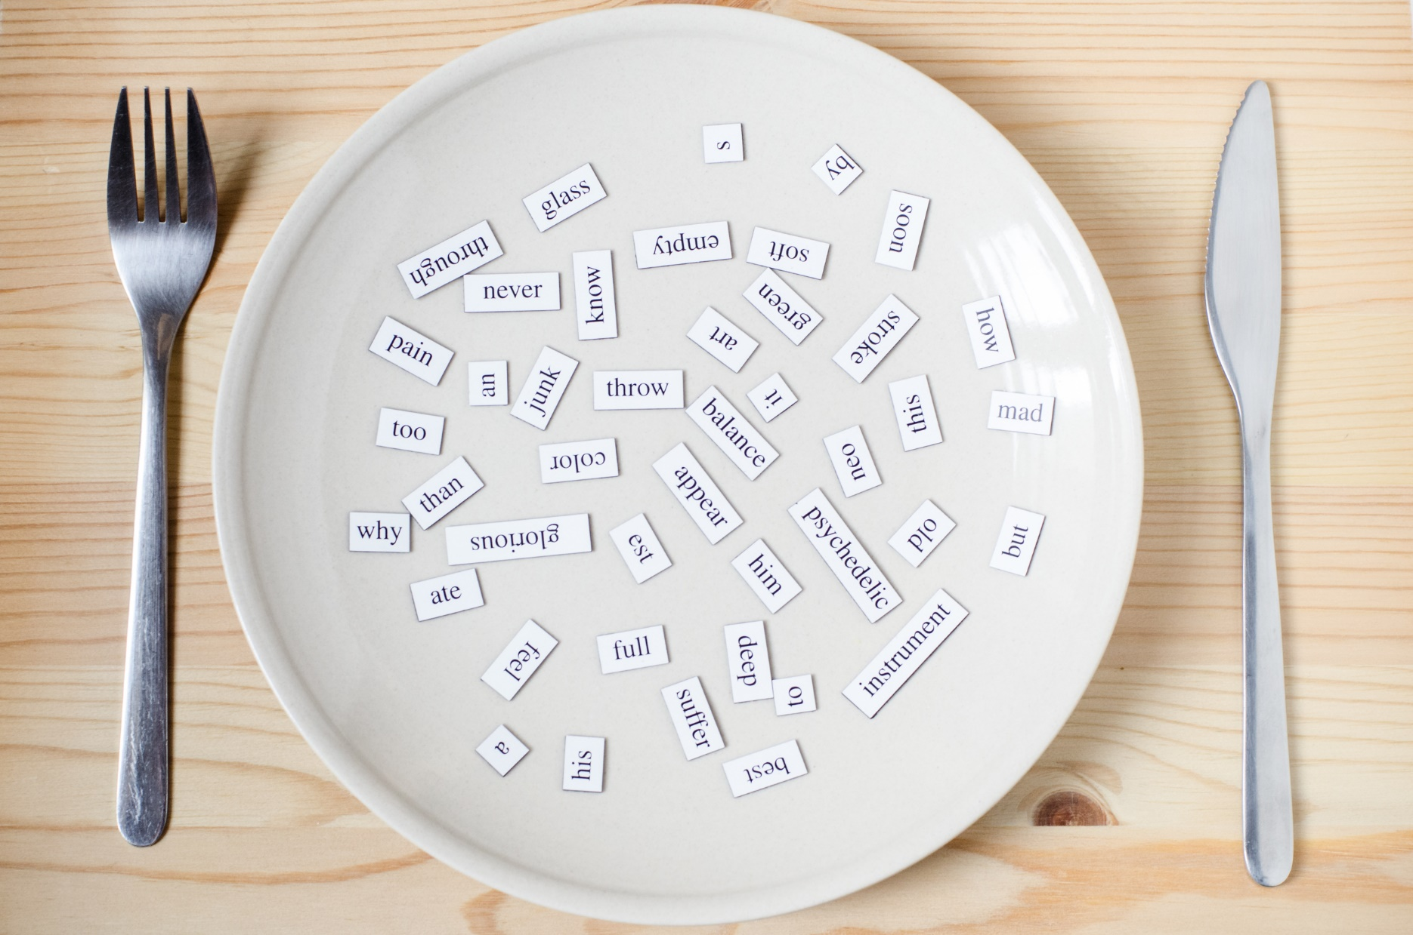
New words
helpful
selfish
kind
funny
friendly
lazy

Slide 8

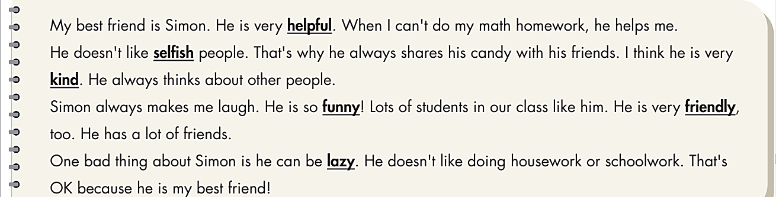
a. Alice wrote an essay about her best friend for homework. Does she like everything about Simon?
→ No, she doesn’t.

Slide 9

b. Match the underlined words with their descriptions. Listen and repeat.
lazy
1. This kind of person doesn't like working. _______________
2. This kind of person likes helping others. _______________
3. This kind of person makes others laugh. _______________
4. This kind of person is nice to others. _______________
5. This kind of person doesn't like sharing _______________
or giving to other people.
6. This kind of person thinks about other people. _______________
helpful
funny
friendly
selfish
kind

Slide 10
New words
Click each English word to hear the sound.
helpful (adj) /ˈhelpfl/ hay giúp đỡ/ có ích
selfish (adj) /ˈselfɪʃ/ ích kỷ
kind (adj) /kaɪnd/ tử tế, tốt bụng
funny (adj) /ˈfʌni/ buồn cười, vui nhộn
friendly (adj) /ˈfrendli/ thân thiện
lazy (adj) /ˈleɪzi/ lười biếng

Slide 11
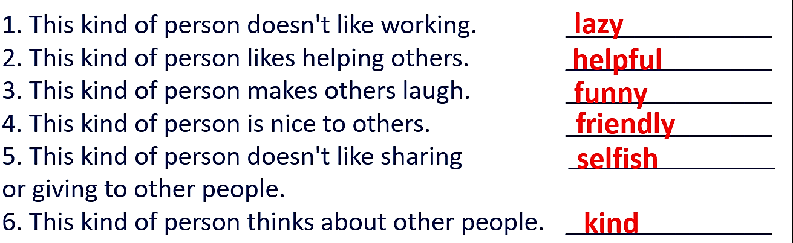
Do the words have a good (G) or bad (B) meaning? Write the correct letter on the line.
______--__________________________________________________________________________________________________
B
lazy B
G
helpful G
G
funny G
G
friendly G
B
selfish B
G
kind G

Slide 12
Extra Practice
WB page 18
a. Complete the words with the vowels (a, e, i, o, u) and y.
1. s e l f i s h
2. h _ l p f _ l
3. k _ n d
4. l _ z _
5. f _ n n _
6. f r _ _ n d l _
e
u
i
a
y
u
y
i
e
y

Slide 13

Fill in the blanks with the adjectives in Task a.
Extra Practice
WB page 18
selfish
1. ______________ people only think about themselves.
2. ______________ people make their friends laugh.
3. ______________ people love talking to their friends.
4. ______________ people are very nice to people and animals.
5. ______________ people help other people by doing something or giving advice.
6. ______________ people don't want to work.
funny
friendly
kind
helpful
lazy

Slide 14

Listening

Slide 15
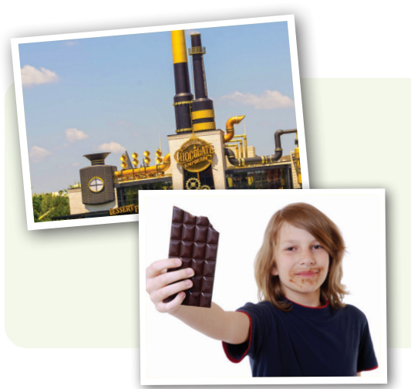
Pre-Listening
a. Listen to Harry talking about a book.
Does he like the book? Yes/No

Slide 16
While-Listening
Listen to Harry talking about a book.
Does he like the book?
Yes
No

Slide 17
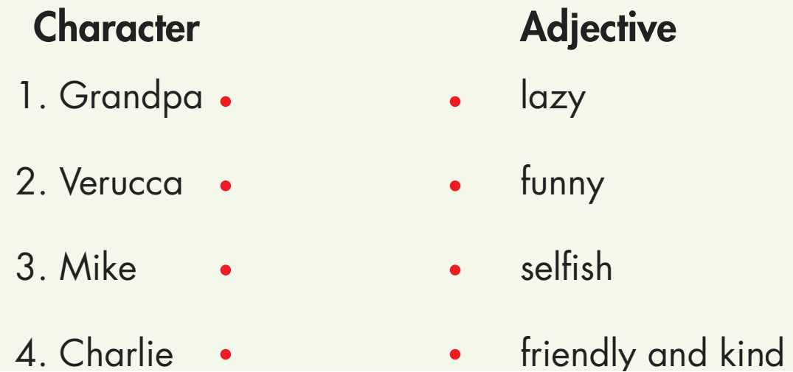
While-Listening
b. Now, listen and draw lines.

Slide 18
Audio scripts
M: Charlie and the Chocolate Factory is a children’s story about a boy called Charlie. He wins a ticket to visit Willie Wonka's chocolate factory. Charlie goes with his grandpa who always makes me laugh. He’s very funny. They meet some horrible children at the factory. Verucca is a very selfish girl. She only thinks of herself. Mike is lazy and only likes to watch TV. Only Charlie is friendly and kind, so in the end Willie Wonka gives him the factory. It's a great story!
1
2
3
4

Slide 19

Extra Practice
WB page 18
Listen and answer the questions
1. What’s Alice like at the start of the book?
________________________________________________________
2. What does she like doing?
________________________________________________________
3. What do Alice's parents want her to do?
________________________________________________________
4. What’s Daniel like?
________________________________________________________
5. What’s Alice like after Daniel helps her?
________________________________________________________
She's funny.
She likes reading books.
They want her to study at home.
He's kind.
She's happy and friendly.

Slide 20
Audio scripts
G: I read a book called Alice, I think. It's about a girl named Alice, her parents, and her friends. She is funny. She loves reading books and often dresses like the characters from her books. Alice's parents want her to study at home. When Alice grows up, she decides to get a new hair cut to make her life better. Later, she meets a kind boy named Daniel. We see how he helps Alice. At the end of the book, she is happy and friendly.
1
2
3
4
5

Slide 21

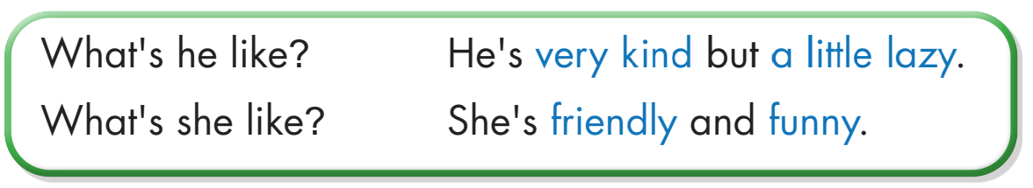
Post-Listening
Listen then practice

Slide 22
Post-Listening
Work in pairs, using the Useful Language to ask and answer about the characteristics of the members in your family.
Suggestions:
1. How many members are there in your family?
2. How old is your father?
3. What is he like?
4. How old is your mother?
5. What is she like?
………….

Slide 23

CONSOLIDATION

Slide 24
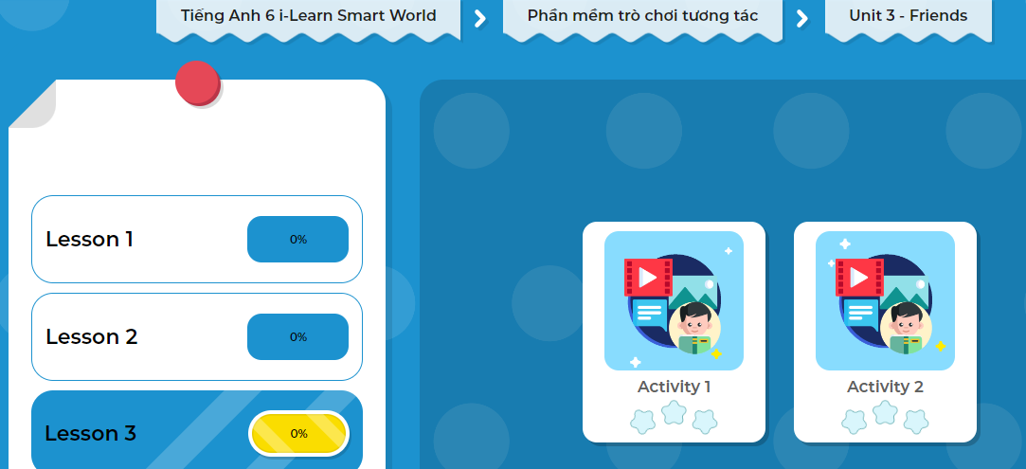
LET’S PLAY!
Click here to play the game!
Notes:
Mở Ứng dụng DHA trên Eduhome. Sách lớp 6, Unit 3 Lesson 3, Activity 1

Slide 25

WRAP-UP

Slide 26
Today’s lesson
Vocabularies
helpful
selfish
kind
funny
friendly
lazy
Useful language
ask and answer about personal characteristics.

Slide 27
Homework
Learn by hearts vocabulary and make sentences using them.
Do the exercise(s) in Tiếng Anh 6 i-Learn Smart World Workbook (page 18).
Do the vocabulary exercise in Tiếng Anh 6 i-Learn Smart World Notebook on page 18.
Prepare for the new lesson – Writing (page 29 - SB).
Play the consolidation games in Tiếng Anh 6 i-Learn Smart World DHA App on www.eduhome.com.vn.

Slide 28

Have a nice day!

