Slide 1

Unit 7: Movies
Lesson 3.1: Vocabulary & Listening
Page 60

Slide 2
Lesson Outline
Warm-up
Vocabulary
Listening
Consolidation
Wrap-up

Slide 3
Objectives
By the end of this lesson, students will be able to…
Vocabulary: Pronounce and use new words related to history: army, king, soldier, queen, battle, general, win, invader.
Listening: Listen to people talking about movies and identify main idea and specific information.
Practice: Talking about a person from history.
Asking and answering questions about a famous person from history.

Slide 4

WARM-UP

Slide 5

Work in pairs
Do you like history?
List down some people from the history that you know and admire?

Slide 6

New words
army
king
soldier
queen
battle
general
win
invader

Slide 7
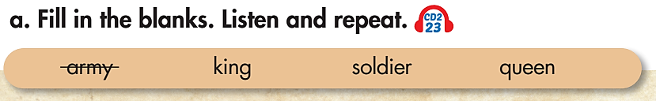
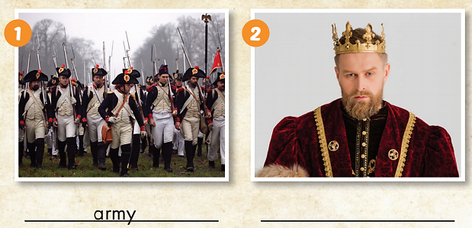
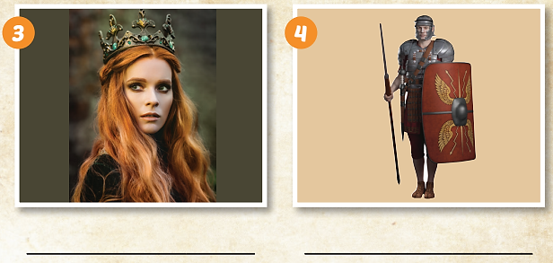

King
Queen
soldier

Slide 8
Listen and repeat. Click each phrase to hear the sound.
army (n) /ˈɑːrmi/ quân đội
king (n) /kɪŋ/ nhà vua
queen (n) /kwiːn/ nữ hoàng, hoàng hậu
soldier (n) /ˈsoʊldʒər/ binh lính

Slide 9
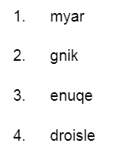
Rearrange the letters to make a correct word. Then answer the questions using the words
army
Do you want to go to the army in the future?
Who is a famous King in your country?
Do you know any famous Queen in the world?
Where does a soldier work?
king
queen
soldier

Slide 10
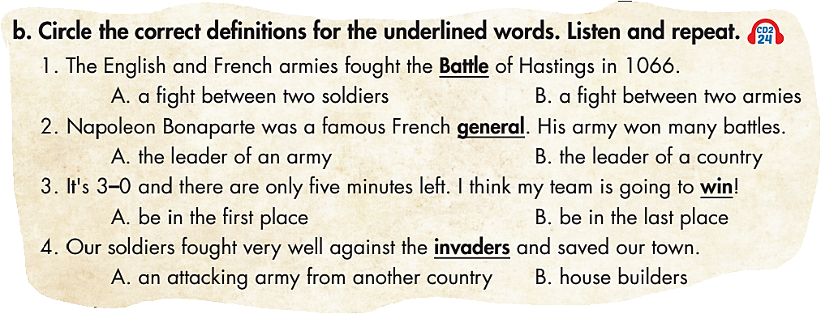

Slide 11
Listen and repeat. Click each phrase to hear the sound.
battle (n) /ˈbætl/ trận chiến
general (n) /ˈdʒenrəl/ vị tướng
win (v) /wɪn/ chiến thắng
invaders (n) /ɪnˈveɪdərz/ kẻ xâm lược

Slide 12
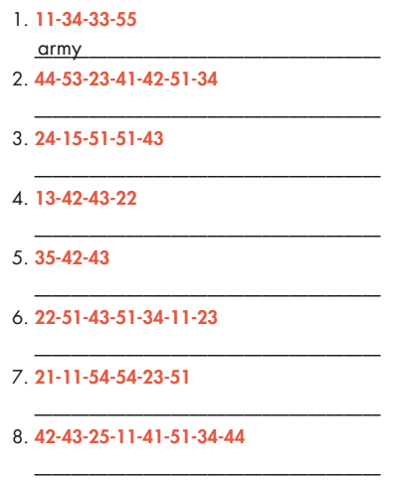
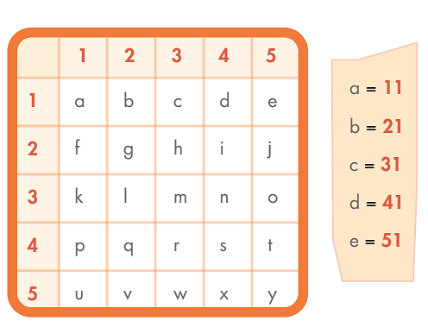
Extra Practice
WB page 42
soldier
queen
king
win
general
battle
invaders

Slide 13
Extra Practice
Choose the word whose main stress is placed
differently from the others.
a. soldier b. awful c. fantastic d. army
a. exciting b. general c. terrible d. battle
a. fantastic b. exciting c. invader d. funny
a. performance b. dessert c. general d. recycle

Slide 14

The Bạch Đằng River is a famous Battle.

Slide 15

Listening

Slide 16
Pre-Listening
1. Do you often watch movies?
2. Do you watch a movie about history?

Slide 17
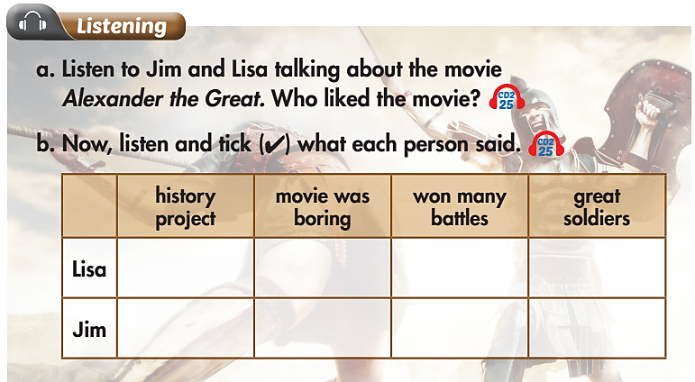
Pre-Listening

Slide 18
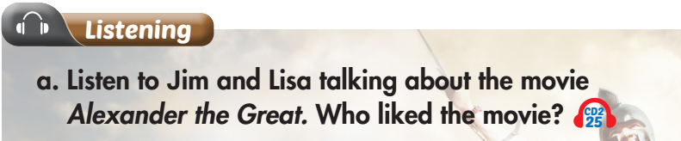
Underline the key words to know what we are going to do?

Slide 19
While-Listening
Listen. What is your answer?
Jim
Lisa
Jim: Yeah, I did. I thought Alexander was cool, but the movie was too long. I thought it was boring.
Lisa: I thought it was great. He was a great king. And I didn't know he won so many battles. I thought it was really interesting.

Slide 20
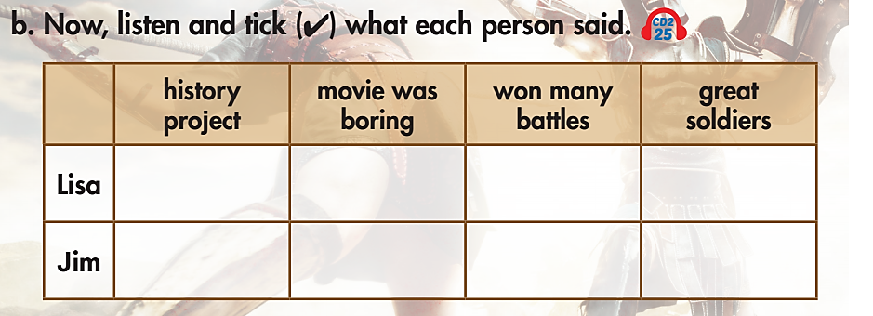
Pre-Listening
b. Underline the key words. What are we going to do?

Slide 21
While-Listening
Now listen and stick.  FIRST TIME

Slide 22
While-Listening
Let’s check.  SECOND TIME
Jim: I'm good, thanks, Lisa. How about you?
Lisa: I'm great. Hey, did you watch the movie for our history project?

Slide 23
While-Listening
Let’s check.  SECOND TIME
Jim: Yeah, I did. I thought Alexander was cool but the
movie was too long. I thought it was boring.

Slide 24
While-Listening
Let’s check.  SECOND TIME
Lisa: I thought it was great. He was a great king. And, I didn't know he won so many battles. I thought it was really interesting.

Slide 25
While-Listening
Let’s check.  SECOND TIME
Lisa: And his soldiers were great. They were so good at fighting.

Slide 26
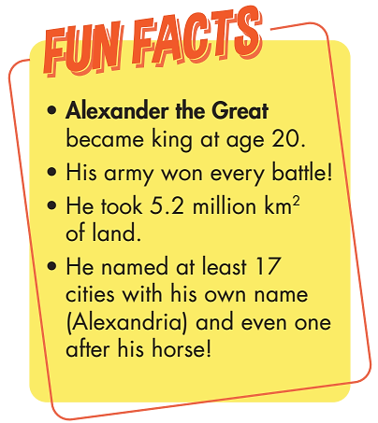
Post-Listening

Slide 27
Practice the conversation with your friend.
Lisa: Hi, Jim, how are you?
Jim: I'm good, thanks, Lisa. How about you?
Lisa: I'm great. Hey, did you watch the movie for our history project?
Jim: Yeah, I did. I thought Alexander was cool but the movie was too long. I thought it was boring.
Lisa: I thought it was great. He was a great king. And, I didn't know he won so many battles. I thought it was really interesting.
Jim: Yeah, Alexander was really clever. He always knew how to win.
Lisa: And his soldiers were great. They were so good at fighting.
Jim: Yeah, they were a big help!

Slide 28
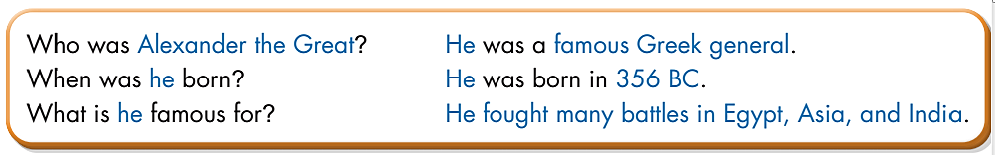
Post-Listening
☞ Practice with your friends

Slide 29
Post-Listening
Work in pairs. Each student writes down a name of a famous person in the history. Each student says the name and answers your friend’s questions. Another student asks questions to know more about that person.
A: I’m thinking about King/Queen……..
B: Who was……King/Queen?
A: He/ She was a famous……..
B: When was……born?
A: He/ She………..
B: What is he/she famous for?

Slide 30

CONSOLIDATION

Slide 31
Prepare a talk about a famous person from a movie you watched.
I will talk about…….
He/ She was a/an………..
He/ She was born in……
He/ She was famous for…..

Slide 32
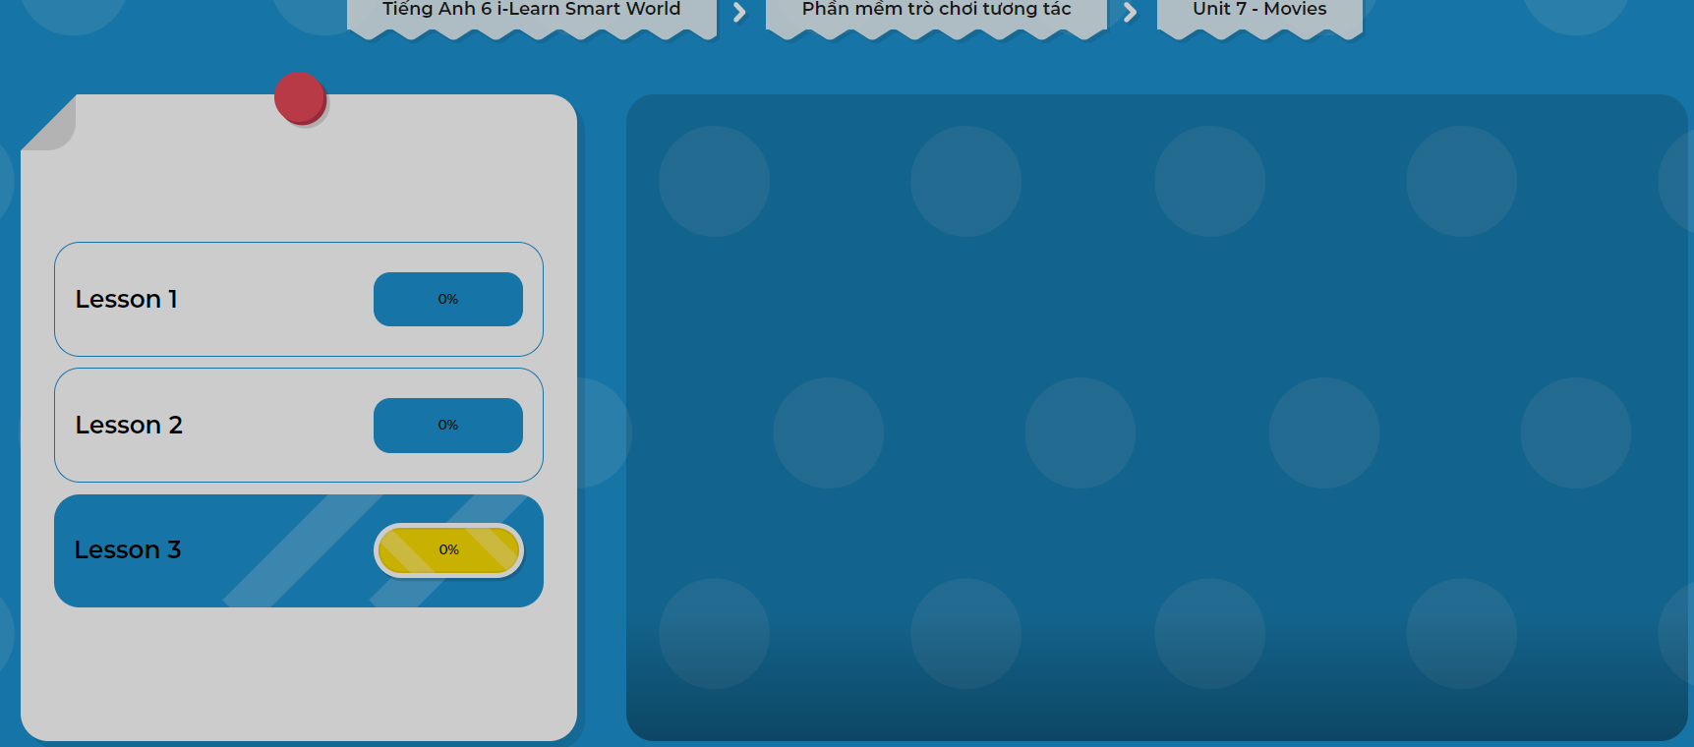
Click on the picture below to play the games!

Slide 33

WRAP-UP

Slide 34
Today’s lesson
Listening:
Listen to people talking about movies and identify main idea and specific information.
Vocabularies
army
king
soldier
queen
battle
general
win
invader
Practice:
- Talking about a person from history.
- Asking and answering questions about a famous person from history.

Slide 35
Homework
Learn by heart vocabularies and make sentences using them.
Do the exercises on page 42 WB.
Do the exercises in Tiếng Anh 6 i-Learn Smart World Notebook on page 44.
Prepare the next lesson (page 61 - SB)
Play the consolidation games in Tiếng Anh 6 i-Learn Smart World DHA App on www.eduhome.com.vn.

Slide 36

Enjoy your day!

